Slide 1
Lauren Tukuafu

Slide 2
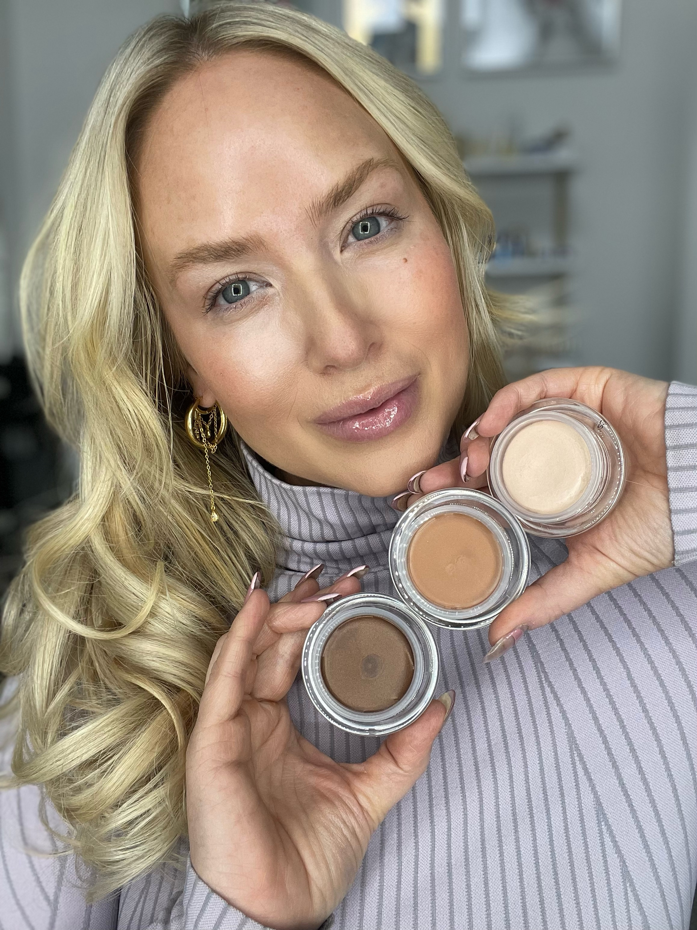
Value
Stacking
How To Strategize You Offer

Slide 3
What is it ultimately that influences the decision for
someone to say
YES and to purchase from you?
PRICE?

Slide 4
I’ts value
That determines where we put our…
TIME
MONEY
ENERGY AND
RESOURCES

Slide 5
Price is what you pay
$$$$
Value is what you think
you’rE going to get.

Slide 6
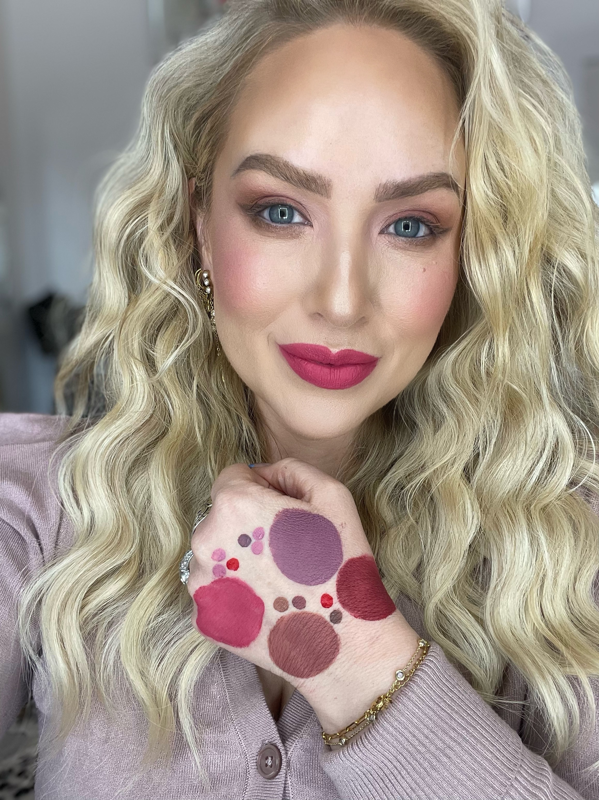
Questions for you:
Are you willing to upgrade your skill set?
Are you willing to play by different rules?
Are you willing to get uncomfortable?

Slide 7
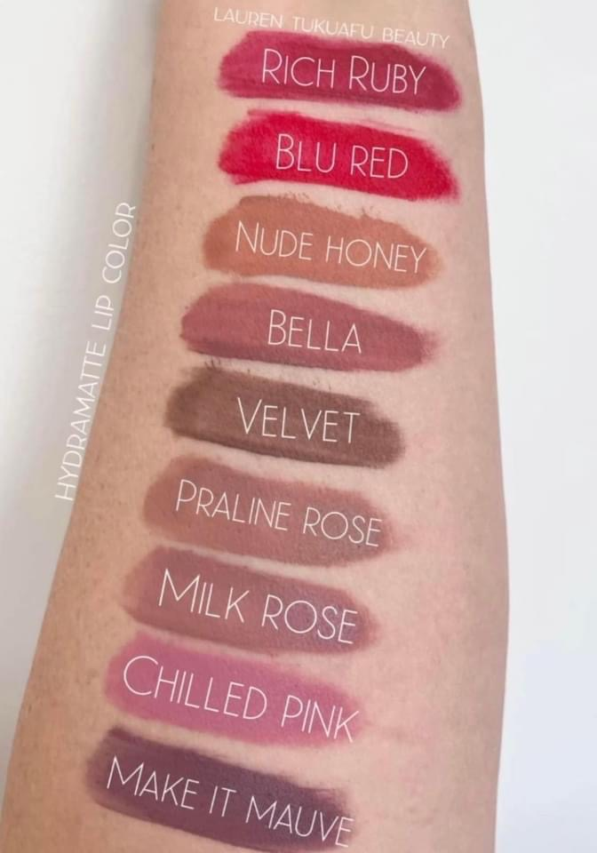
The 2 types
of value
1- Perceived Value - what people think
they’ll get if they buy (before they buy)
2 - Actual Value - what is the real
life experience after they do buy from you

Slide 8
What is your process….
When someone buys from you?
Or joins your team?
That is 75% of the value you offer!
The other 25% Is the product.

Slide 9
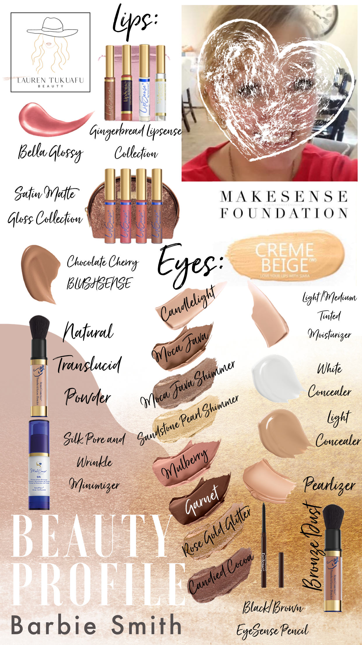
People will buy from
you because
you can anticipate
their
PROBLEMS, and
NEEDS that
help them reach
their GOALS!

Slide 10
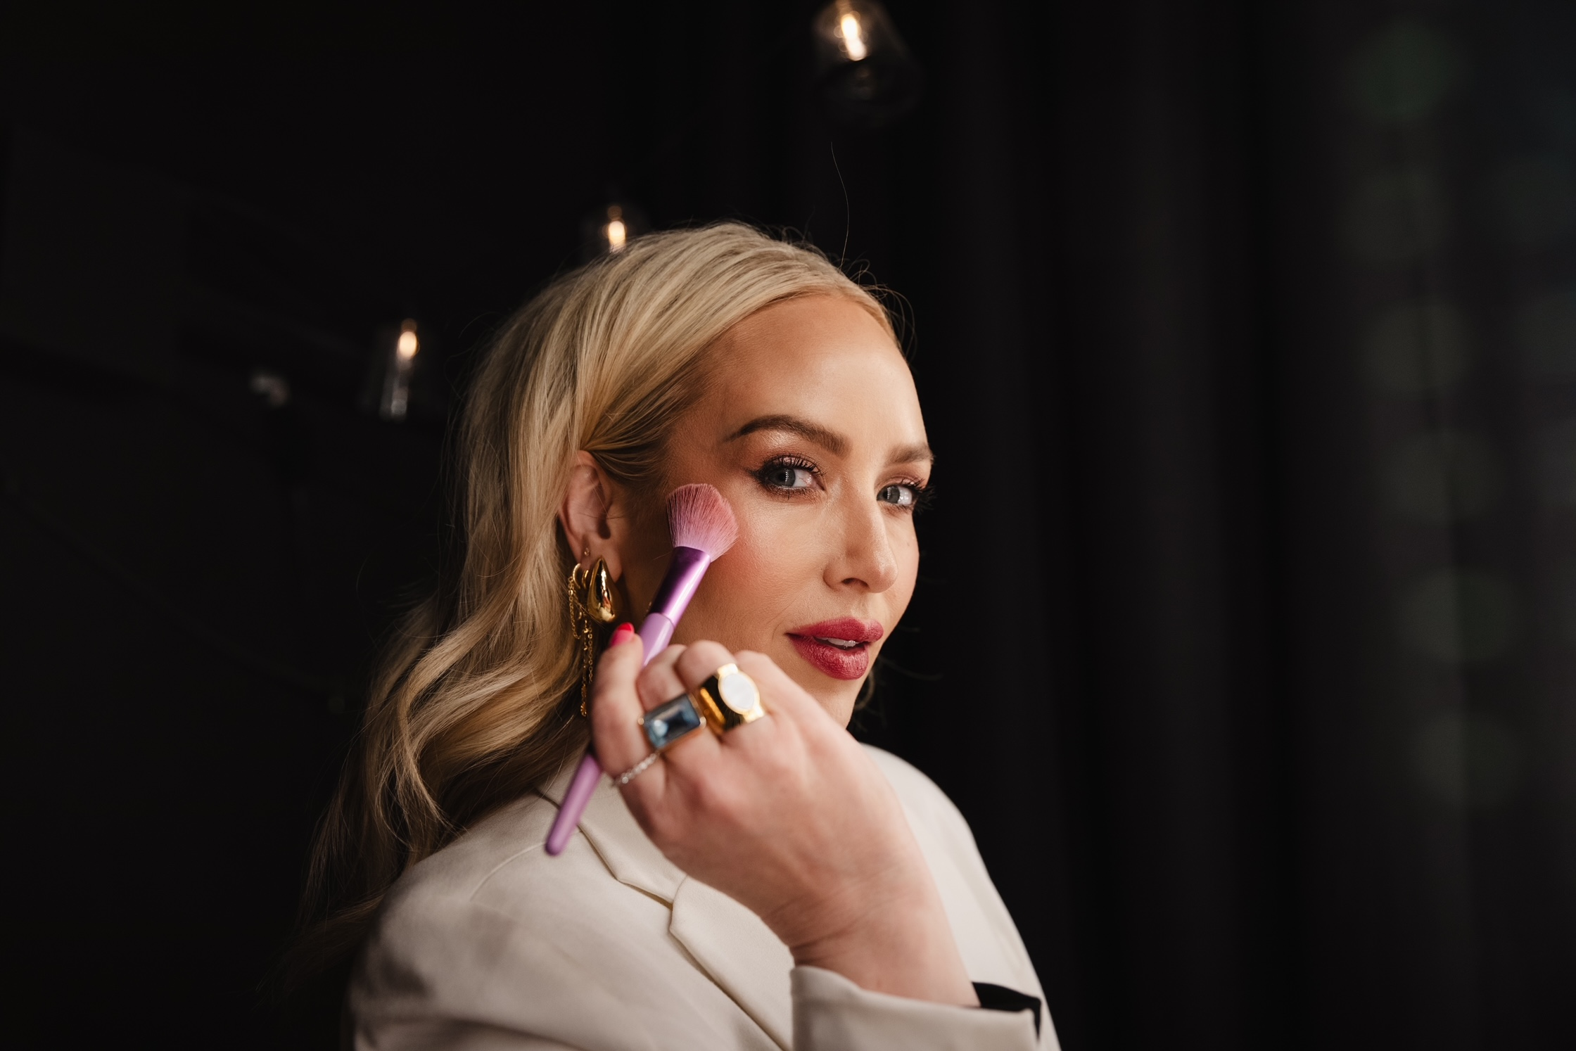
What do people get when they buy from YOU?
Highlight that in your offer!
IT’S BOTH THE PRODUCT AND YOUR PROCESS!
Value Stack!
Color match
Custom profile
Additional education
15 minute call

Slide 11
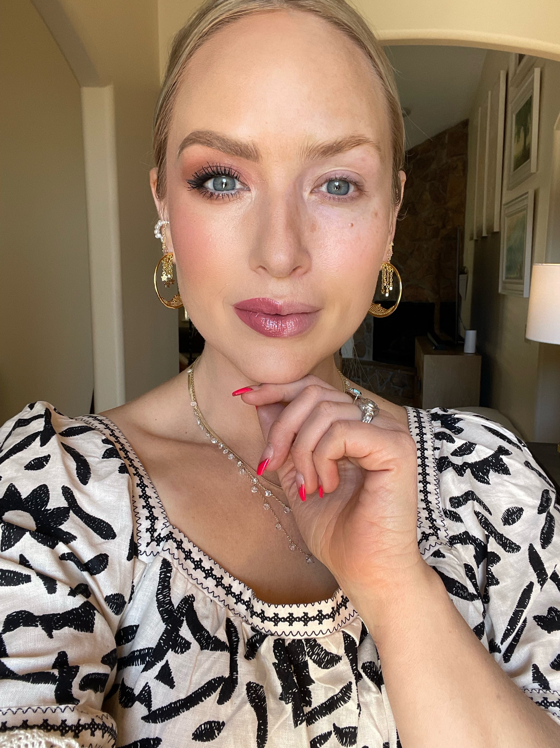
Think of your customer….
What goals do they need help with?
Makeup technique?
Color Selection?
Skincare Solutions?
A Community?
What brushes to use when?
Organization?
Self Care?

Slide 12
Remember YOU have what people want….
And it's not jus the product.
Your knowledge and expertise is
THE VALUE!

