Slide 2
Can you think of a sentence that you repeat regularly in your business…?
A phrase you say, again and again…?
A tip you always find yourself giving to customers…?

Slide 3
Share scripts
Welcome to team + onboarding
Product info
FAQs
Resources and links
Images
Links
Specific repeated phrases
Images – eg lip graphics
AND MORE!

Slide 4
TASK 1:
Get your phones out
Download boards app – looks like this ->
Create yourself an account

Slide 5
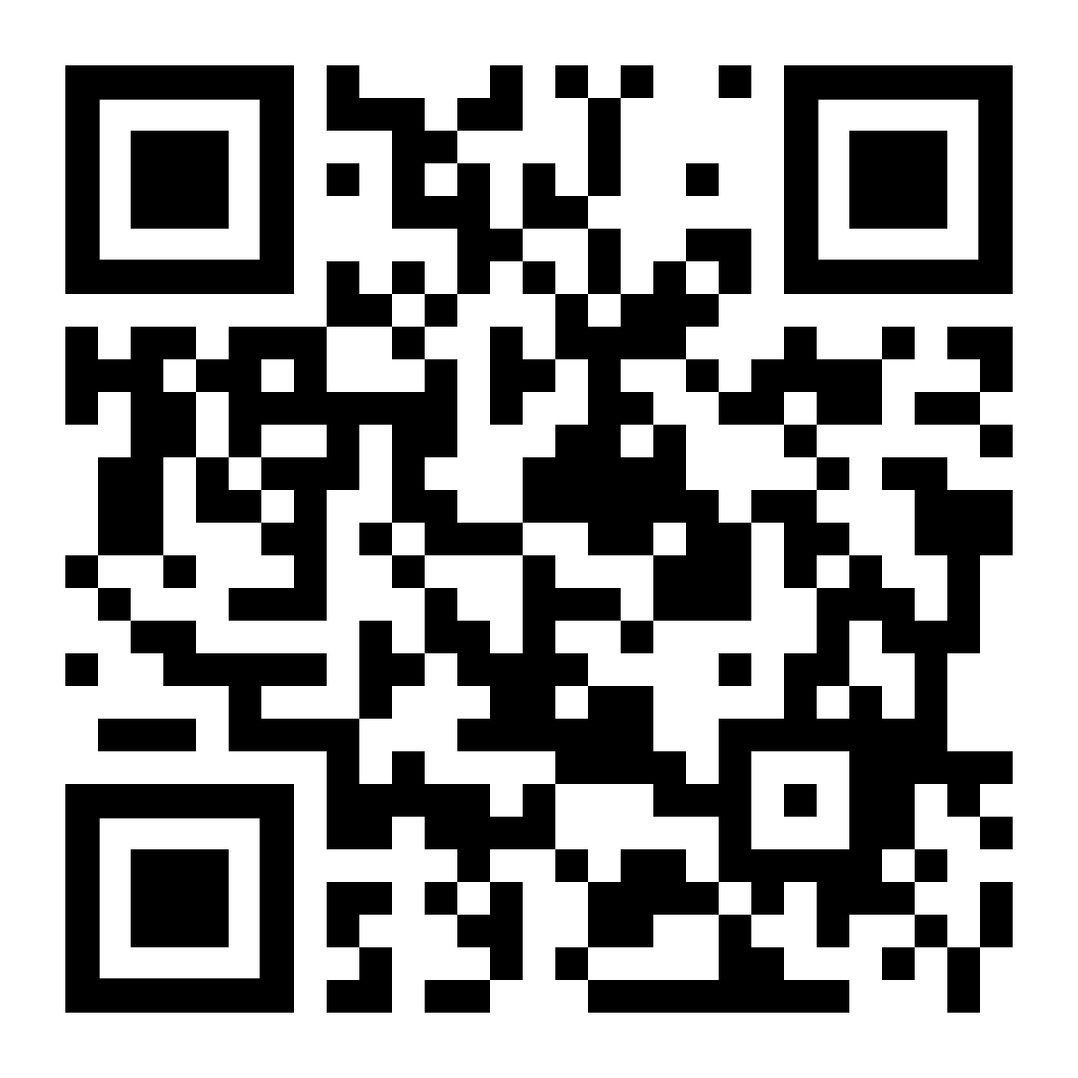
FREE EDITION = 3 boards only
(unlimited content can be held in them!!)
TASK 2: Join Sheersense board – scan QR code ->
(https://boards.com/b/KZIq2l.3PDLZsj9 )

Slide 6
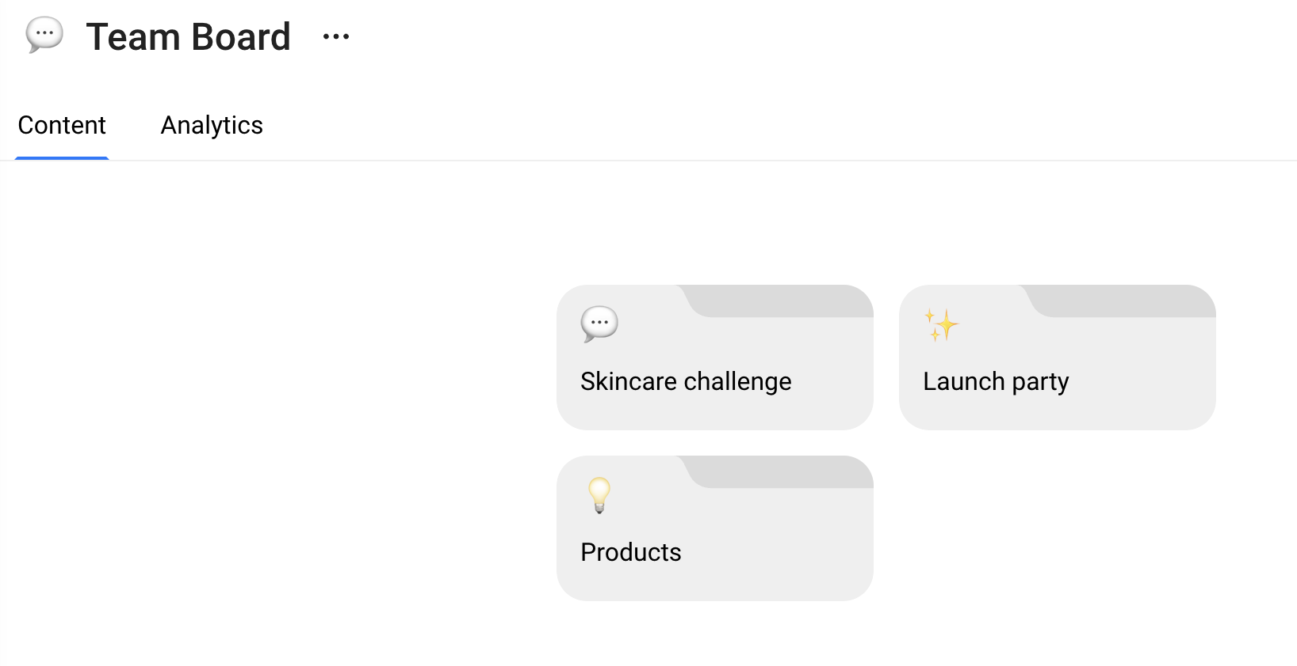
Sheersense Team Board
HO will be adding more to this for us!

Slide 7
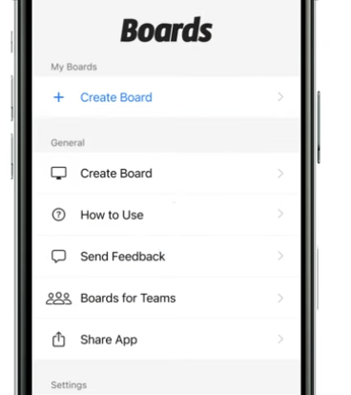
TASK 3: Make YOUR boards
- Create your own board
- If you’re a leader, create yourself a team board too

Slide 8
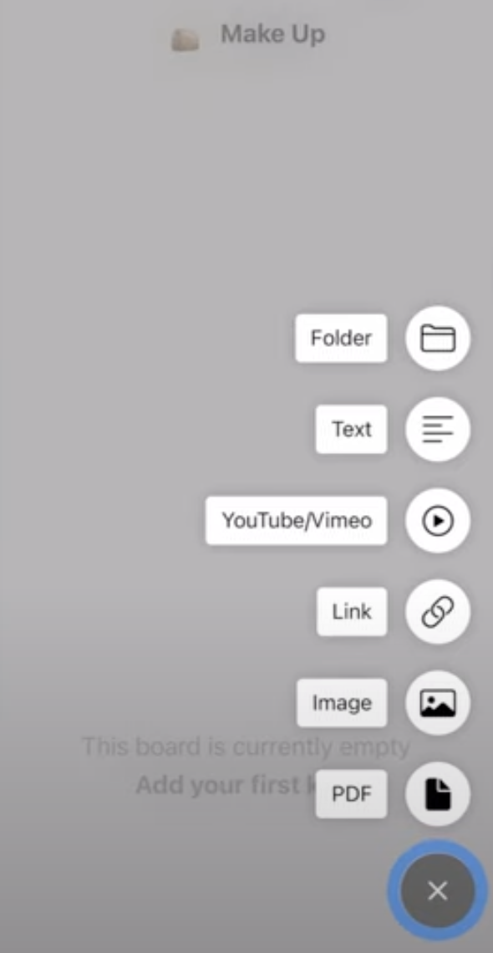
How to add stuff to YOUR boards
TASK 4: Create a folder and add:
(text) your commonly repeated sentence
(image) add a photo
(link) a link to your FB group

Slide 9
Folders (can have folders within folders)
Scripts
Promotions
Before/afters
Testimonials
Post ideas
Text
Images
TIP: Press and hold to reorder

Slide 10
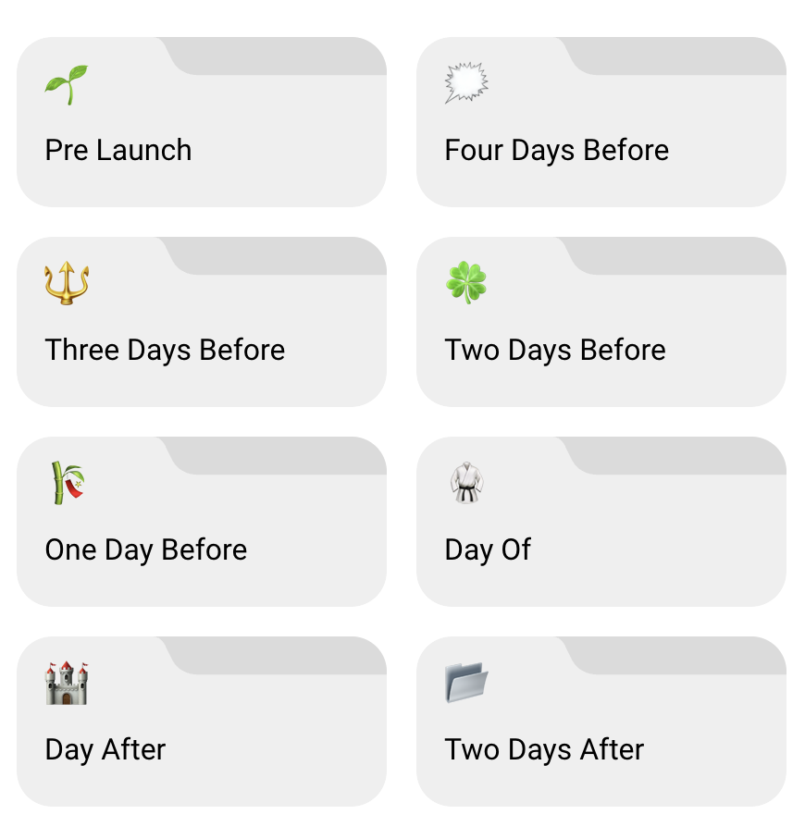
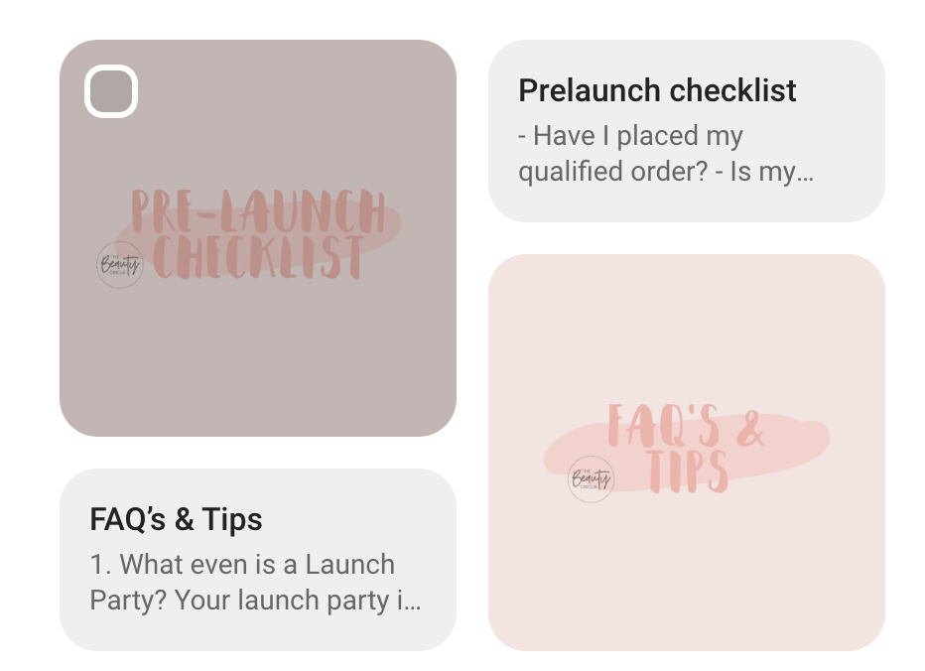
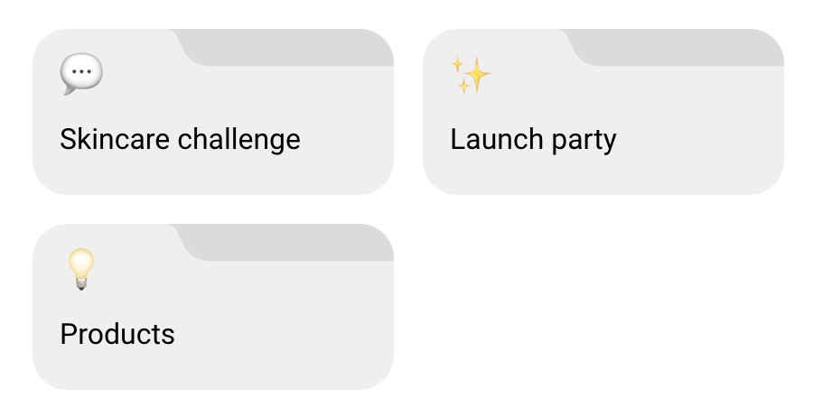
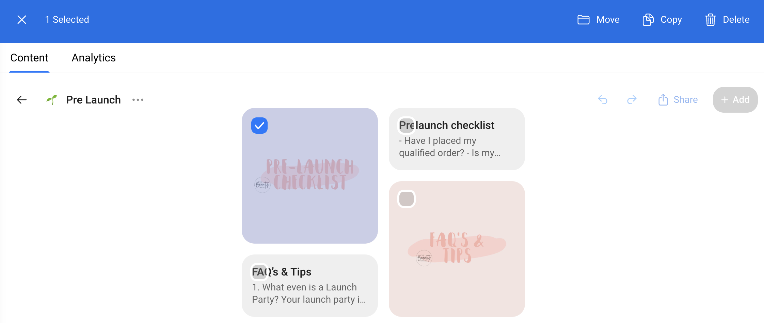
Copy from other folders
Find your board
and copy into there!

Slide 11
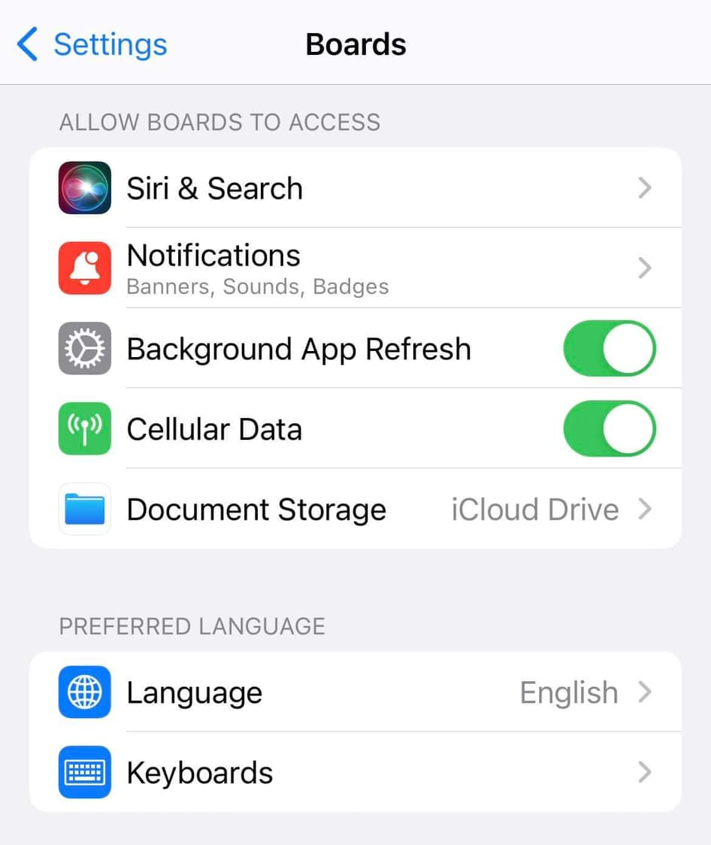
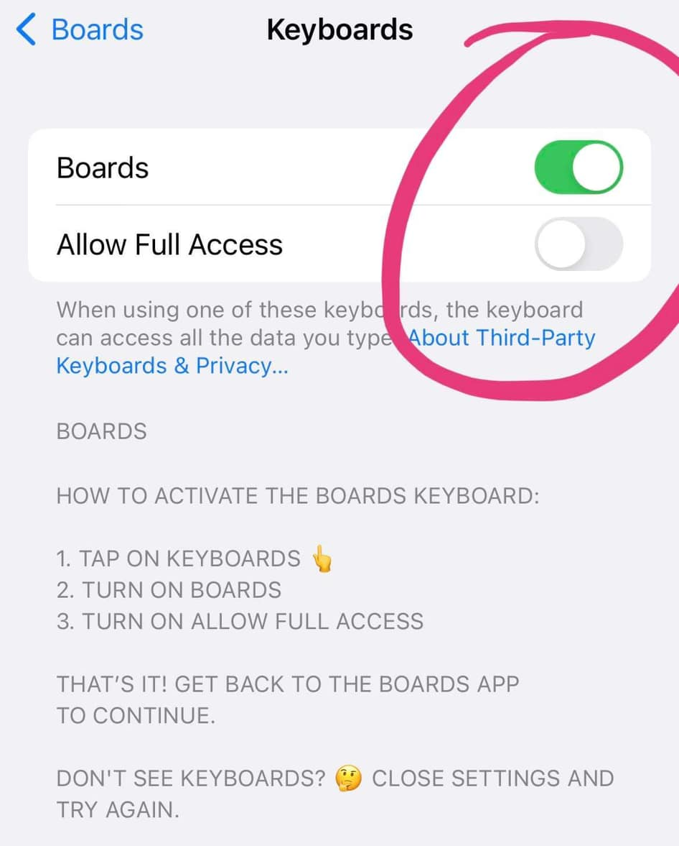
KEYBOARD EXTENSION
Go to
Settings - apps - boards app
Make sure you have the
keyboard allowed with ‘full access’
THEN… the MAGIC happens!!

Slide 12
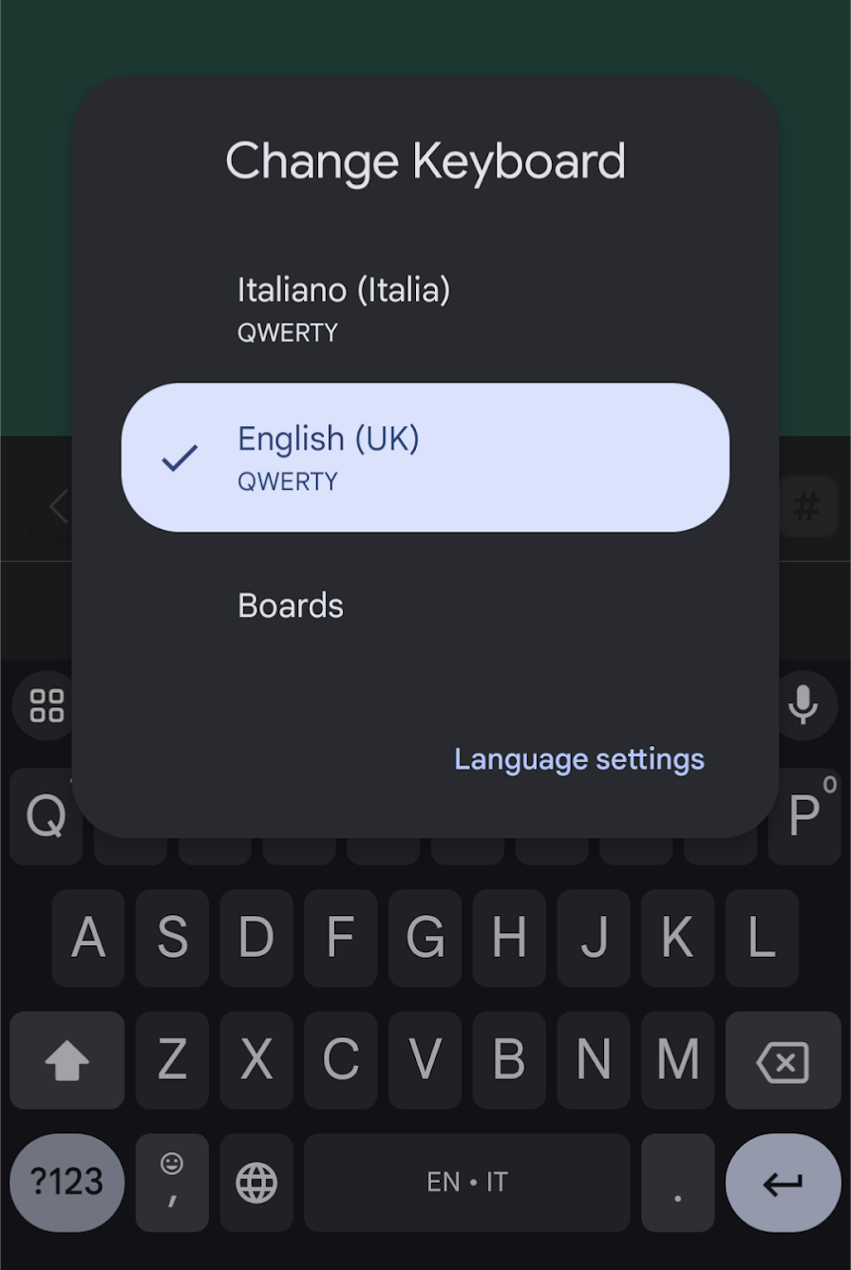
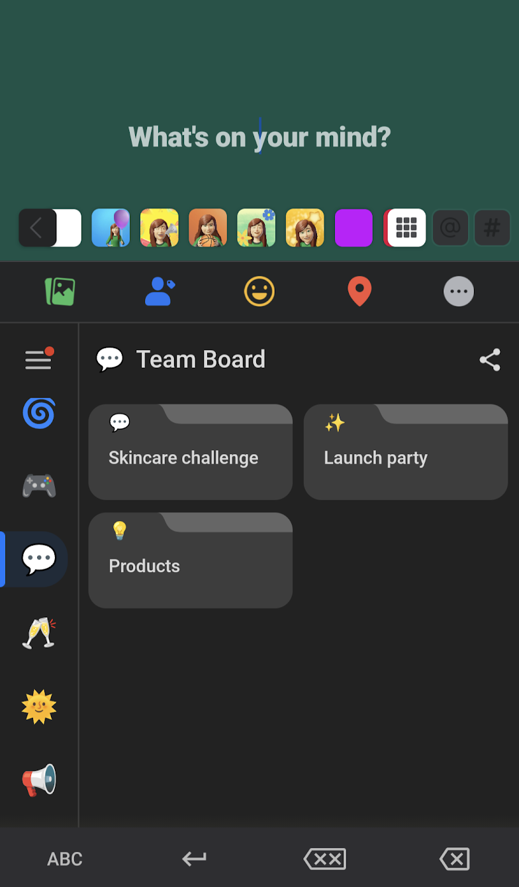
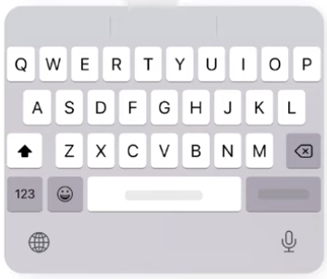
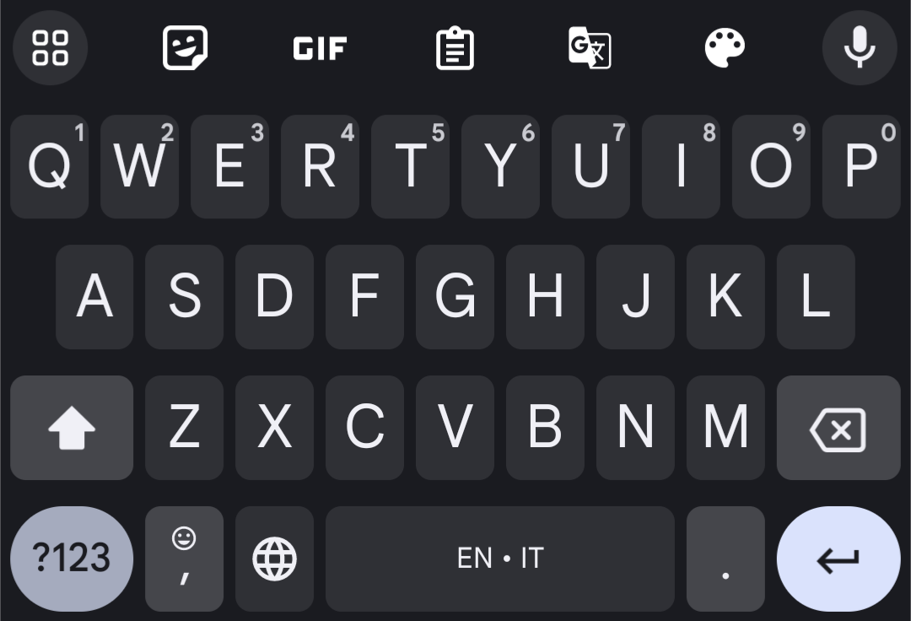
Look for the GLOBE (different for different phones!)
Apple
Android
WARNING – android users… images are a little trickier in FB… (I like to use my laptop so I can copy and paste)
CAN save every picture by messaging it to yourself then save it there
OR open the in your google chrome and use as a webpage…
(ask me if you need more help with this!)

Slide 13
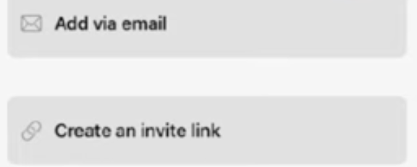
Sharing a board
If you are a leader, share your board with your team now!

Slide 14
TASK 5: Move to sit next to people in your team.
What would you all like to see in your team board?
(if you are a leader, you should have created a team board and shared it with the team)
Get brainstorming together, what would help you
make notes in boards so you can come back and fill later!!!
Welcome – getting started checklist & essential need to knows
How to launch
Building your audience ideas
DMOs
Recruiting
Following up
Scripts – title it OBVIOUSLY!!
Product education (how to use products, product knowledge,etc)
How-to’s (videos work directly from the app so you could add screen records!)
Content campaigns
SOME
IDEAS

Slide 15
FAQs:
Q:Is it worth paying for the paid version?
A: If you’re like me and your toxic trait is collecting things then you may want to consider paying for the upgrade…
But it is ABSOLUTELY not needed for the average distributor
Q: If I add something how quick will others see it?
A: Anything you update, will automatically (and instantly!)
update for everyone who has the board shared
Q: Do I have to add the keyboard?
A: I honestly would, it makes using scripts SO quick!!
Q: Will it only let me add one photo at a time?!
A: If you use it on a computer, you’ll be able to add many photos at once so it’s worth using a computer for creating bigger boards!

Slide 16
ANY QUESTIONS?!

