Slide 2
CREATING COMMUNITY ON FACEBOOK
Your Facebook Group is more than just a place to sell, have you thought about: - Your Core Values - Serving Your Audience - Content Creation
Notes:
Let’s chat Creating Community on Fb. Fb is my platform of choice, it works well for me, my comfort level and is where my target demographic spends a lot of time. When it comes to FB and creating community we are going to cover these 3 areas: Core Values, Serving and Content Creation. When you can look at your FB group as more than a place to sell, this is truly where the magic happens. Tell 300 PV 2019 story.

Slide 3
CORE VALUES
How do you want your customers to feel and what can you do to cultivate that experience?
-My word is “empowered.”
Notes:
- I think this is an aspect often overlooked in FB groups. Yes this is your store and where you are selling but your group has the power to be so much more and when you hone into your core values this where it goes from a group to a community. - I picked the word empowered because it drives the way I show up and how I treat my group - How does empowered weave itself into my daily actions: I empower my customers by building their trust, providing them with the knowledge they need to make a decision, and providing consistent follow up. I want my customers to feel empowered in their buying experience. That means, I want them to come into their transaction knowing and trusting me, knowing the products, knowing the price point and the VALUE, knowing the steps of the transaction, knowing how to use their new products and know that they will be followed up with.

Slide 4
CORE VALUES
A closed Facebook group: - empowered to share without fear - space just for them - you control who enters - fosters community feel
Notes:
- A closed group helps my group members feel comfortable sharing selfies and asking questions. - It is a space just for them because its private and everything stays in that group. People who may not comment otherwise feel comfortable doing so. - From a business standpoint setting up a closed group allows you to keep track of your network .Can ask qualifying questions upon entry - Allows you to work your funnel better as you can build a system for when new people join. You don’t want people popping in unnoticed. Every new member should get a friend request, welcome DM, tag them in welcome post and custom profile. - If your group is public what is there reason for NEEDING to join?

Slide 5
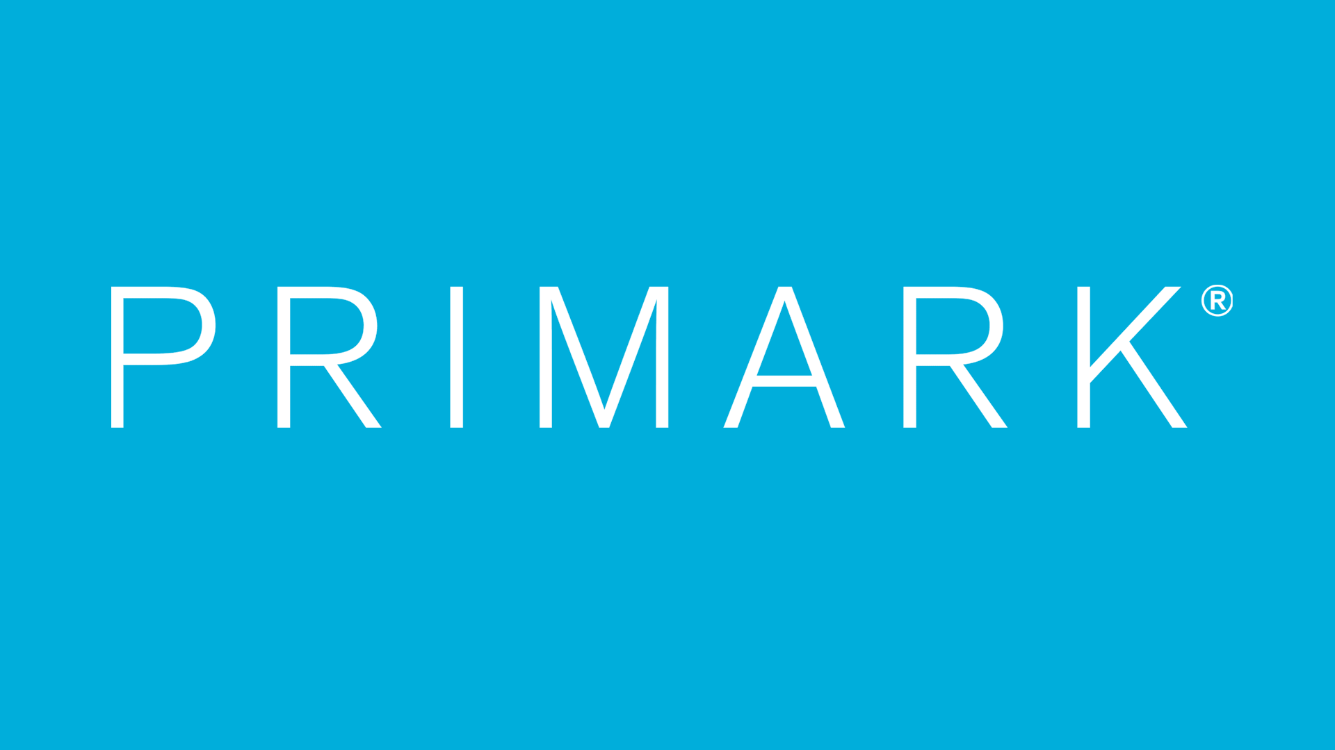
SERVING YOUR AUDIENCE
-Primark vs. Louis Vuitton customer experience -What shopping experience do you create for your customers?
Notes:
Primark vs. Louis Vuitton – Can use Canadian Walmart as experience you pretty much run through the entire transaction yourself. Louis Vuitton – tailored experience, attention to detail and customer follow up. What experience are you creating for your customer? What are you currently doing to create that unique shopping experience? 73% of consumers say that customer experience is a very important factor in their purchasing decision, so much so that even if they love a company or product, 59% will still walk away after a bad experience. HUG YOUR CUSTOMER – JACK MITCHELL

Slide 6
SERVING YOUR AUDIENCE
Building Trust
-We are in the business of NETWORKING, not selling.
-Every interaction is a potential friendship, not a potential transaction.
-How are you showing up as your authentic self for your audience?
Notes:
Trust - Our goal is to grow our network through authentic relationships. Friend your customers. Take an interest in them. Reach out and connect about non-business related things. Share your life – good and bad.. Remember you are in this for the long haul and not a quick fix. View each interaction as a friendship, not a transaction.

Slide 7
SERVING YOUR AUDIENCE
How are you following up with your customer?
-Easiest way to maintain relationships and sell, but underutilized.
-Follow up does not need to be tied to a sale.
- Knowing your customers spending habits leads to trust and loyalty.
Notes:
Follow up – Follow up is probably one of the easiest ways to maintain good relationships with customers AND sell, but it is underutilized. Pick a method you like and stick with it.
What are different reasons to follow up with your customers?
Keep your customers in the loop as you place your order, ship or deliver their product, and make sure to create a timeline to follow up with them based on their order. Example: Mascara, follow up through transaction until delivery, and then schedule out maybe 1 week post and 2.5 months later for refill. Providing a service so there are never gaps in their products running out.
Follow up does not have to be linked to a sale – keep yourself at the forefront of peoples minds. Mothers Day, birthdays, Holidays etc.
Knowing your customers and their spending habits will lead to customer trust – you can serve your customers better when you know their spending habits with you. 9 out of 10 consumers value when a business knows their account history and current activities with that company.
- After building a relationship, customer spend grows alongside trust. Eventually, loyal customers spend 67% more than new ones

Slide 8
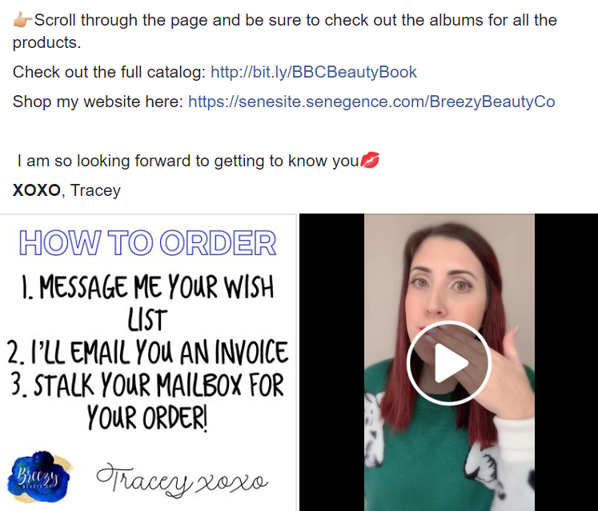
SERVING YOUR AUDIENCE
Welcome Post
-give people somewhere to start Albums + Catalogue
Notes:
Joining a thriving group is like walking into a party that has already started. Be a good host! Tag all new members in a welcome post. Knowledge – Empower them to be able to find answers. Catalogue, pricing visible, instructions on how to order, etc.

Slide 9
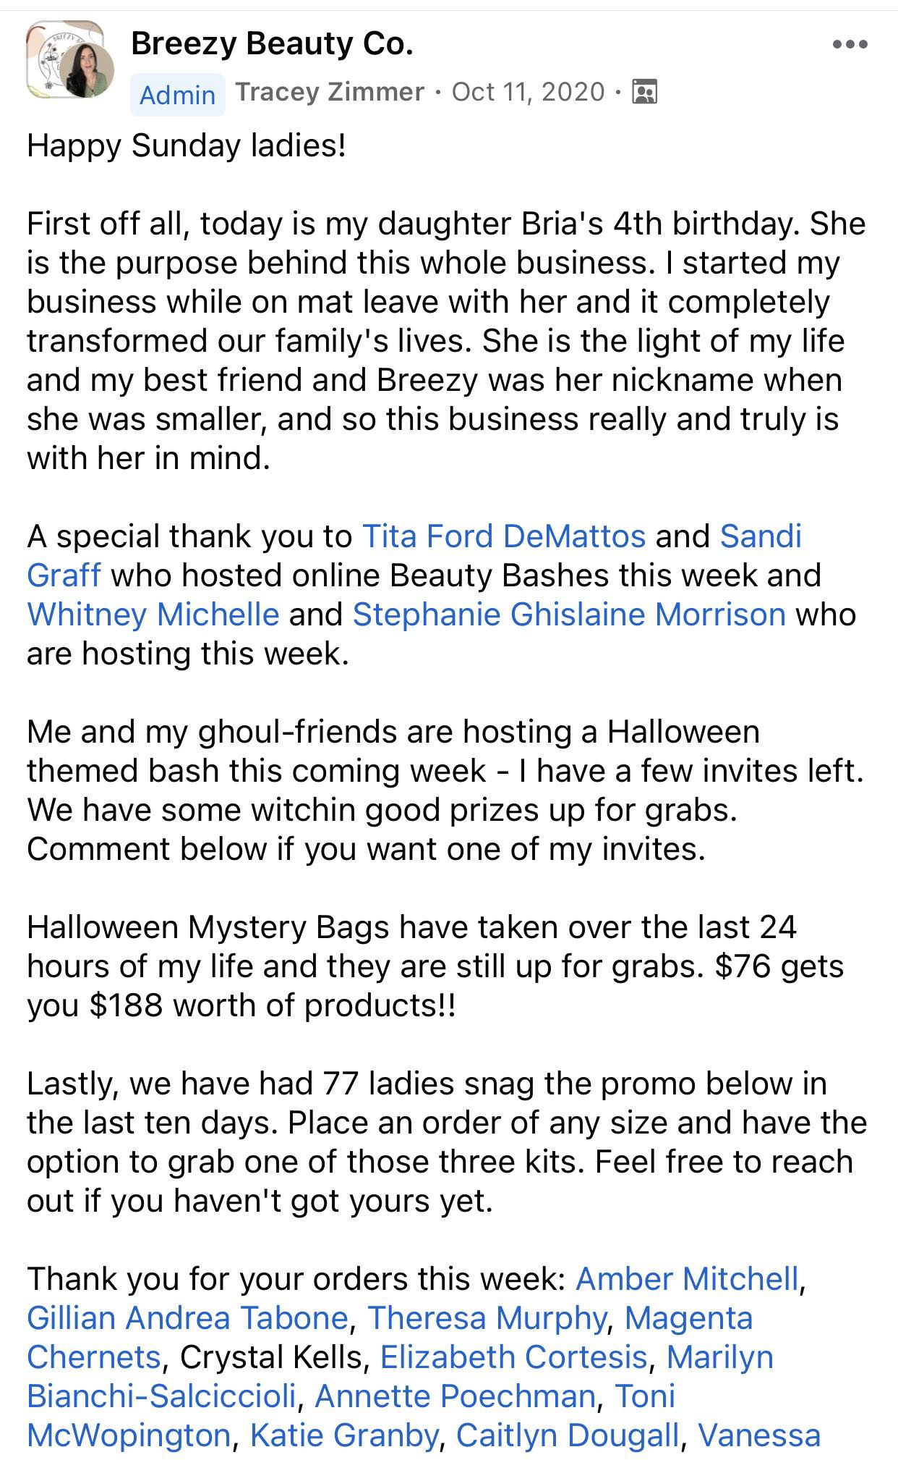
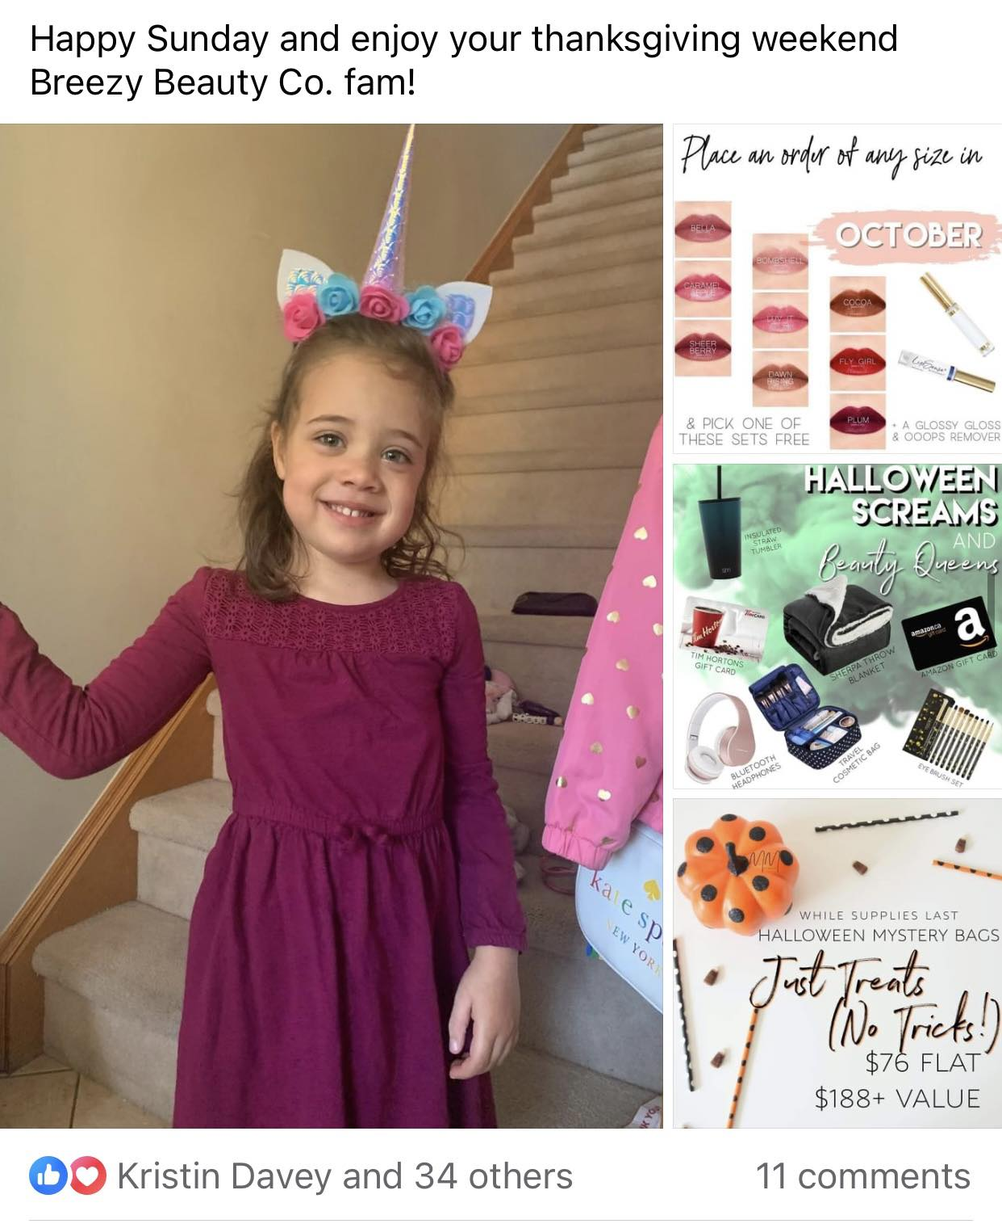
SERVING YOUR AUDIENCE
Utilize Insights and Collect Data
- Shout out monthly top commenters and spenders - Monthly birthday shout out - Weekly “Newsletter”
Notes:
- This is a great to encourage community. Check your insights in your group and do a monthly shout out for your top commenter and top spender - Do a post at the beginning of every month asking who has a birthday that month - Weekly newsletter update post

Slide 10
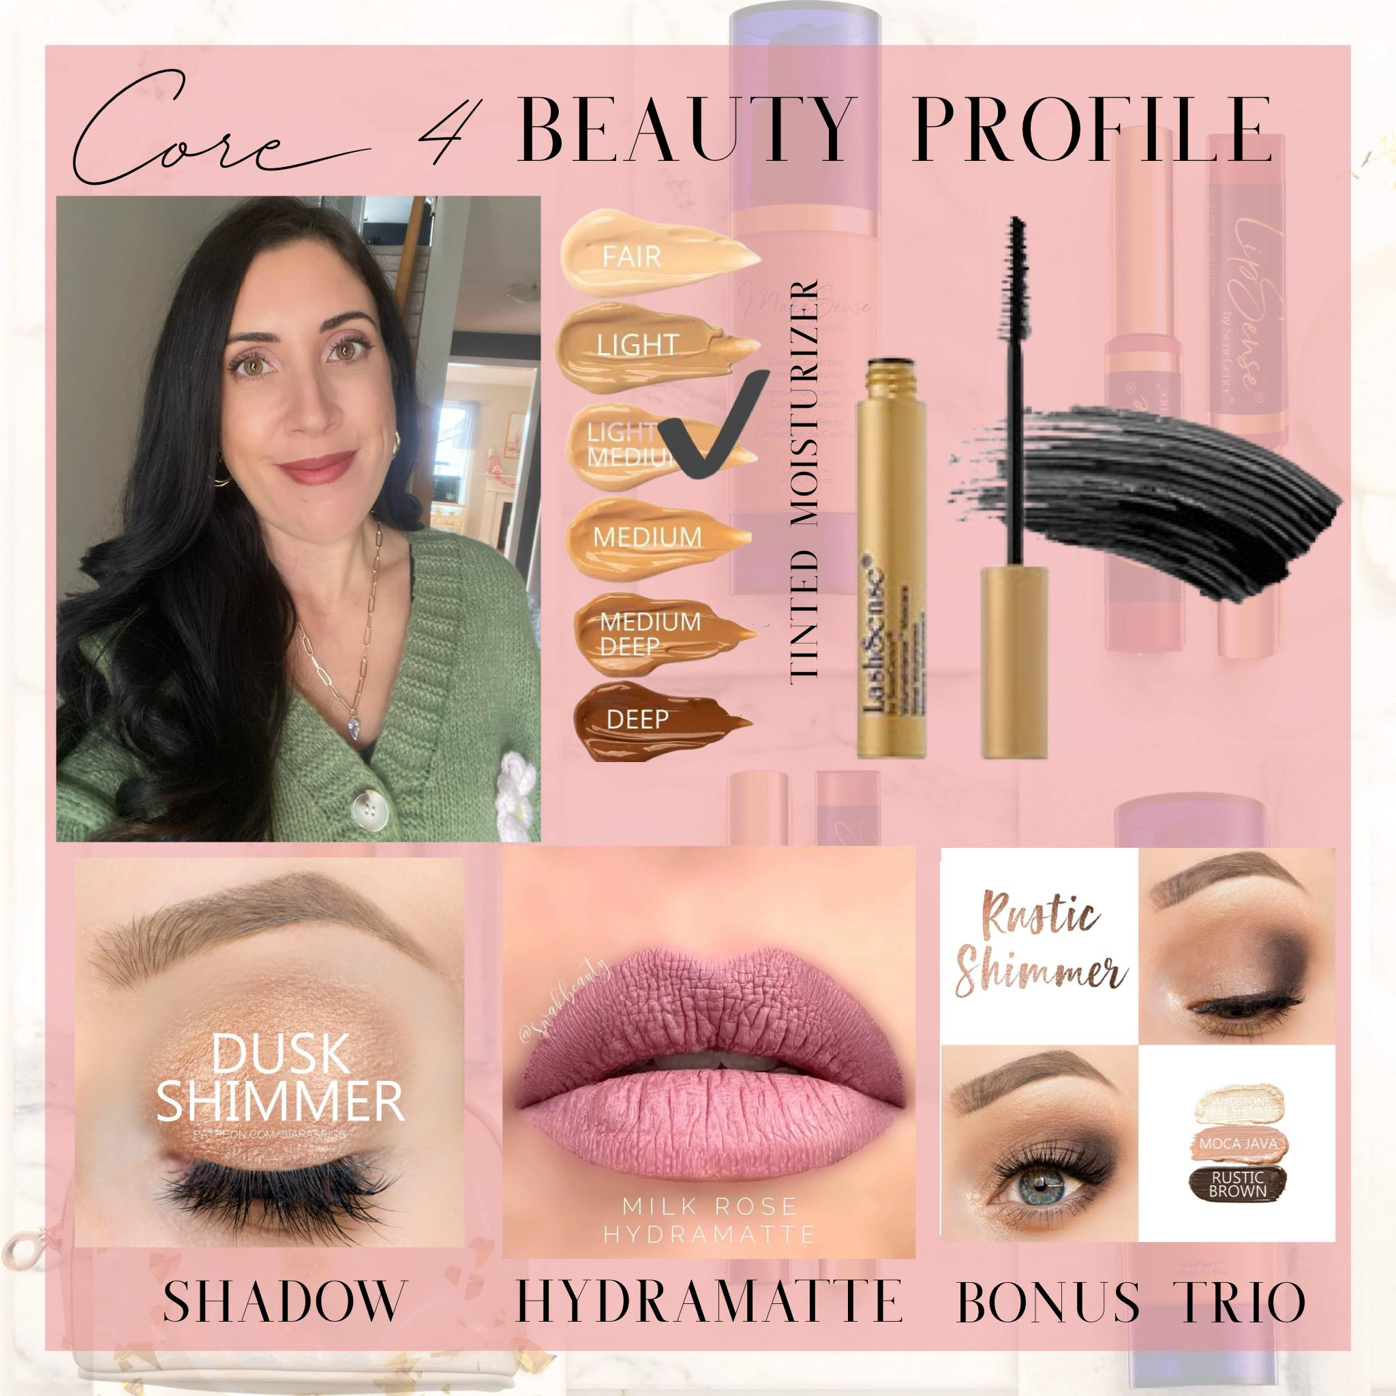
SERVING YOUR AUDIENCE
Custom Profiles - make custom profiles for all new group members + first time customers

Slide 11
CONTENT CREATION
Create Content Your Customers Want to See
Stop blaming the algorithm
Be aware of how posts are doing (factor in timing, types of content) - Drip Campaigns and verbiage around Audience Avatar
Diminish decision fatigue - Engage your audience (no comment left behind)
Notes:
-The thing with creating a strong community is you want people to keep coming back so you want to be creating content that your audience wants to see. This is where when people blame the algorithm for them not getting engagement or interaction or sales, what I want to ask them is, is your content catered to the audience that you are serving? if it doesn’t interest them why would they look at it? Why would they keep coming back? - Be aware of how your posts are doing - this is where you can utilize insights. Also utilize your audience avatar so think about when your audience is likely to be online. For me, my ideal audience is a working mom so she is very likely checking her phone when she wakes up she she’s checking her phone on her lunch break and she’s checking her phone when her children are in bed so I have time to my post to go off accordingly. -Also thinking about variety of content, what kind of content does your audience like to see and can you mix it up so can you do things like static post with pictures? Live video, short form video like reels that you can post in your customer group, polls, mixing up the kind of content will also allow you to collect the data to see what kind of post perform the best in your group. - Drip campaigns and verbiage around your audience avatar – explain drip campaign and give example could be candlelight Shadowsense - Diminished decision fatigue - This is where again I kind of tie this into my drip campaigns, but I will do bundles that correlate with my content so if I’m doing a drip campaign on a five minute face, I will pick four products that are gonna be bundled together, and I might even give colour suggestions because a confused mine does nothing when there’s too many options or people don’t know where to start. They will do nothing. - And this is something that I talk to my team about all the time it is kind of like one of our phrases is no comment left behind engage your audience. We are really good at putting the content out there, but we sometimes forget to create that back-and-forth dialogue so when someone comments on your content, even if it’s something like, I love that colour. Write something underneath. Keep the conversation flowing because of what that’s gonna do is one it’s gonna alert them that there’s a notification they’re gonna go back into your group. They might look around a little more but it’s gonna show Facebook that you are using Facebook for what Facebook is for Facebook is for connecting with other people and the more that you can connect with people the more that it will boost your algorithm and your content will be pushed out further to your audience and Facebook sees that people are engaging and posting and there is that community feel that’s when Facebook starts to favor your content and it starts to do better.

Slide 12
CONTENT CREATION
Quick Content Creation Tips:
Treat your content drip campaigns like an essay. - Give people a chance to share their opinions daily - Monthly – have one content piece or event that will fill your funnel with your Audience Avatar
Notes:
- Treat your content drip campaigns like an essay- so an essay has a thesis, which is the statement that you’re going be trying to prove throughout your essay, it has a body and it has a conclusion and I want you to think about your drip campaigns the same way so if it’s a four-day campaign, you always want to start with your pinned post, your pinned post is the post that’s going go up first you can pin it to your feature and that’s going tell your customers what they can expect for however, many days your campaign is what products are going cover what they’re going to learn in any sort of promotions you have I would tile this post with a short pre-recorded video of myself or a selfie of myself or a reel that relates to the campaign and then 2 to 3 pictures that go with it so it could be any sort of promotions that are going on color collages if it’s some sort of makeup campaign or anything like that. - Posting - My rule of thumb is 2 to 3 times a day during my drip campaign and my final post is going to mimic my pinned post so that’s going be my closing out post so that’s where I will recap any promotions if there’s any deals that I have on and you know that that’s ending tonight to have them submit their orders but you’re kind of use that to close out the sales strong. - Give people a chance to share their opinions daily. This is huge one because it will keep people coming back, but too it will boost your algorithm so once a day I have a post that I call my nothing related to Senegence ‘s post. It is a random engagement it could be something like do you like cats or dogs do you like pineapple on your pizza? It’s just something to get people chatting and it’s going to boost that algorithm. - Monthly this could be some thing that if this is daunting, you do it quarterly, but I want you to think about. Can you have one piece of content a drip campaign, a sale, a mega party, that is going to fill your funnel with your audience avatar that are not currently in your group so this will be a piece of content that you could post on your personal page or in your stories that might attract people into your customer group this could be something like a wash face challenge tired tips for moms, etc.

Slide 13
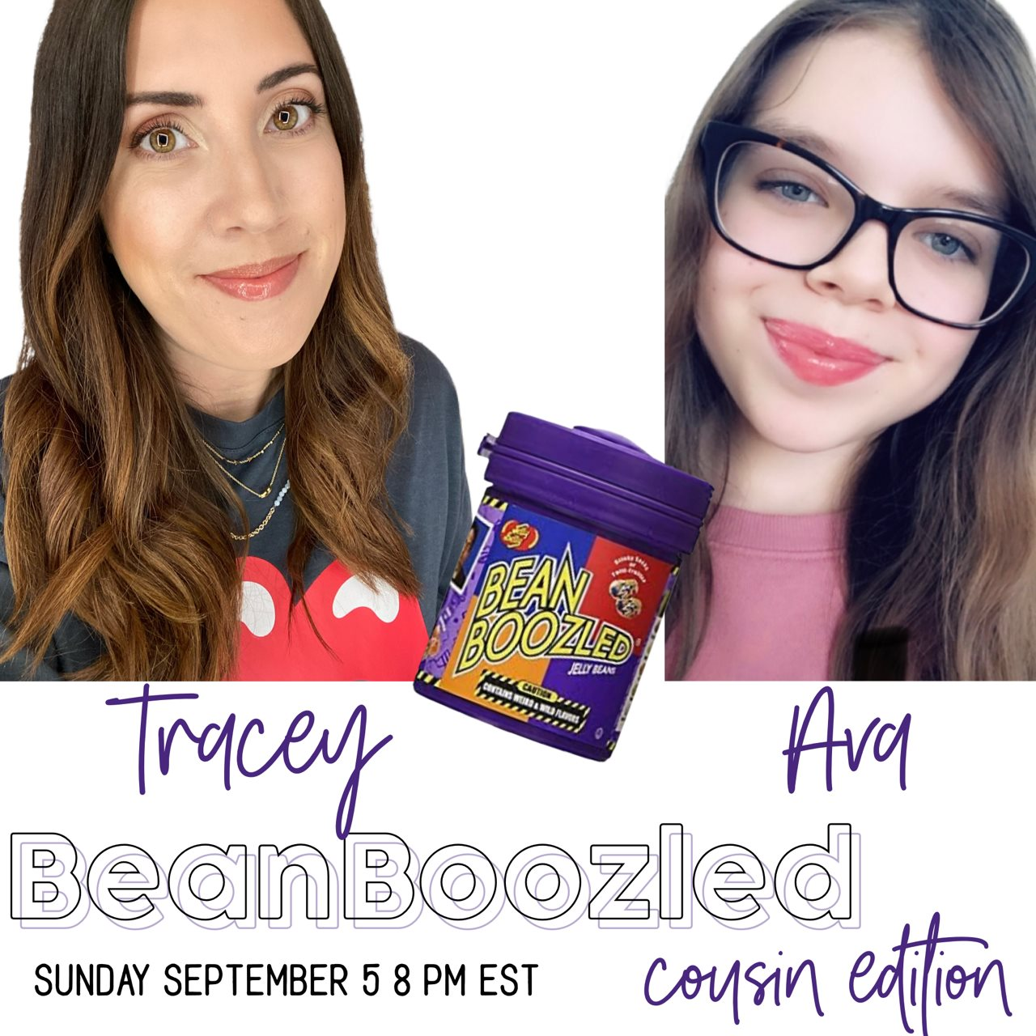
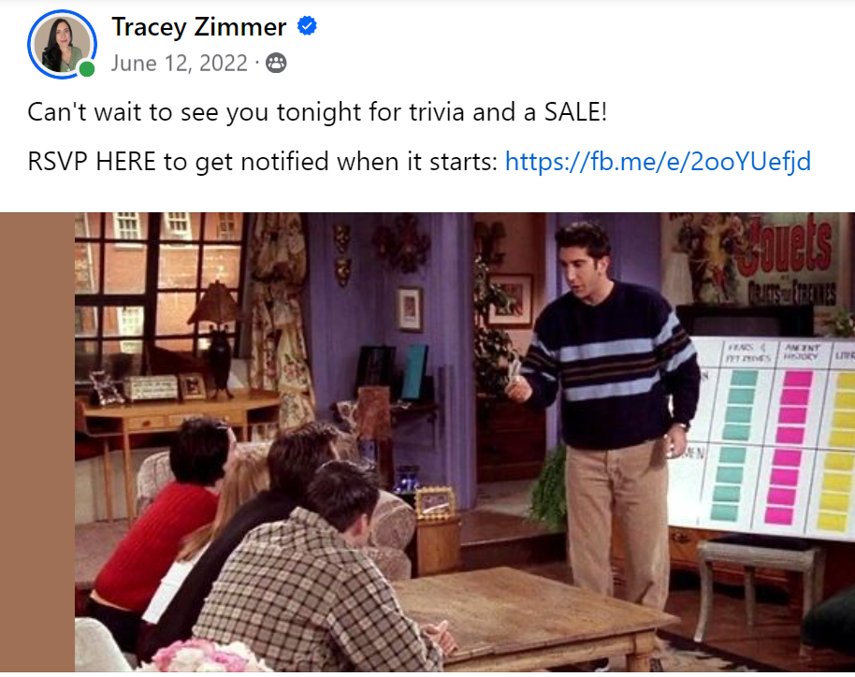
CONTENT CREATION
Fun add ons:
- Messenger sales
-Live sale/trivia
Notes:
Lastly, I want to end on some fun add-ons so this is where again we always want to think about how we can keep people coming back. There’s so much going on on the Internet. There’s so many distributors. What makes you stand out? What fun are you having because that that’s going to make people want to show up.
For me, I try to incorporate a variety into what I’m doing and try to do something every at least one to two months that is maybe not something I usually do so for example that could be a messenger sale that could be a live sale that could be a trivia night that could be an album sale that could be something like let’s make a deal.

Slide 14
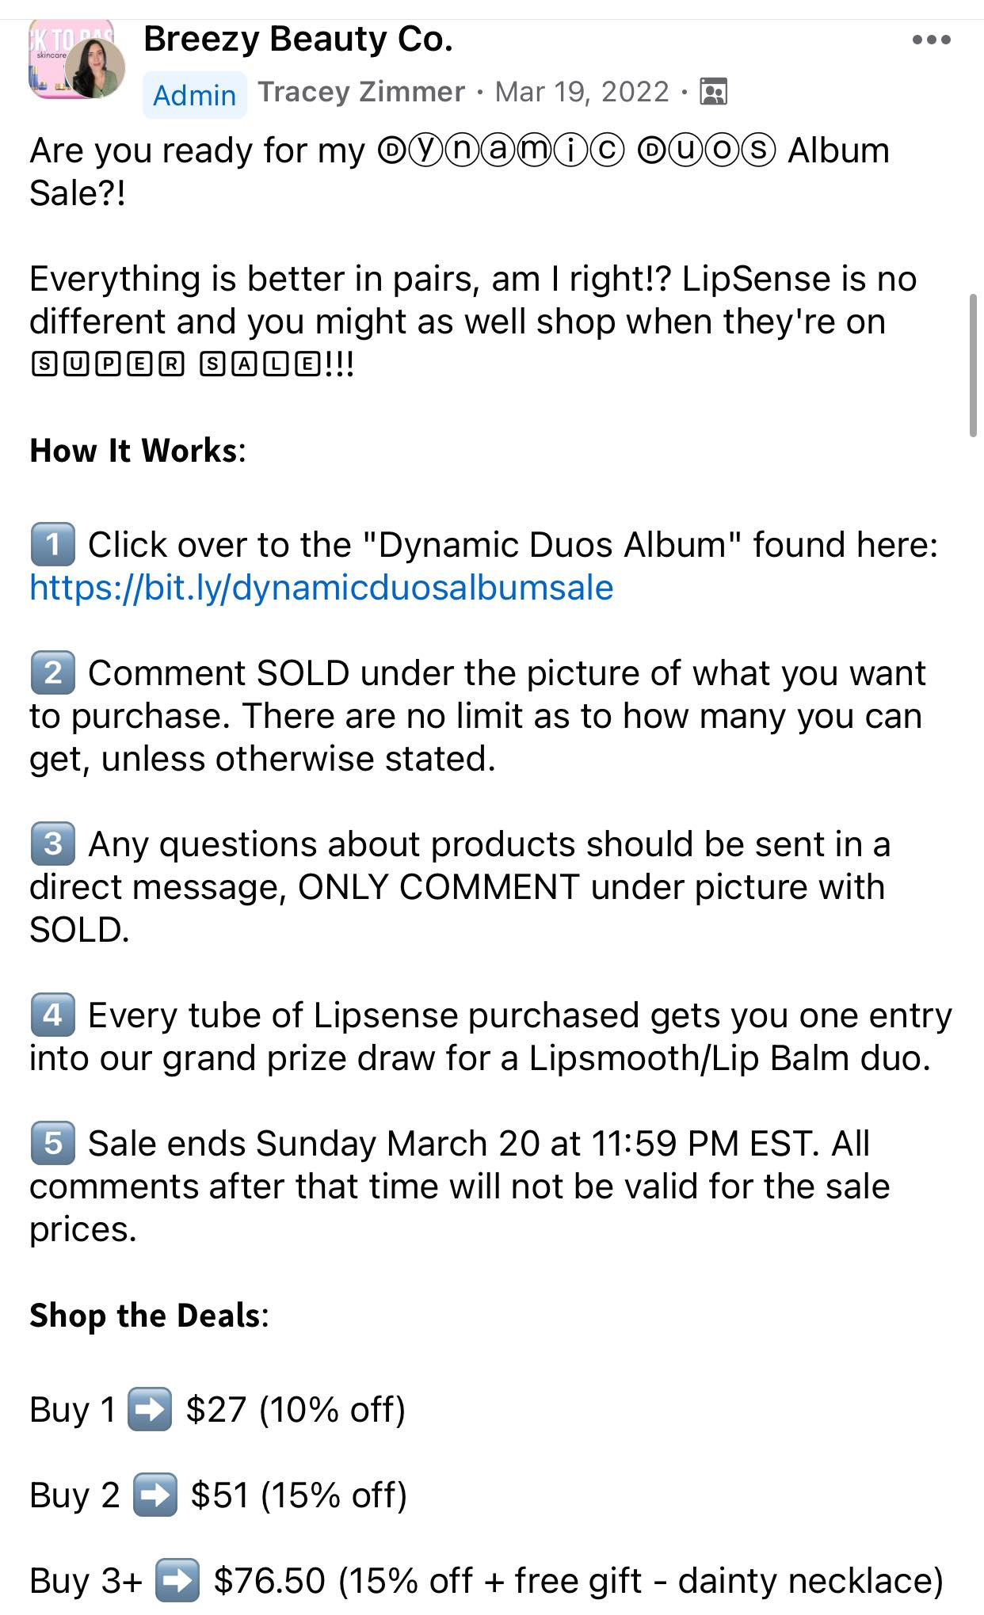
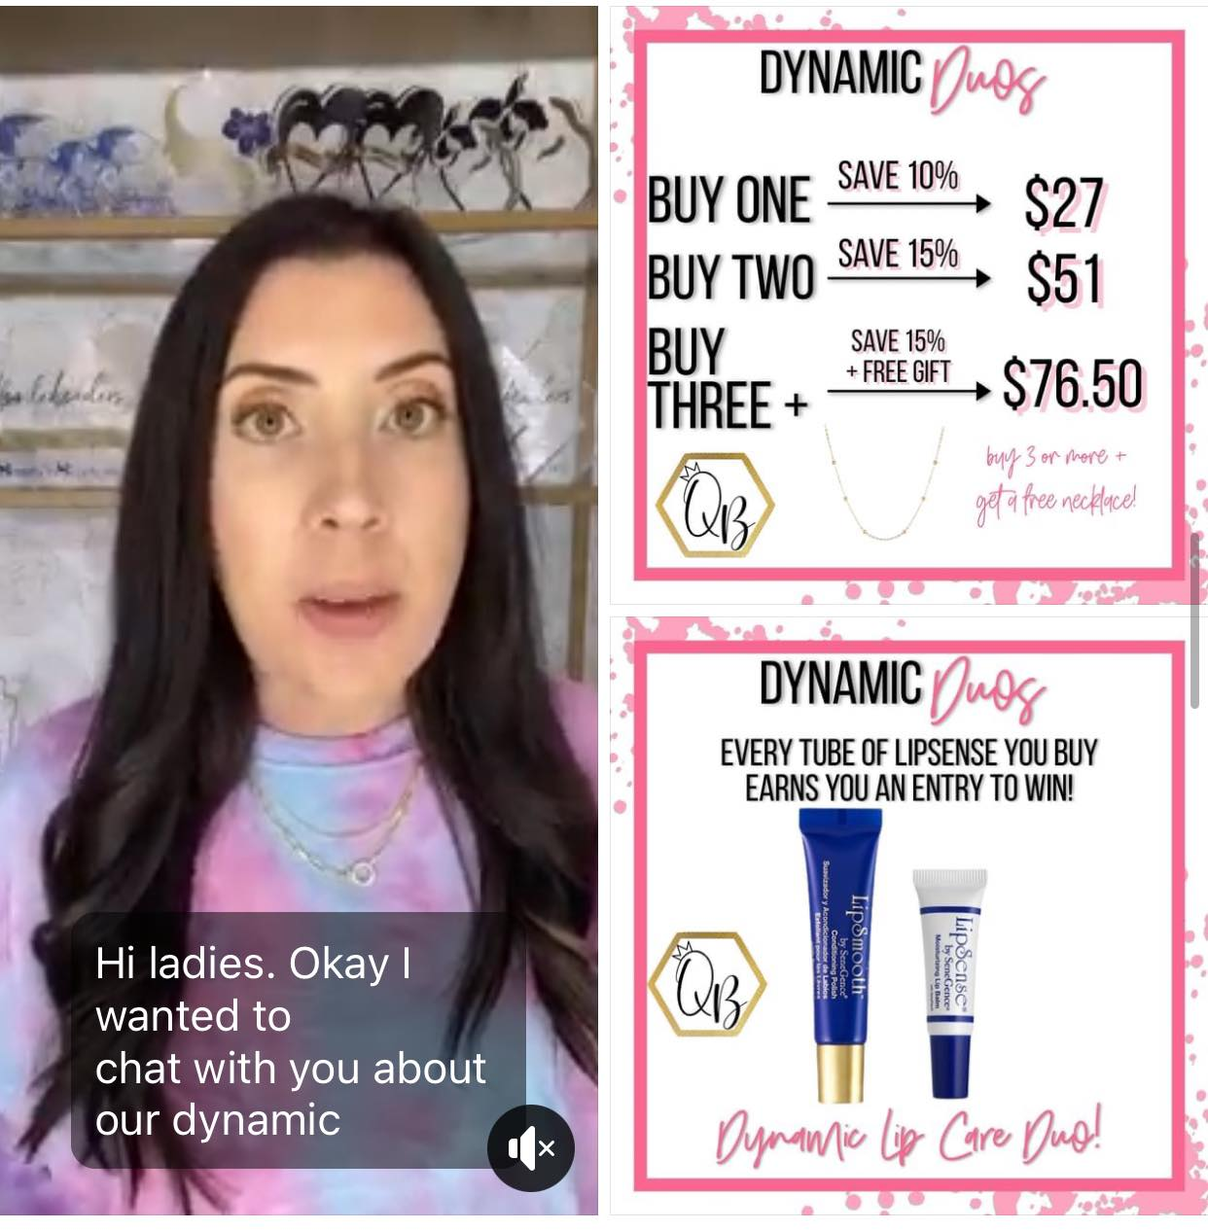
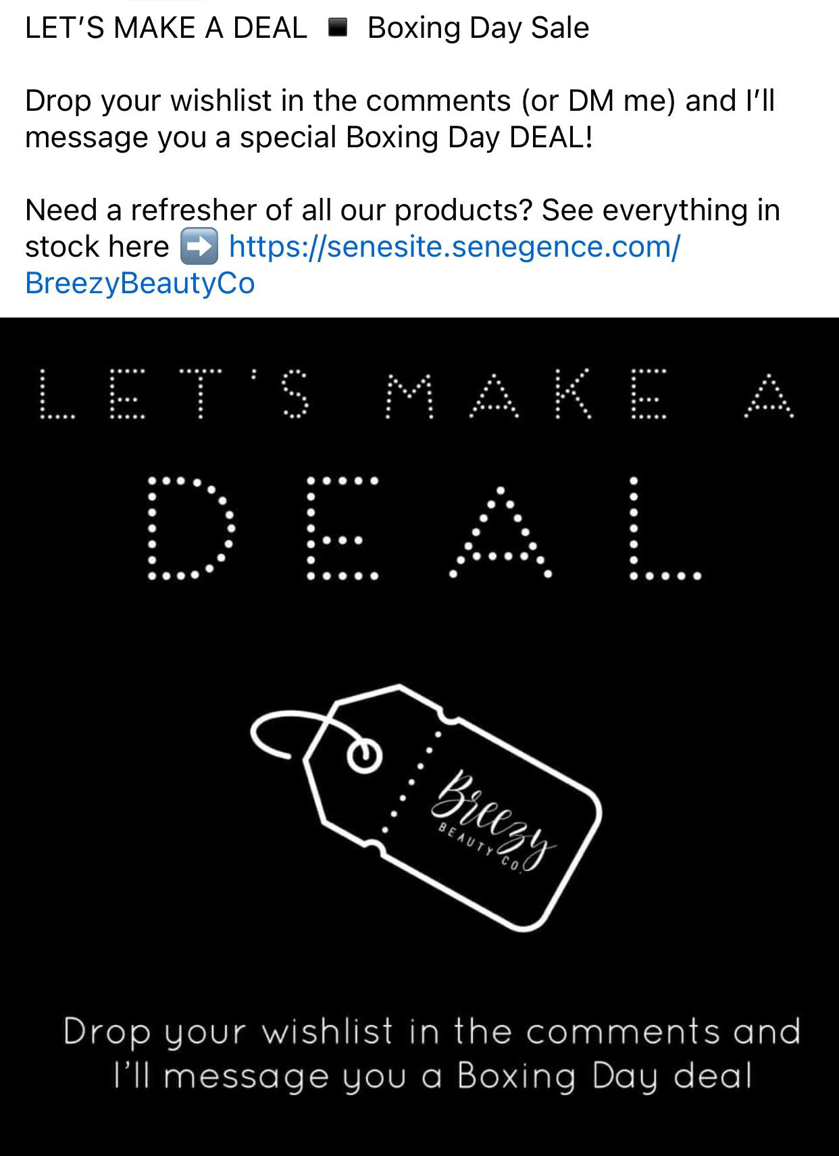
CONTENT CREATION
Fun add ons:
Album sale
Let’s Make a Deal

