Slide 2
NEW RELEASE!

Slide 3
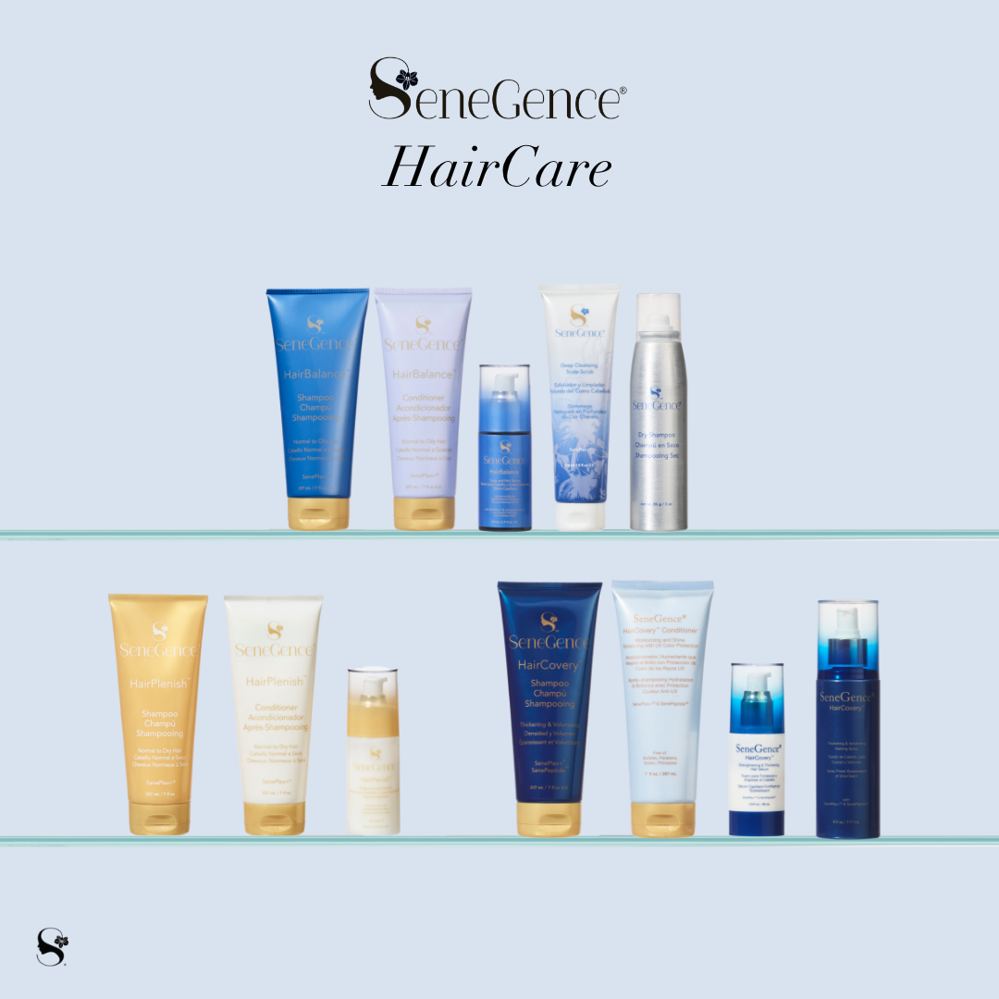
NEW TO THE UK - SENEGENCE HAIRCARE
3 Systems available
Choose your type:
HairCovery - Thickening and Volumising
HairPlenish - for Normal to Dry Hair
HairBalance - for Normal to Oily Hair

Slide 4
Unique Selling Points
SCALP HEALTH
Calms, cleanses and soothes scalp and
hair without drying or stripping
No Sulfates or Parabens - sulphates kill the
hair follicle and make hair thinner
No animal by products or testing - Vegan
Gluten free
SenePlex + and Capixyl
Botanicals and Peptides
CAPIXYL™ WORKS TO INCREASE THE NUMBER OF HAIR
FOLLICLES PER SQUARE CENTIMETER BY OVER 79%
IN FOUR MONTHS.*

Slide 5
A quick note on Scalp Health
See your scalp as an extension of your face!
Healthy scalp = healthier hair
“skincare for the scalp”
Treating the hair at the scalp and then working the product through from
root to ends will help produce strong, healthy hair over time.
Stimulates follicle regeneration with the use of Capixyl

Slide 6
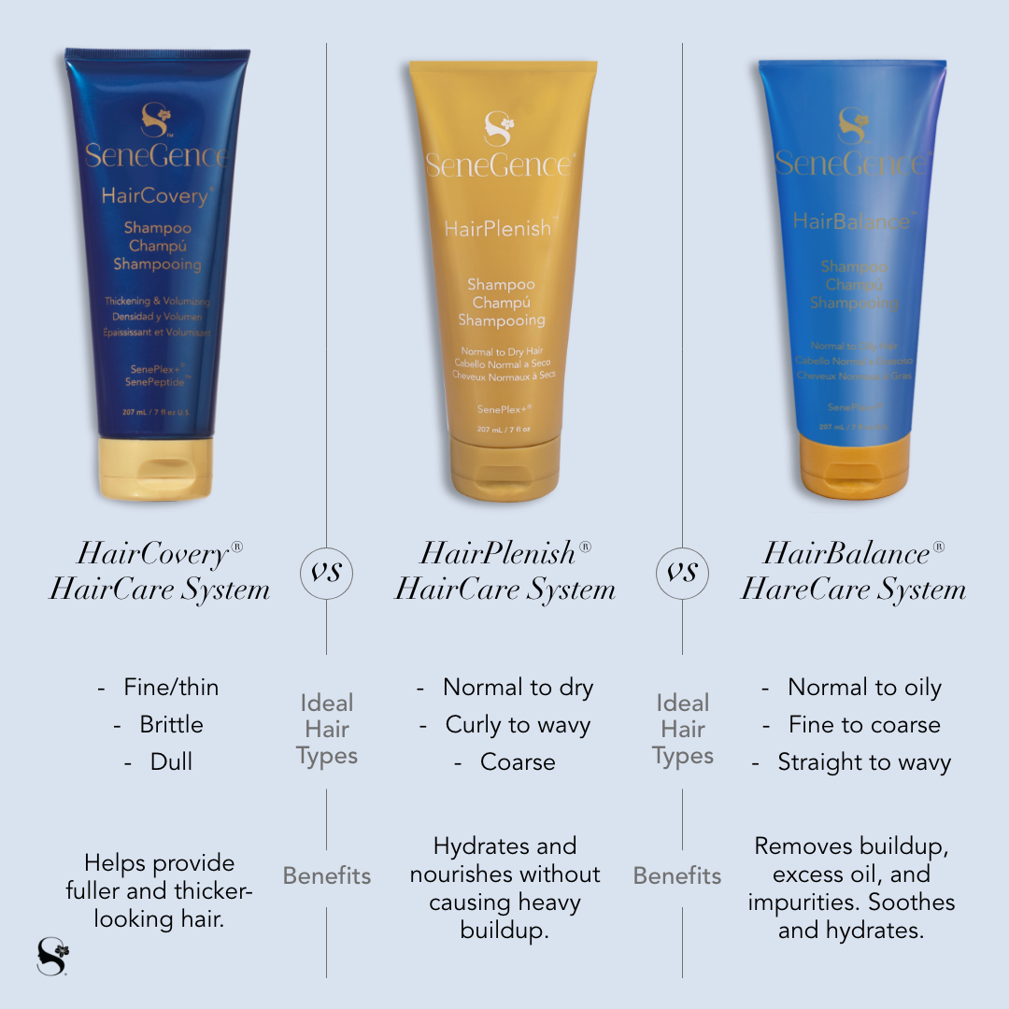
There are a few simple questions
you can ask to help determine
hair type

Slide 7
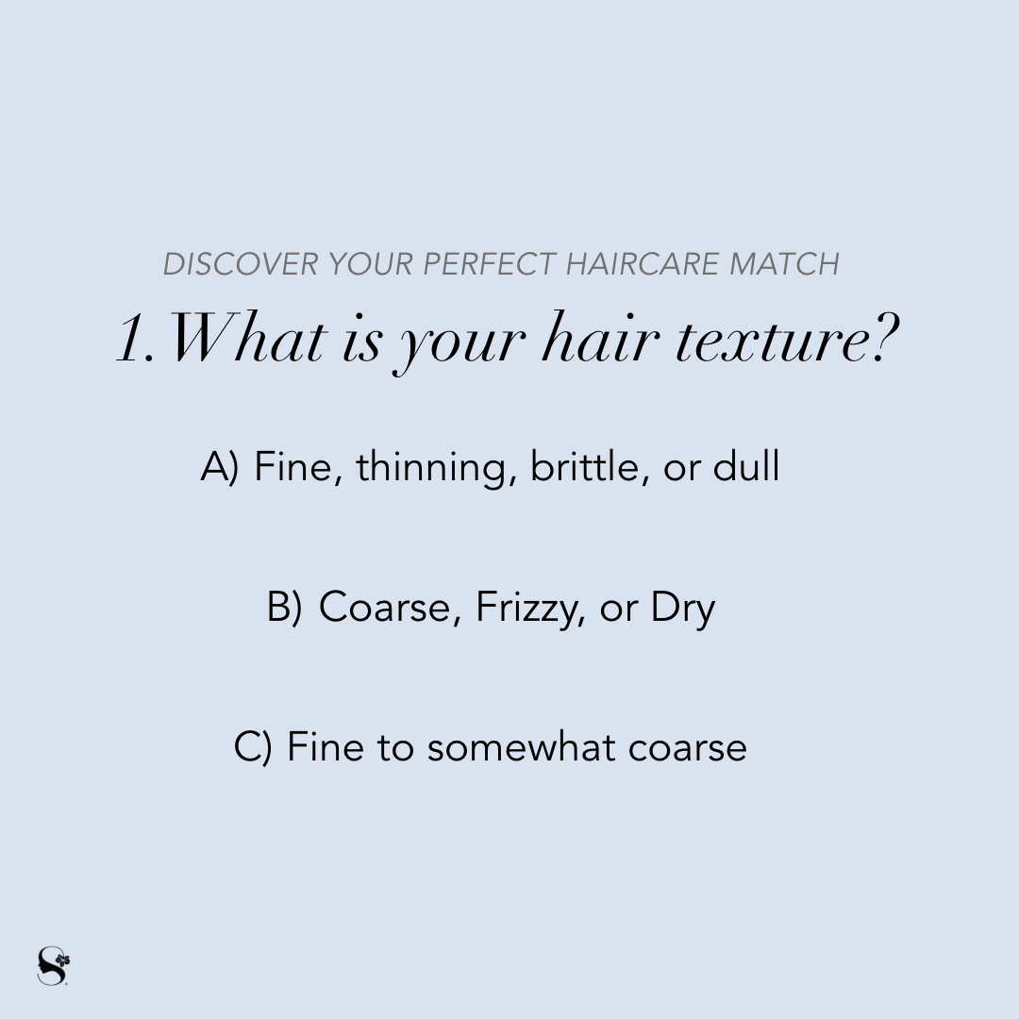

Slide 8
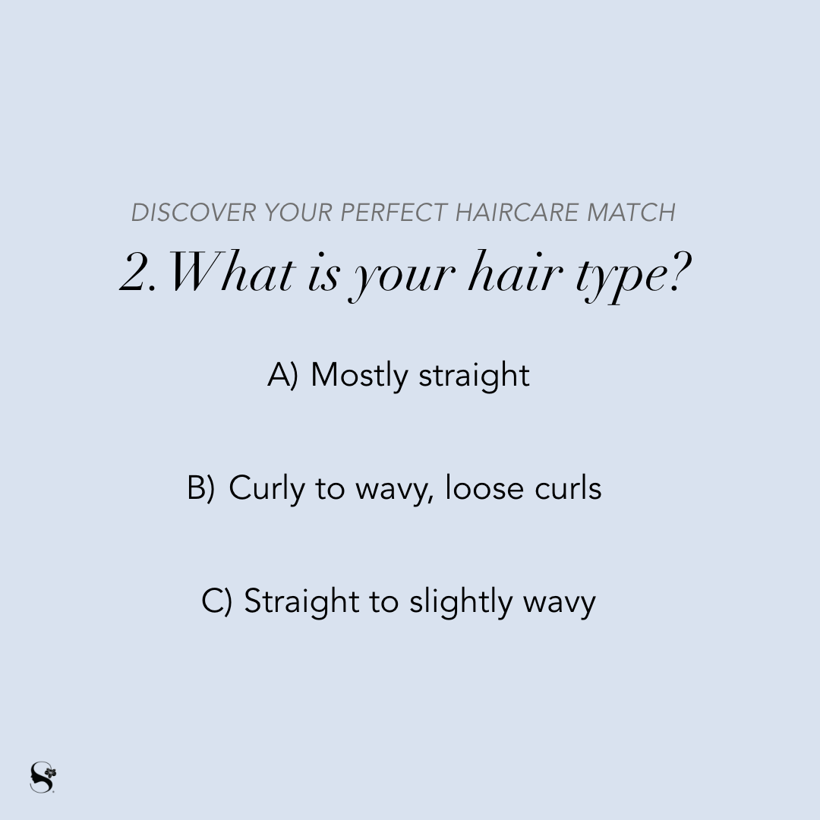

Slide 9
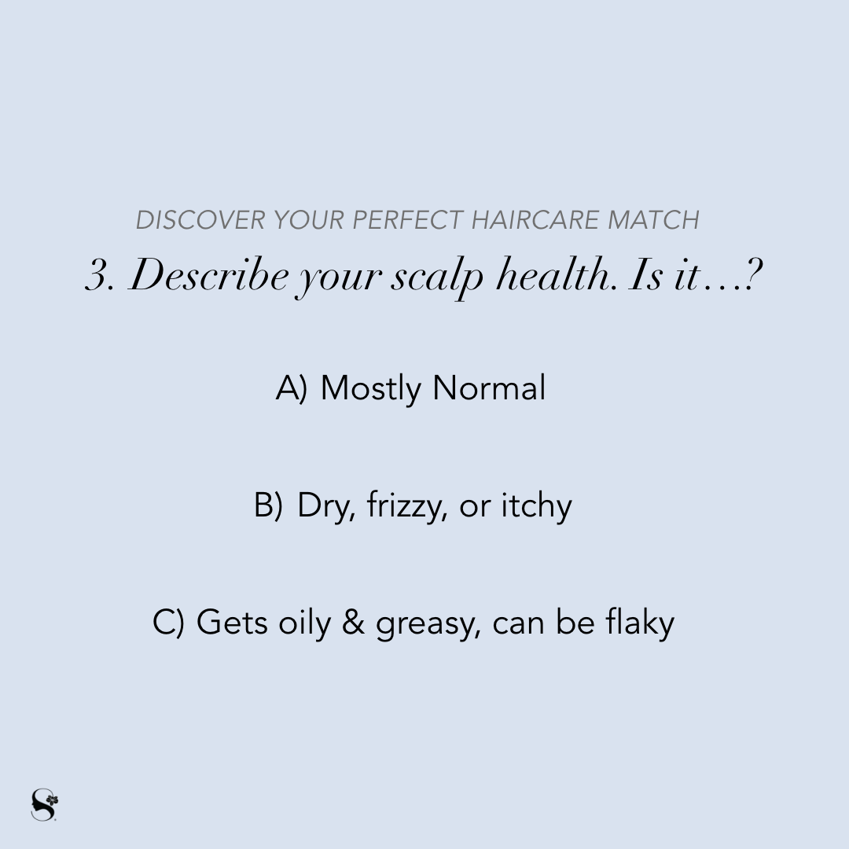

Slide 10
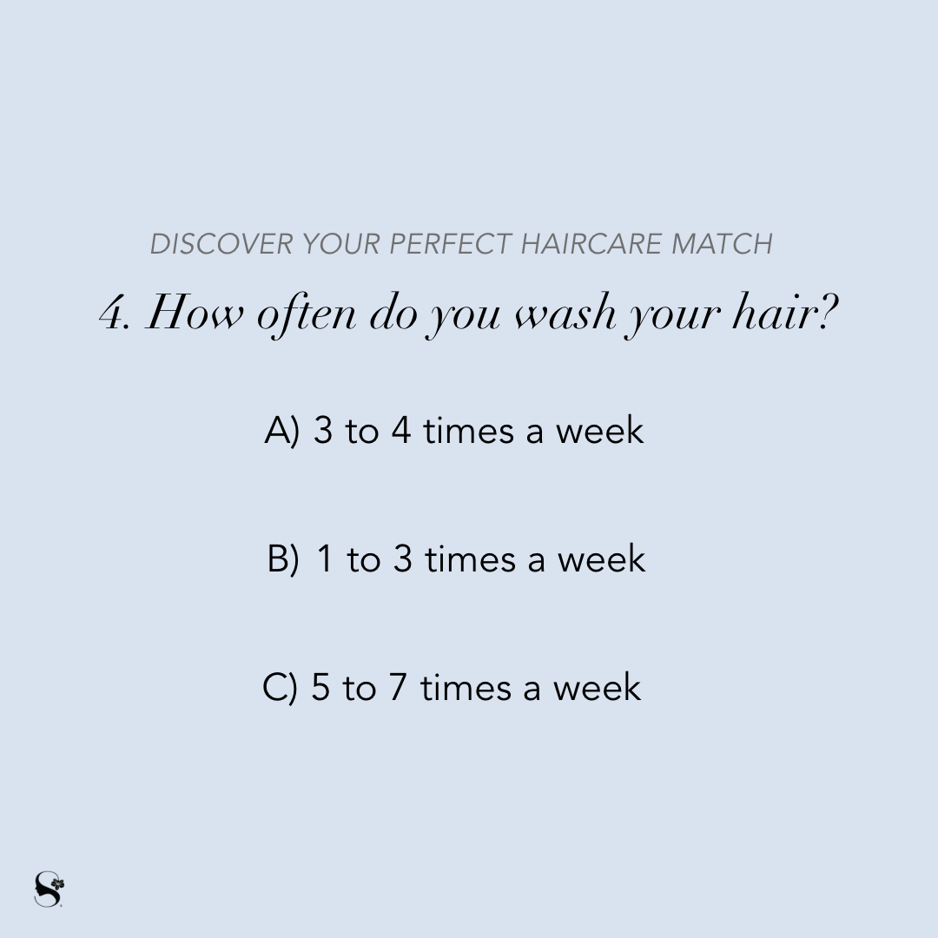

Slide 11
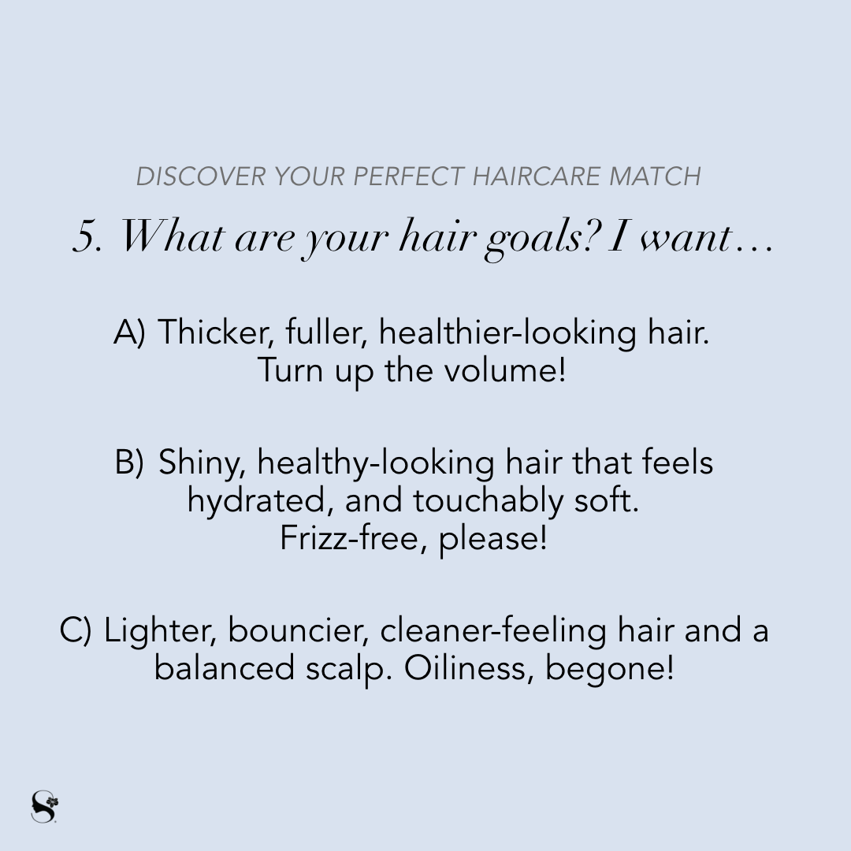

Slide 12
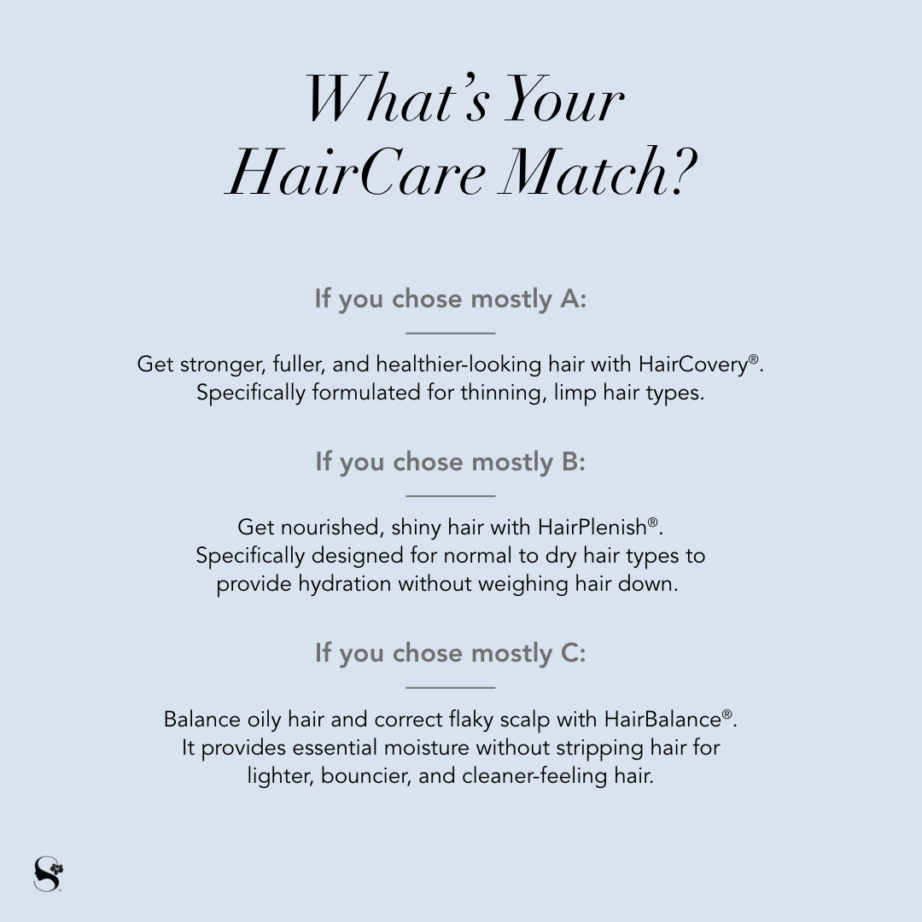

Slide 13
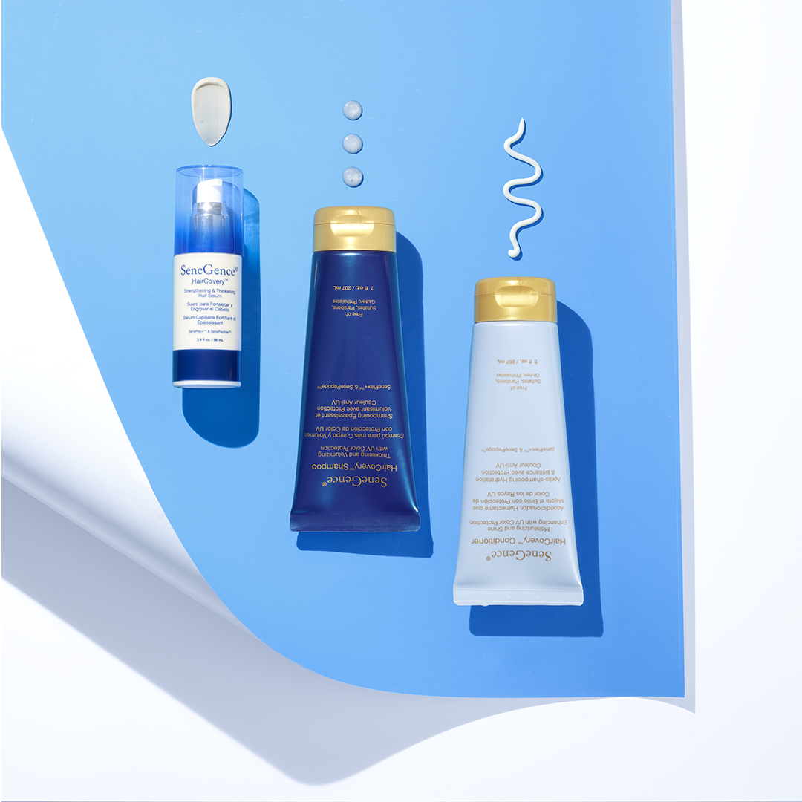
HairCovery®
ingredients that address thinning, limp hair types,
powered by Capixyl™, which fortifies every strand to
promote thicker, fuller, and healthier-looking hair.
SenePlex+®and SenePeptides - support a healthy-looking scalp and voluminous, strong locks of hair.
Recovers the strength, softness, and volume of your hair from root to tip

Slide 14
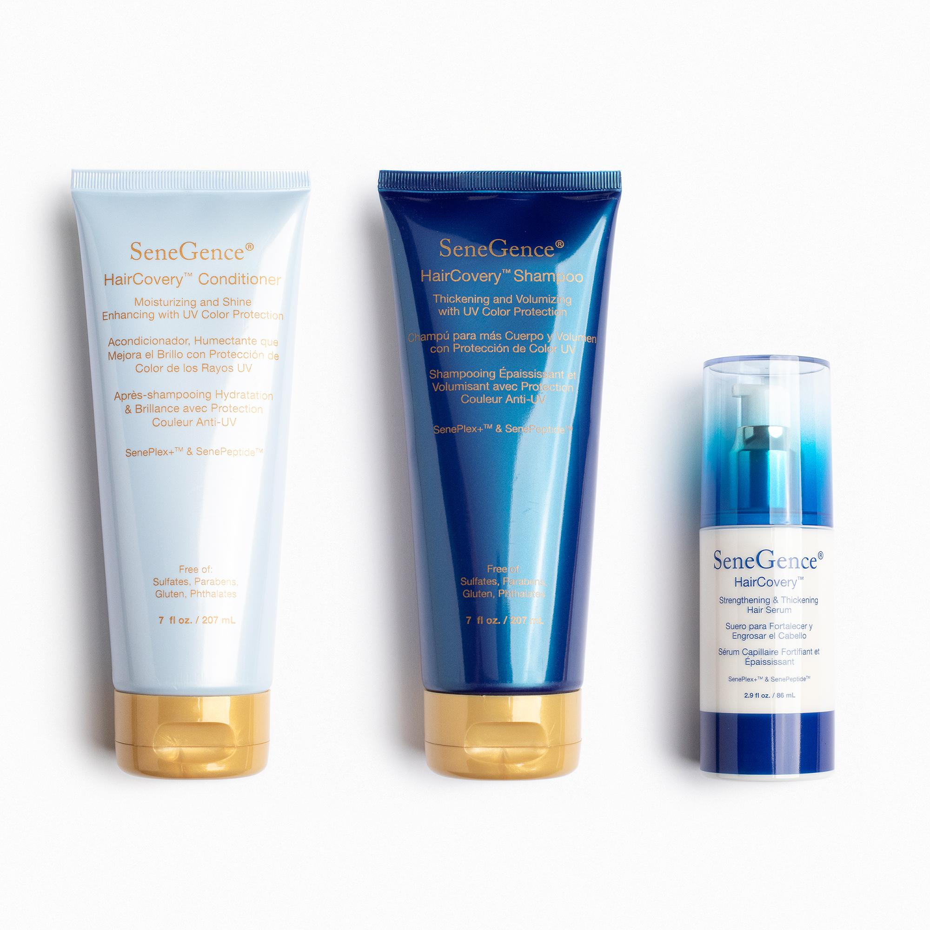
HairCovery -
All with UV Colour Protection
Thickening and Volumizing Shampoo: revives hair -
nourishing botanicals, vitamins, and lightweight moisture.
Works to give you thicker looking, bouncier hair.
Safe for color-treated hair.
Moisturising and Shine Enhancing Conditioner: restores hair’s texture and radiance with moisturising botanicals and vitamins.
Dry, brittle hair is transformed into luxuriously soft, shiny, and
healthy-looking locks. Formula is also beneficial for colour-treated hair.
Strengthening and Thickening Serum
Formulated with nourishing botanical extracts and powerful peptides that help to moisturise your scalp, this leave-in serum helps to strengthen hair to return it to its healthiest, shiniest, and most vibrant state.

Slide 15
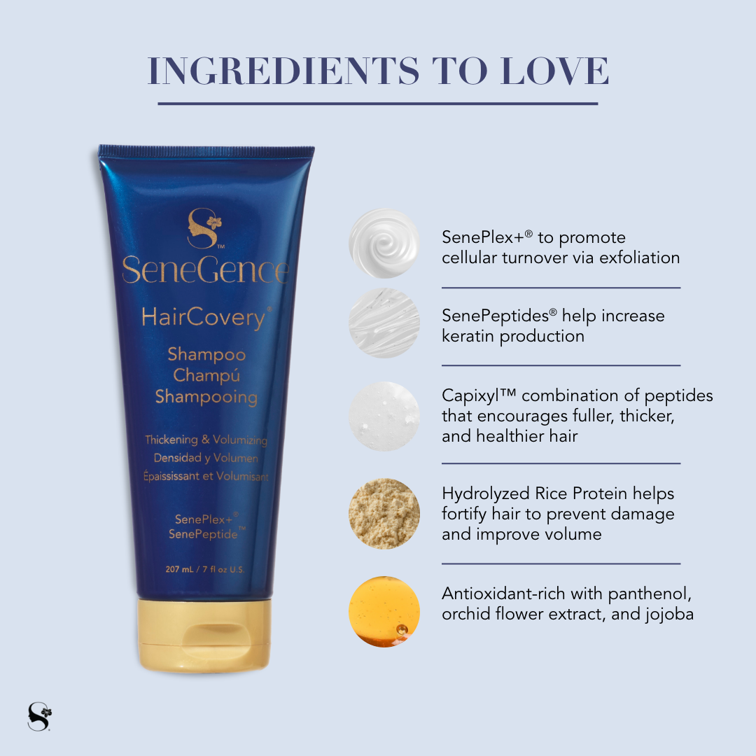
Key Ingredients
Capixyl - volumises and stimulates growth
with the help of red clover flower extract -
enhances hair density and reveals
thicker healthier hair
Panthenol (Vitamin B complex) - nourishes
and moisturises for a healthy scalp and
conditions hair from root to tip
Rice Protein - fortifies hair to prevent
damage and improves

Slide 16
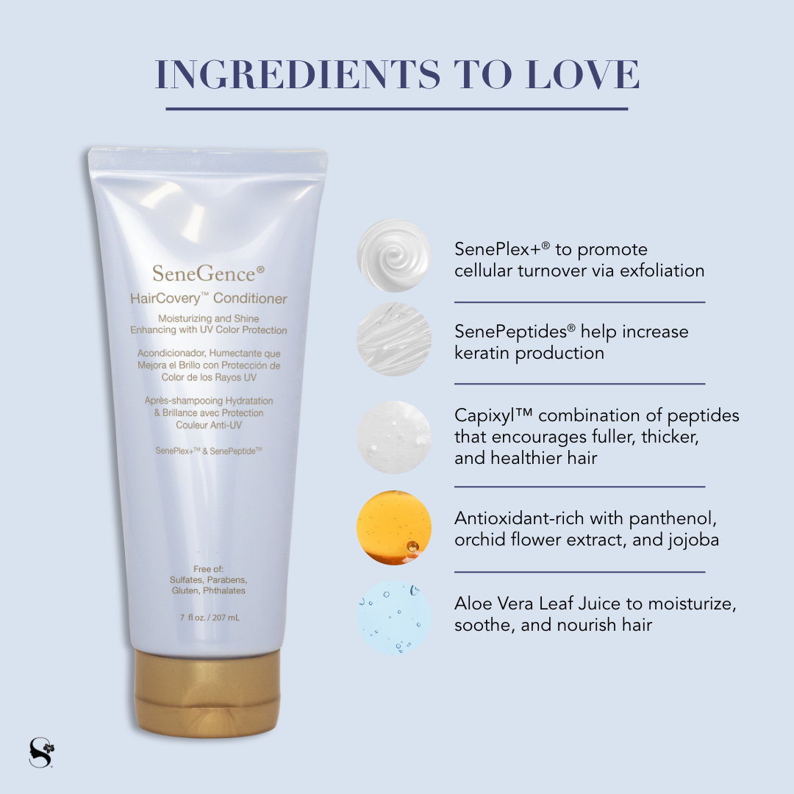
Jojoba Ester - helps prevent UV damage
which can improve colour retention of
coloured hair
SenePeptide - increases follicular activity
which can enhance hair strength and
stimulate keratin production
SenePlex+ - Kinetic enzyme that prompted
cellular turnover via exfoliation
Orchid Flower - protects against free
radicals
Aloe Vera - moisturises and
soothes

Slide 17
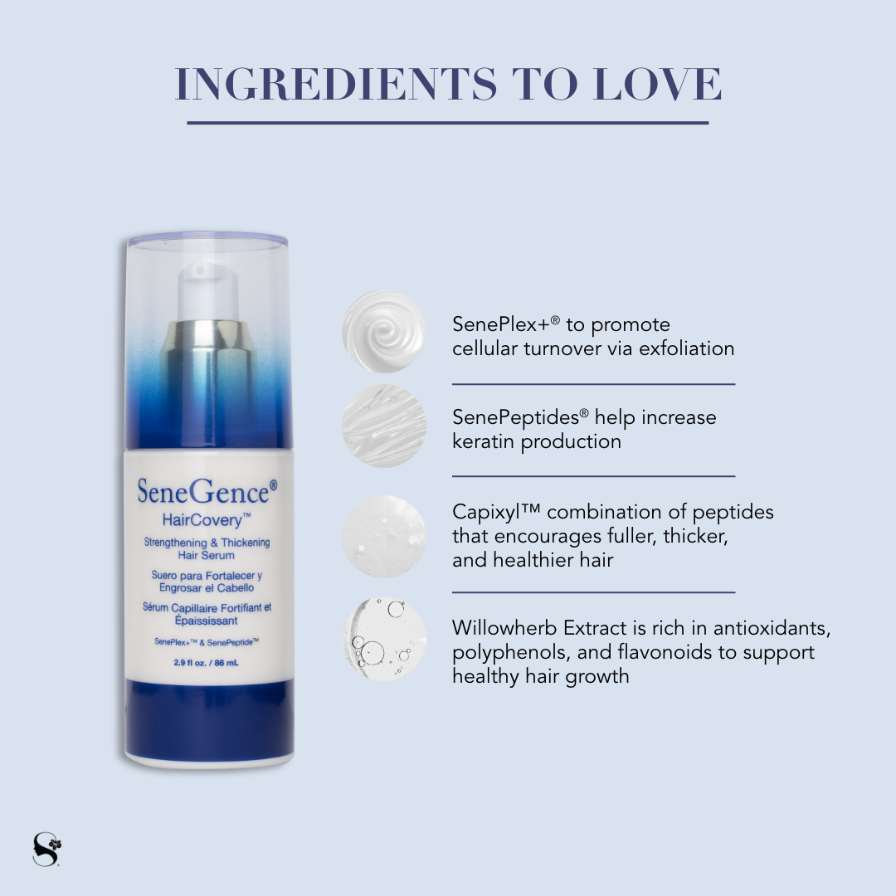
Intense leave hair serum
Powerful lightweight serum - packed with
nourishing ingredients to moisturise the
scalp to reveal thicker, healthier,
shinier,strong hair.
Contains Willow herb to calm the scalp and
promote moisture
enhances the appearance of fuller
more voluminous hair from scalp to tip
strengthens and encourages a
health scalp
adds radiant shine

Slide 18
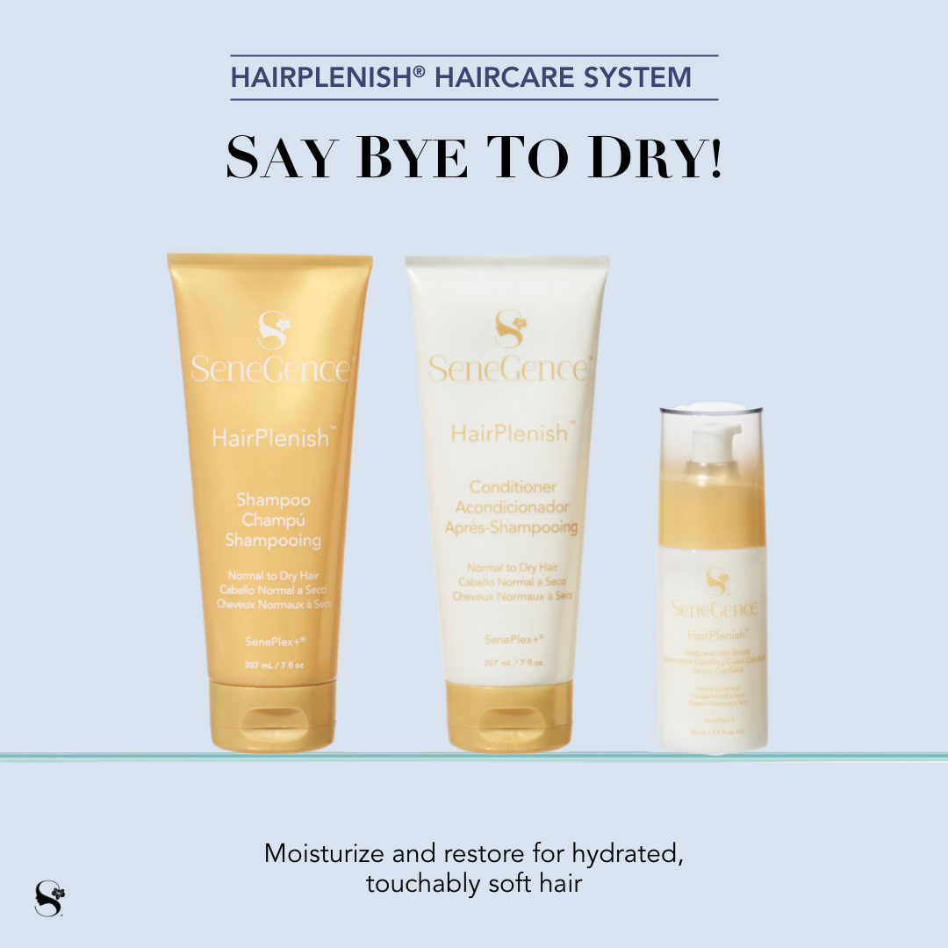
HairPlenish®
Specifically formulated for normal to dry hair types,
these products protect hair colour while gently
cleansing and moisturizing for nourished scalp and hair.
Formulated without sulfates, parabens, silicones, gluten.
1. A rich lathering Shampoo that leaves hair looking healthy, soft, and smooth
2. A creamy conditioner that reduces tangles and the appearance of frizz
for easily manageable, touchably soft hair
3. A leave-in scalp serum with powerful peptides to moisturize your scalp and help
return hair to its shiniest, most vibrant state.

Slide 19
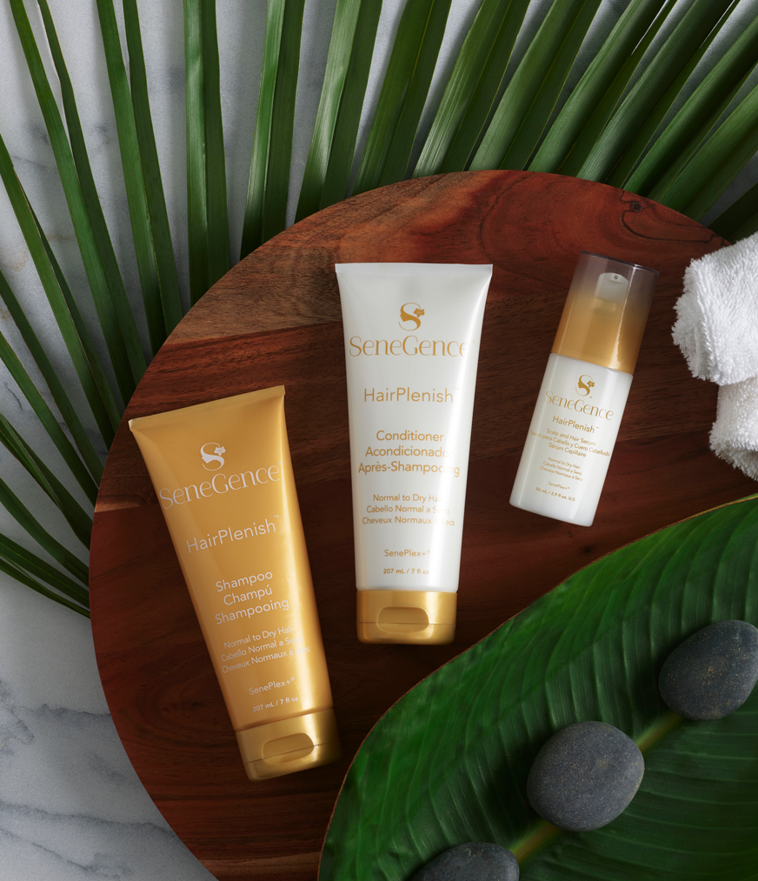
HairPlenish with SenePlex+ - for Normal to Dry Hair
Shampoo
Conditioner
Scalp and Hair Serum
Achieve - shinier, healthier, smoother, vibrant, more
manageable, moisturised hair
Eliminates dry dull hair without leaving the hair “heavy”
for a vibrant appearance
Reduce scalp dryness and flaking
Lightweight formula - Designed to cleanse, hydrate and nourish
from root to tip

Slide 20
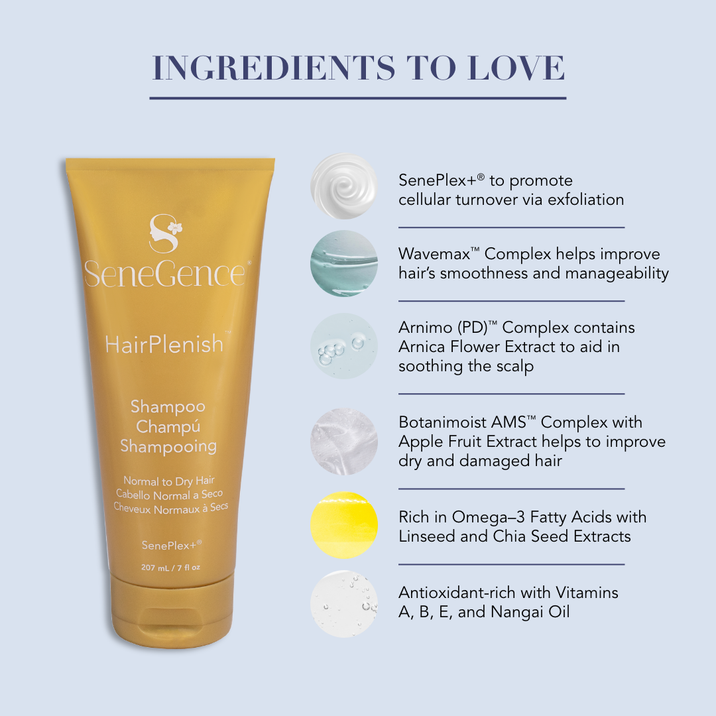
Key Ingredients
Wavemax™ Complex: with Linseed and Chia Seed.
Helps improve hair’s smoothness and manageability
and reduces frizz.
Arnimo(PD)™ Complex:
Contains arnica flower extract, which aids in soothing
the scalp.
Arnica Flower extract - helps soothe scalp
Apple Fruit Extract - deeply moisturises and helps
address dry and damaged hair

Slide 21
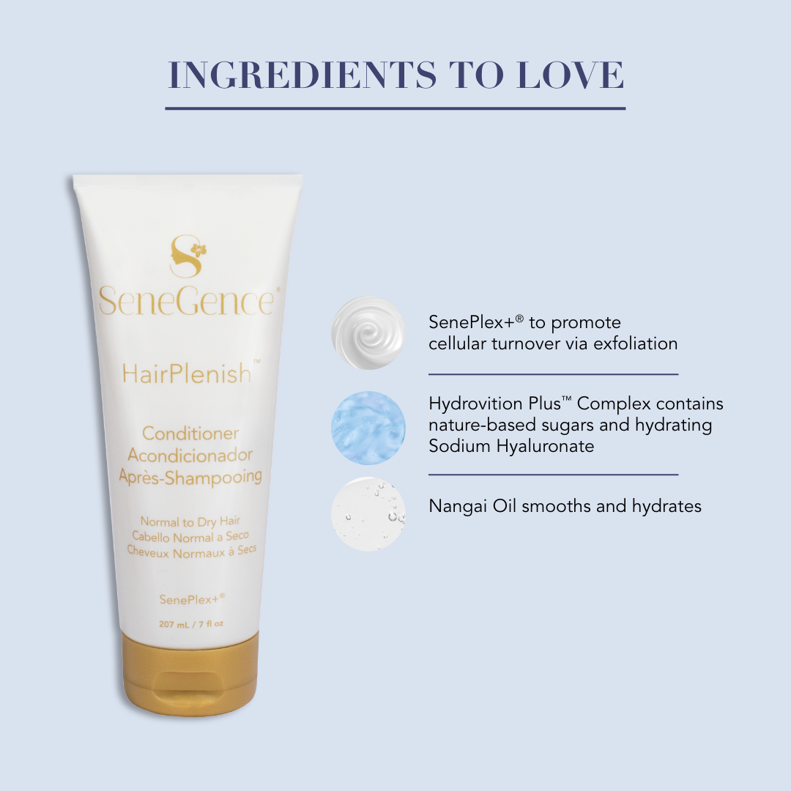
Nangai Oil - essential fatty acids - smooths
hair
Vitamins A, B, E - hydrate scalp and hair
Hydrovition Plus™
Complex: Complex made of nature-based
sugars and moisturising sodium hyaluronate.

Slide 22
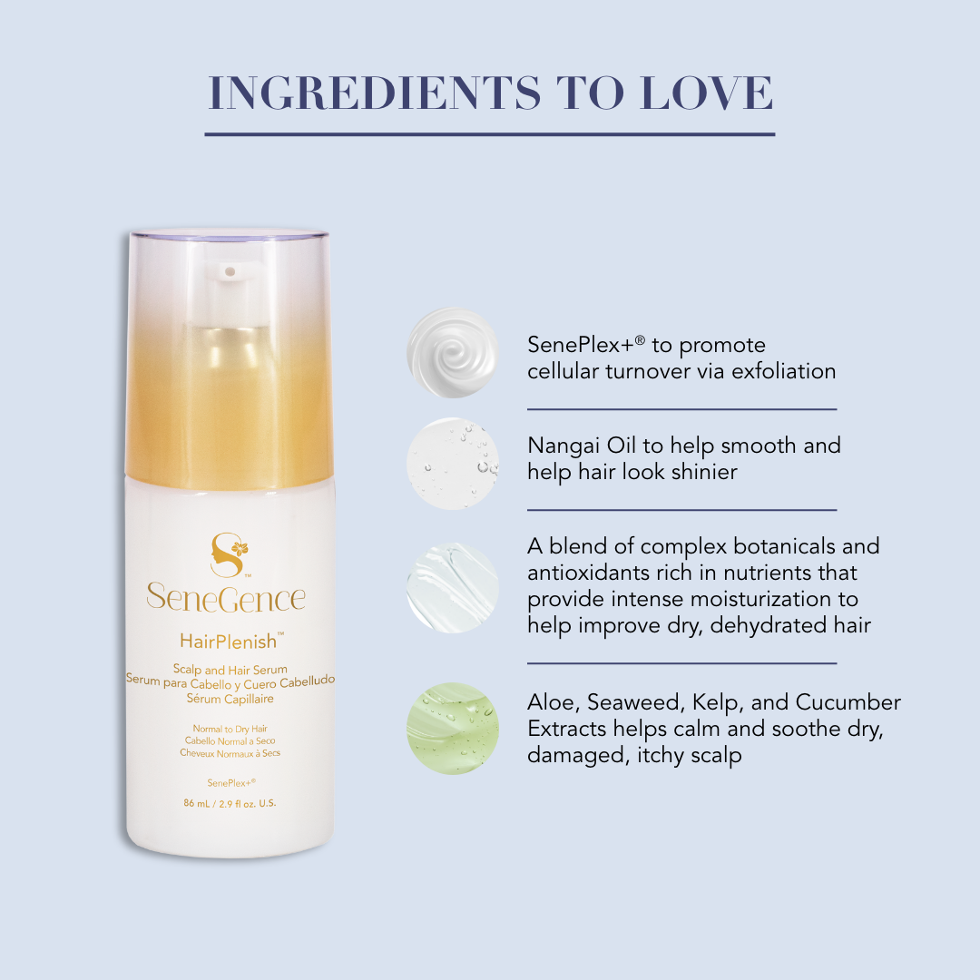
Aquaxyl™: A complex of nature-based sugars
that help to improve dehydrated skin.
Botanimoist AMS™ Complex:
Contains apple fruit extract, which provides
natural moisturization and a light, non-tacky feel.
Avocado Oil - protects against heat damage
Aloe, Seaweed, Kelp, Cucumber extracts -
adds minerals and nutrients to calm and soothe
dry damaged hair and itchy scalp

Slide 23
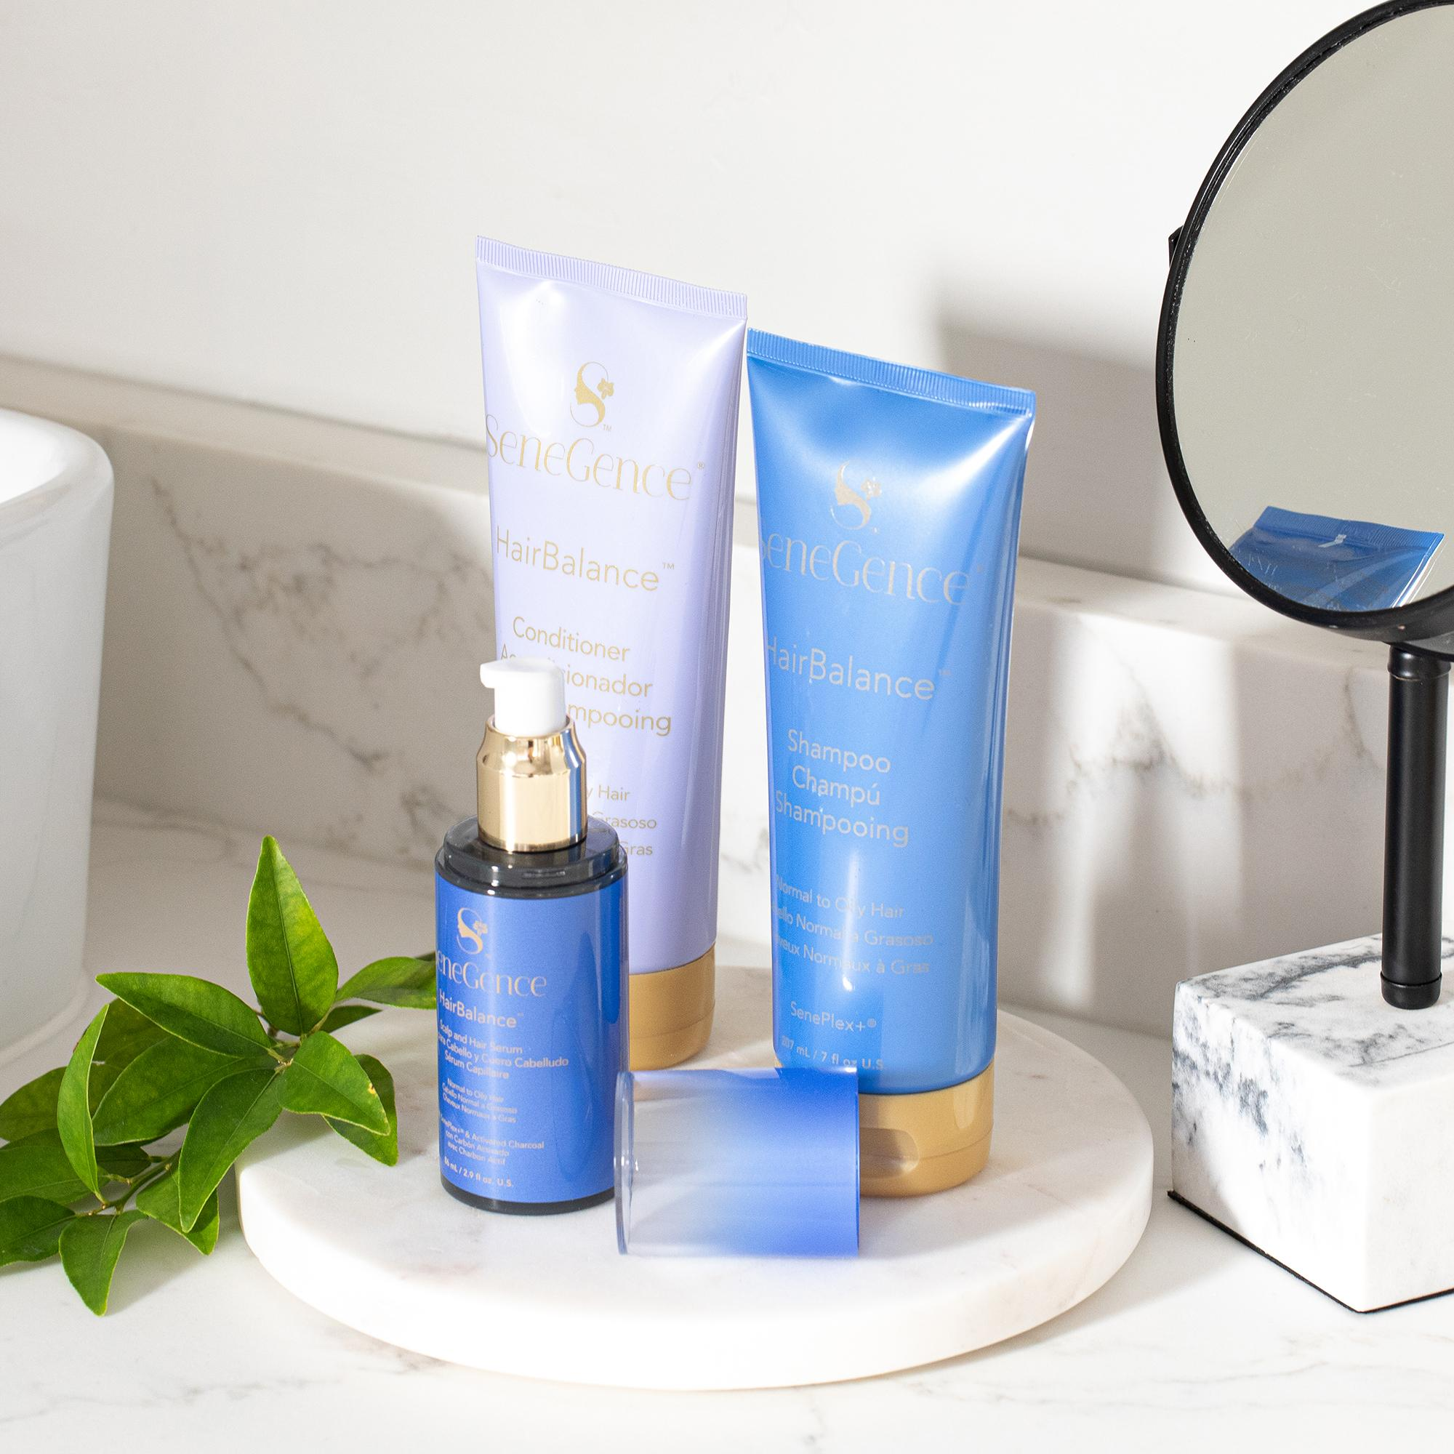
HairBalance®
Specifically formulated for normal to oily hair types,
these products protect hair color while deeply cleansing,
clarifying, and balancing for revitalized hair and scalp.
Rich in Vitamins A, B and E to protect the scalp
Aloe, Seaweed and Kelp to calm and soothe
Sodium Hyaluronate to moisturise
Contains Pentavitin® : Provides instant hydration and helps
to rebalance the skin for scalp comfort.
Cleaner feeling hair from root to tip

Slide 24
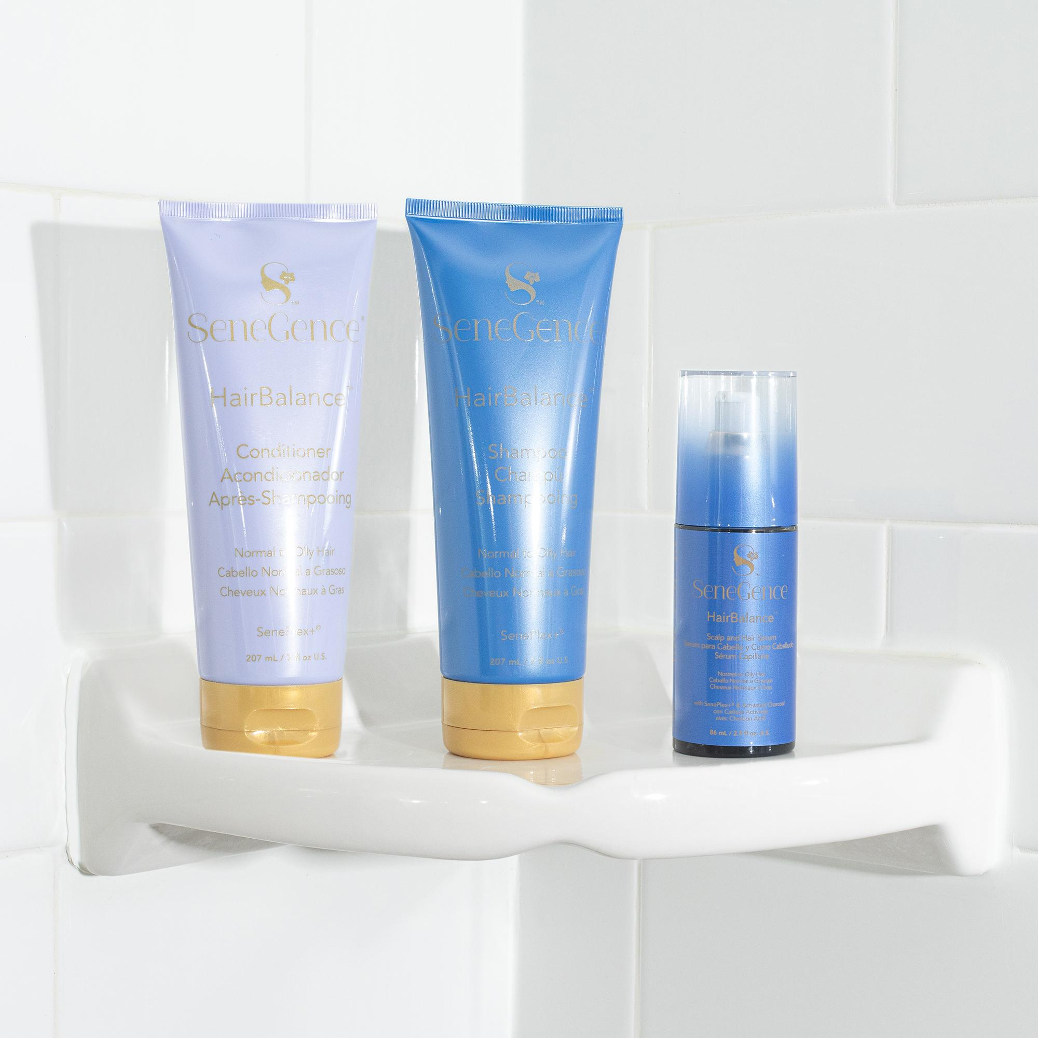
HairBalance® Shampoo and Conditioner for Normal To Oily Hair
HairBalance®Scalp & Hair Serum with SenePlex
A purifying, balancing formula to remove buildup,
excess oil, and impurities, while soothing and
hydrating
A botanical and vitamin infused conditioner to
help hair feel healthy and touchably soft, while
adding shine and bounce.
A leave-in serum with activated charcoal to absorb
excess oil and energise the roots for optimal scalp health.

Slide 25
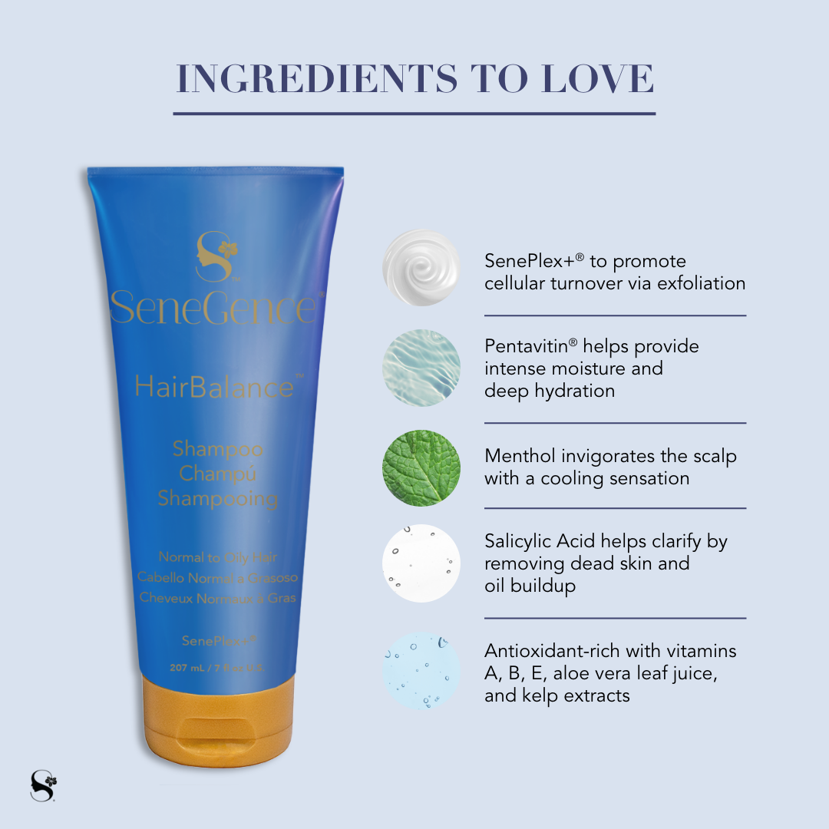
Key Ingredients
Menthol: Provides cooling and refreshing
sensation to the scalp.
Pentavitin: plant-derived active for intense
hydration and reduction of flaky scalp
Merquat 3330PR Polymer (complex): helps hair
feel smooth and not matted or tangled
Jaguar C-17: plant derived from Guar Beans to
increase shine
Salycilic Acid - remove sebum buildup

Slide 26
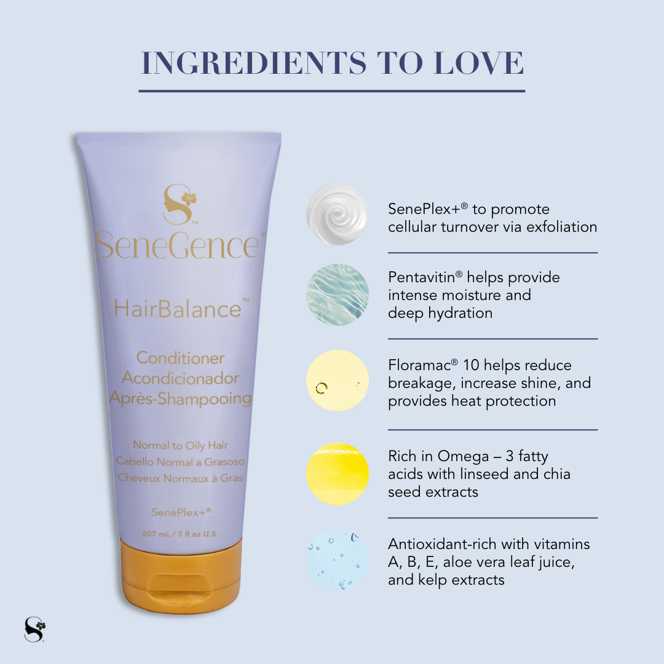
Floramac® 10: Macadamia Complex, Helps to
reduce breakage, increase shine, and provide
heat protection
Pentavitin: reduces scalp flaking and helps
combat oily scalp and itchiness
Wavemax: with Linseed and Chia - smooth
and reduce frizz and protects coloured hair
Menthol: cools and pruifies
Glycerin: Hydrates the scalp

Slide 27
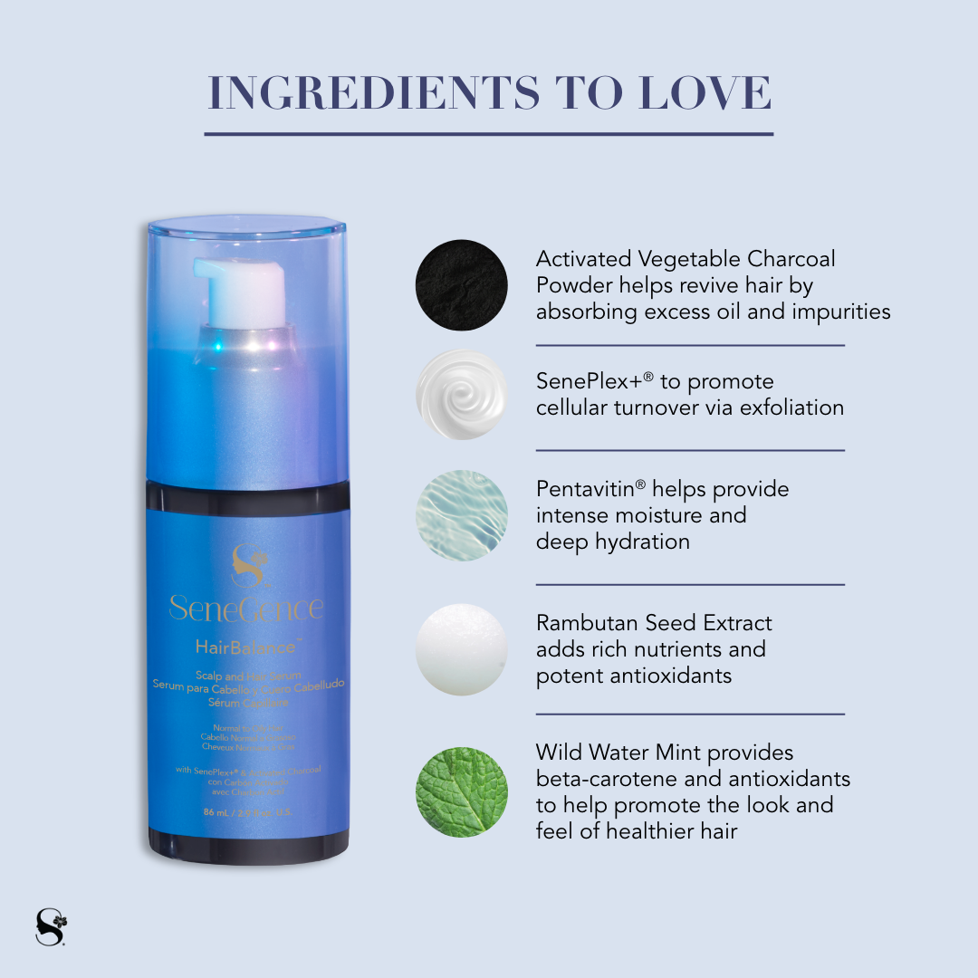
Activated Vegetable Charcoal Powder: absorbs dirt and
oil that clog hair
Rambutan Seed Extract: Protects and energises the
roots. Rich in antioxidants
Water Mint: Provides a cooling, refreshing sensation
Marimoist: (complex) includes red seaweed and SH
to Moisturise and soothe

Slide 28
How to use?!
Be prepared, it’s very different.

Slide 29
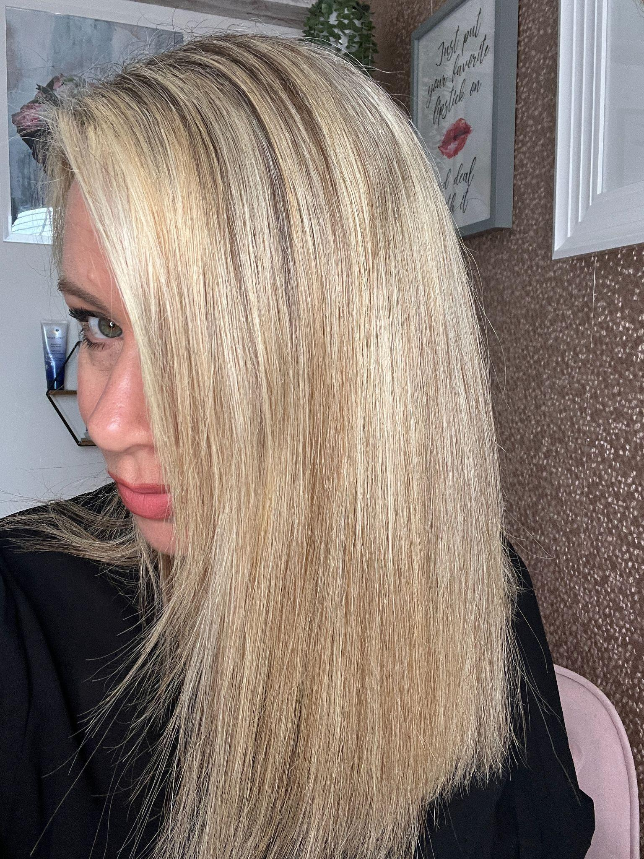
My Results

