Slide 2
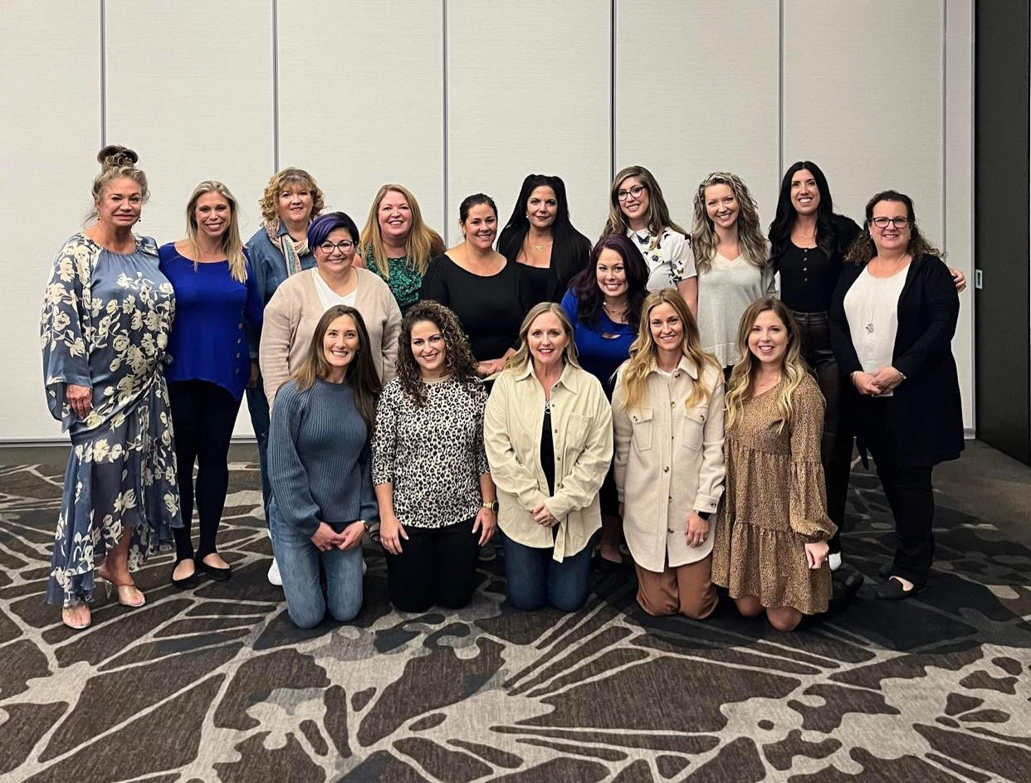
RECRUITING REDEFINED
WHY RECRUIT: - Residual Income - Leveraged Efforts - Community + Friendships - Scaleability - Long-Term Stability - Personal and Business Growth
Notes:
Before we dive into how to recruit, let’s look at why we should recruit: - Residual Income – make money while you are living your life - Leveraged Efforts – I would not be able to do half of what I do without my team. They have unique gifts and strengths. - Community + Friendships – the best part. - Scaleability – many hands make light work - Long-Term Stability – not just relying on personal sales, the team helps create stability and consistent income. - Personal and Business Growth – growth as a leader, and growth in business.

Slide 3
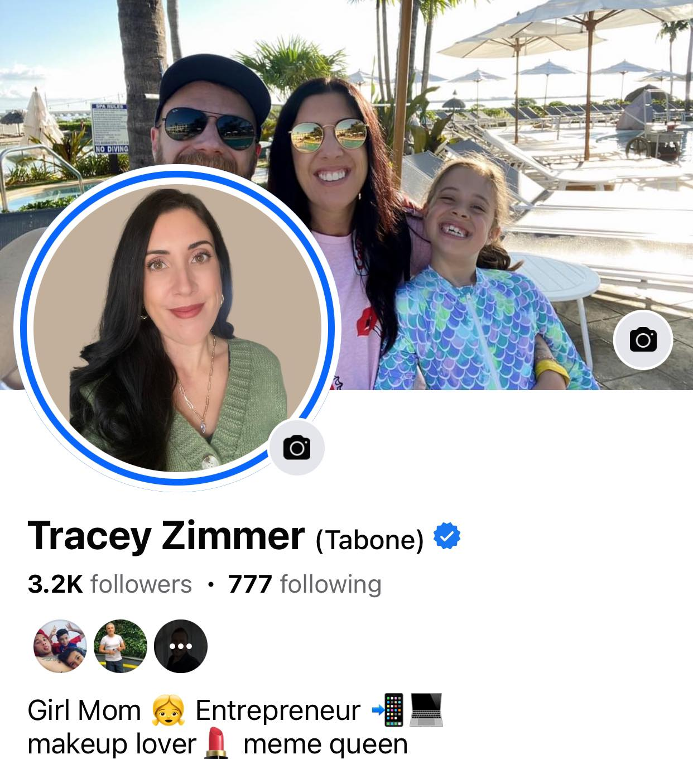
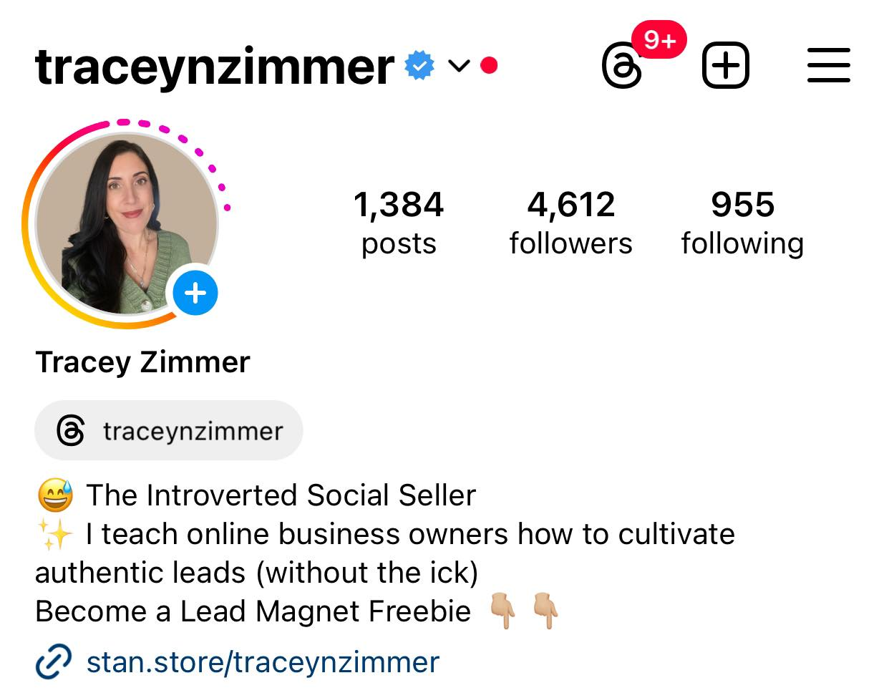
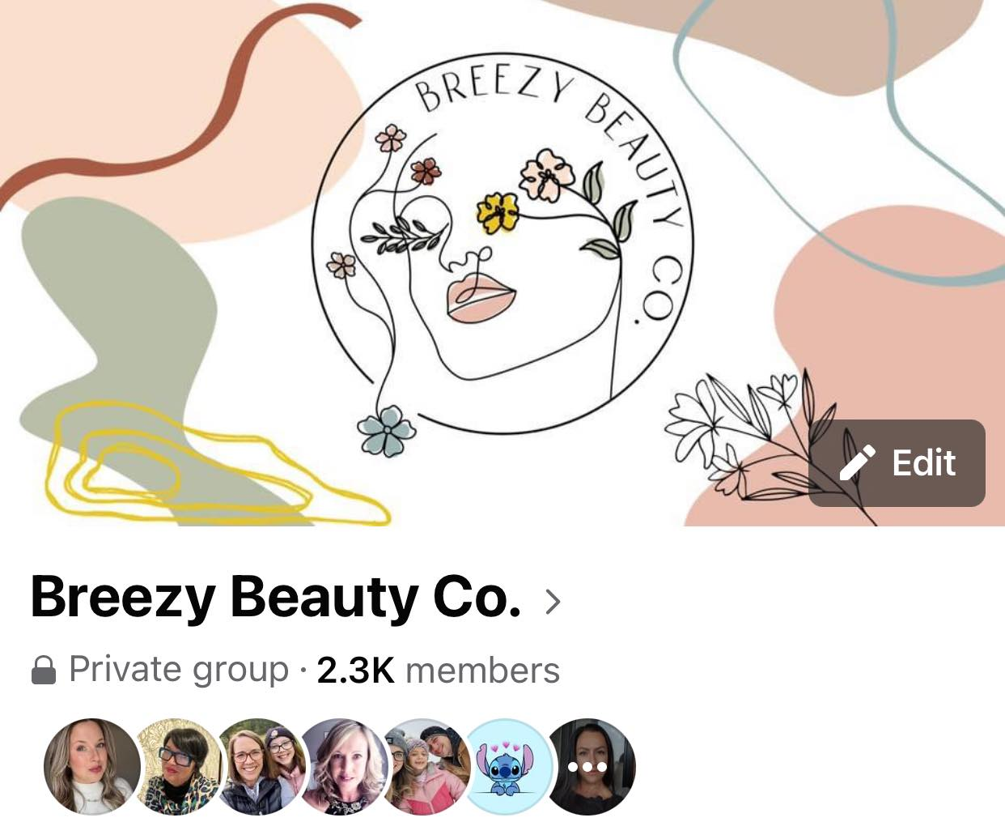
RECRUITING REDEFINED
AN OVERVIEW OF MY FUNNEL:
Personal FB Account + Instagram Account = My Billboard
Closed FB VIP Group = My Storefront
Notes:
I want to share with you my funnel. I share it with you not because I want you to replicate it, but I feel like you need to understand my funnel in order to understand the way I recruit. You will all have some sort of funnel. Now my personal belief is that if you are building a business online, and this is your primary way of building your business than your social media accounts are your business tools and need to be utilized as such. (explain funnels) – live on the platform where your people are, not what is trendy. Selling in FB group, building follower/friends on other accounts – people do business with people they like, know and trust – build that factor on my personal accounts/stories. Billboard spaces – 80% you/20% biz and storefront is other way around.

Slide 4
RECRUITING REDEFINED
In order to recruit, you need to know who you are recruiting, ask yourself: -Who are you speaking to?
-What content are they consuming?
-What are their pain points and how can your business solve them?
Notes:
“if you’re speaking to everyone you are speaking to no one” – I wanted everyone to be my customer base, but the messaging, pain points etc are so different for each. First and foremost you need to figure out who you are speaking to. What content are they consuming – what accounts, platforms, types of content, where are they showing up. What are their pain points and how can your business solve – AI/Chat GPT can help with this too!

Slide 5
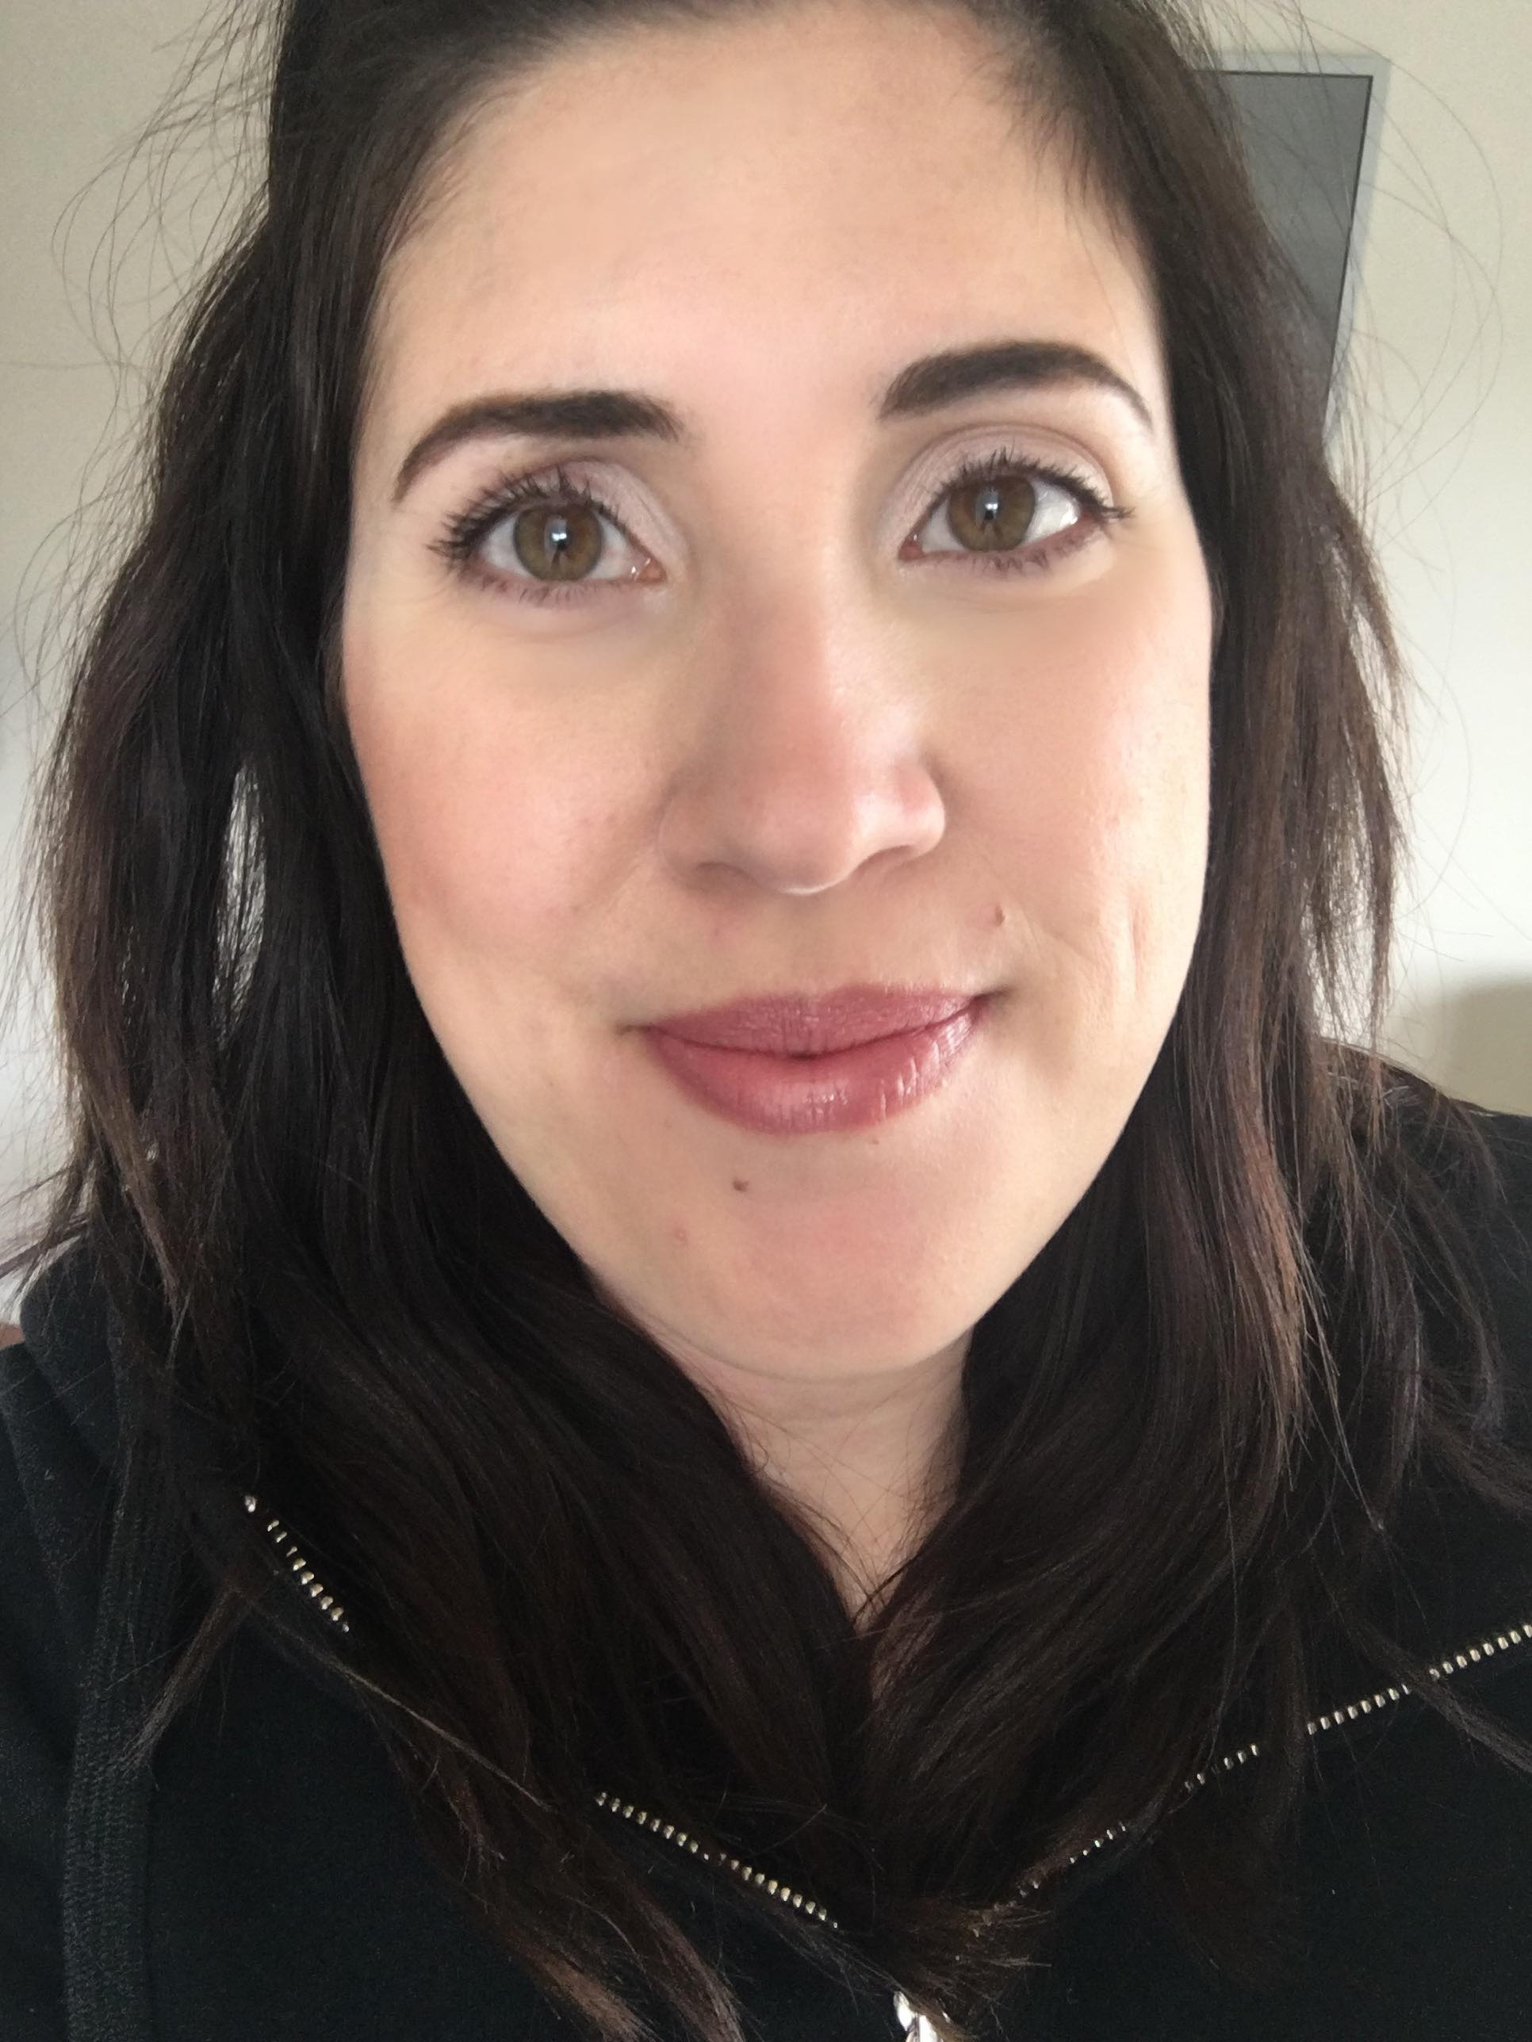
RECRUITING REDEFINED
My first ever business selfie
AUDIENCE AVATAR:
Who is she?
What is she consuming?
How would my opportunity serve her?
Notes:
I want to share this picture for a number of reasons. First off, she is my audience avatar. Often times looking at who you were before you started the business will give you a pretty clear picture of your avatar. I also want to share this because as much as this picture makes me laugh, she sold $700 (400 british pounds) with that selfie. Why? Because this girl was ignorance on fire. She was imperfect action – and she showed up as she was and sold $700 in her first week in business. Her audience resonated with her because guess what, her audience isn’t perfect either! They don’t want someone who is perfect, they want someone who is going to give them the permission to show up as they are and allow them the confidence to say maybe I could do this too. That is a HUGE part of recruiting – I would actually argue it was easier for me to recruit as her, than as me now. (Explain my audience avatar in relation to recruiting)

Slide 6
RECRUITING REDEFINED
Consistently Generate New Leads: - Go where the people are Create content catered to your audience avatar - Go where the people are
Notes:
We have to go where our audience avatar is - not where we want to go. Are they on FB? Are they reading emails? Are they consuming video content? You can try new things, but you should live where your people are. So for me I live on Fb, but I dabble in e-mail lists, reels, etc.

Slide 7
RECRUITING REDEFINED
You’ll recruit more and sell more by doing neither - say what?
-Provide value to generate new leads
-Provide value to nurture warm leads
- Value doesn’t always equal teaching.
Notes:
This sounds really counterproductive, but this is where my business shifted. I had a slow, steady build for my first two years but when I understood this concept was when everything changed for me. Value does not have to always be in the form of education. Value will keep your current leads engaged and attract new leads – key thing to note is that the value must be valuable to your audience avatar.

Slide 8
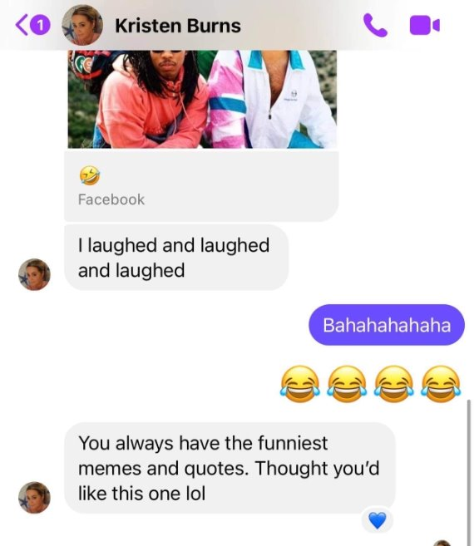
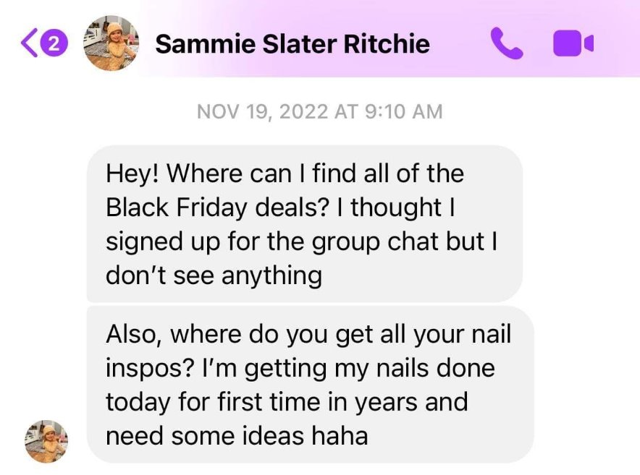
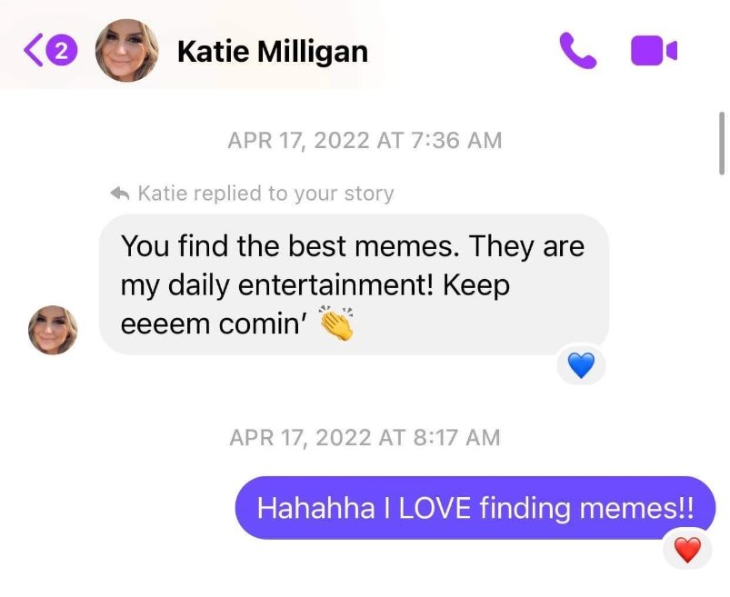
RECRUITING REDEFINED
What are your brand segments? What makes people think of you? What keeps you at the forefront of their minds?
Notes:
You will know you are doing this right when you kind of put yourself in a box and this is where you need to be so set on using social media as a business tool. Every way I show up is thought out with connection and value in mind. I do this mostly on Instagram stories - I have figured out what my brand segments are – starbucks, nails, memes, being awkward and I have made that my entire personality. People are going to start to think about you during the day and they are going to start to message you about your brand segments. This is value – recommending starbucks drinks, sharing nail ideas making people laugh, being real. Purpose of this is to open the door to conversation – lets you get into the DMs. Conversations about nothing allow people to drop their walls and build connections. Then one day you say, Hey listen I absolutely love talking to you online, we have such good conversation. This might be a bit selfish of me but I just keep thinking of how much fun you and I would have if you were on my team. I don’t even know if you know what I do, but I would love to talk to you about it if you’re open to it.

Slide 9
RECRUITING REDEFINED
Value-Added Content Brainstorm: - 5 Day Skincare Bootcamp - Makeup Bag Refresh - Mom Makeup Hacks -5 Minute Face Masterclass - Mindset + Gratitude Challenge - Drink Your Water Challenge
Notes:
This isn’t something you need to do all the time – maybe once a quarter but it is just another way to provide value that will allow you to funnel into your storefront from your personal platforms. Drink Your Water example – promote on community groups where avatar hangs out, persona page, stories etc, can personally invite people. This is twofold – do it in storefront so nurtures current leads who participates, caters to new leads. Can also go one step further and DM participants and build relationships.

Slide 10
RECRUITING REDEFINED
Moving leads out of the “Friend Zone” + through your funnel:
-The commercial method
-Automating the process
-Be in it for the long haul
Notes:
The commercial method – you are the show, senegence is your commercial. If they like the show they will stay for the commercials.
Automating the process- how often are you talking about the opportunity and you automate that? Automating this allows me to talk about my business opp on my billboard platforms 1x per week. Film evergreen at beginning of month, save and repost every week. Redo every month. - Be in it for the long haul – nothing worth having comes easy. It will take as long as it takes, I am not going anywhere.

Slide 11
RECRUITING REDEFINED
Overcoming Objections:
“An objection is not a rejection;
It is simply a request for more information.”
Notes:
In recruiting my job is not to get them to a yes, its to provide them enough information to make an informed decision.

Slide 12
RECRUITING REDEFINED
Use your content to break down objections:
-Debunk business myths daily with the way you present content online.
-Know your audience and their pain points
Notes:
Using content to break down objections, warms up leads for us. Can do this in written post, reel, live video, stories etc. This is where knowing your audience and pain point really comes into play. Cycle through prompts In different formats.

Slide 13
RECRUITING REDEFINED
Action Step: Make a master list of your audience avatar’s objections and the solutions to those objections
Notes:
If you can make a list of 20 objections = and each week you break down one, that is 4 months of content.

Slide 14
RECRUITING REDEFINED
Examples of objections:
-I’m not a sales person
-I don’t have the start up money
-I’m too busy to add to my plate
-my friends won’t shop with me
-I failed in direct sales before
-I’m shy
-I need to think about it
Notes:
Im not a sales person – share stories of your team or peers - I don’t have the money – try before you buy program - too busy – show people a day in the life, show them nooks and crannies – fb scheduler example. -

Slide 15
RECRUITING REDEFINED
Examples for content creation:
-Nooks and crannies
-Day in the life
-Perks of your business
-Access to resources
-Daily wins

Slide 16
RECRUITING REDEFINED
Bonus Tip:
Not everyone joins for the money. Always go back to your audience avatar and make sure you are showing all positive perks of joining your business!

Slide 17
RECRUITING REDEFINED
A Moment on Mindset:
-There will never be the right time
-People are waiting to join you now as you are
-Give yourself the permission for this to take as long as it takes
-If you wouldn’t say it in person, don’t do it online
ays go back to your audience avatar and make sure you are showing all positive perks of joining your business!

