Slide 1

Lauren Tukuafu

Slide 2

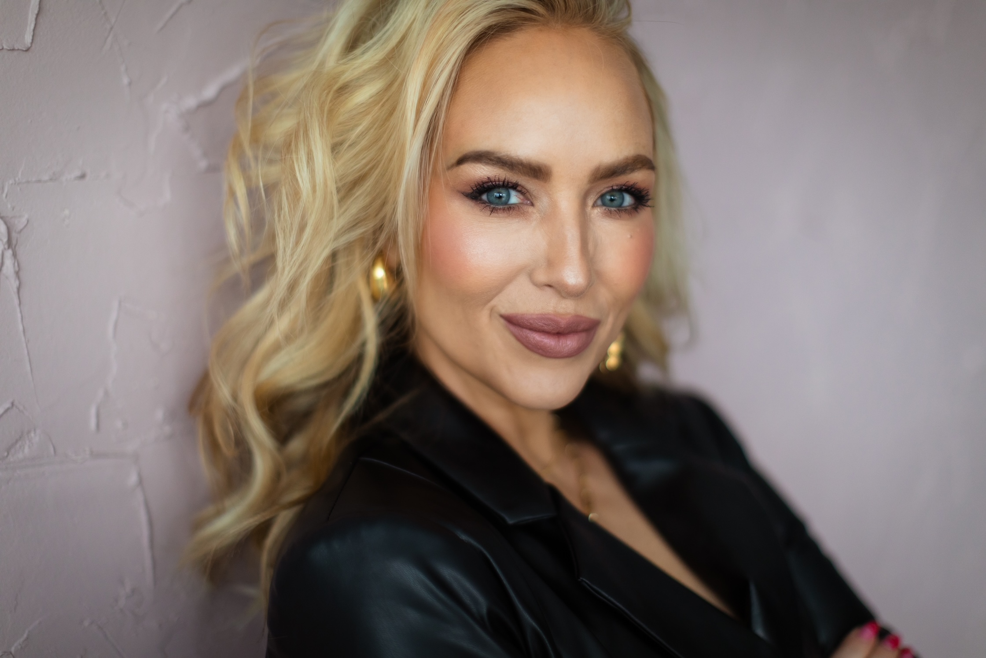
Making Sales Through Instagram Stories and Reels

Slide 3

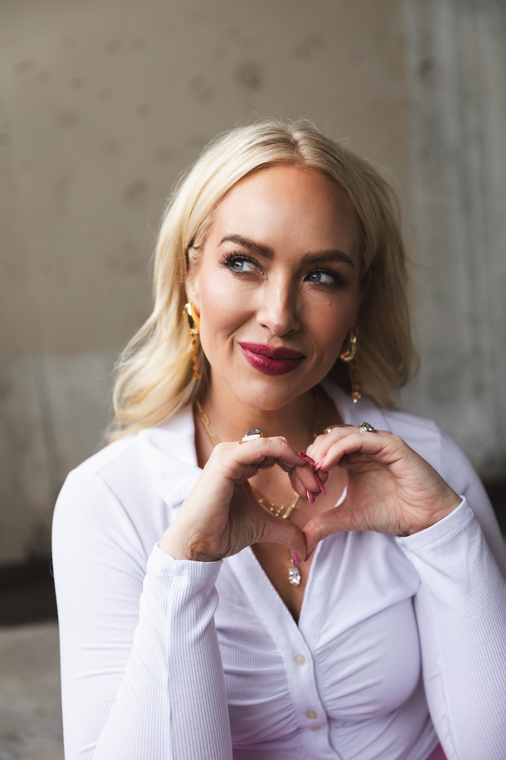
-Every customer has to go through
the 4 business seasons.-
WHAT IS
YOUR
NURTURING
STYLE?

Slide 4


4 Business Seasons
Visibility
Engagement
Leads
Sales
Take your customer by the hand and lead them.

Slide 5
#1 You can’t skip the work in the
VISIBILITY SEASON
This is where people become aware of you.
UNKNOWN ——TO KNOWN

Slide 6

HOW DO WE BECOME MORE VISIBLE?
-tag local businesses to get re-shared
(not other SheerSense Distributors)
-become a source of VALUE
-collaborate with other creators/businesses
that compliment your business
(not competing products obvi)

Slide 7

What are your 4 buckets?
What
Makes
You
Interesting?

Slide 8
#2 Engagement
Ask your audience to take action!
Think of it like early dating!
You wouldn’t expect to get married after the first date!

Slide 9
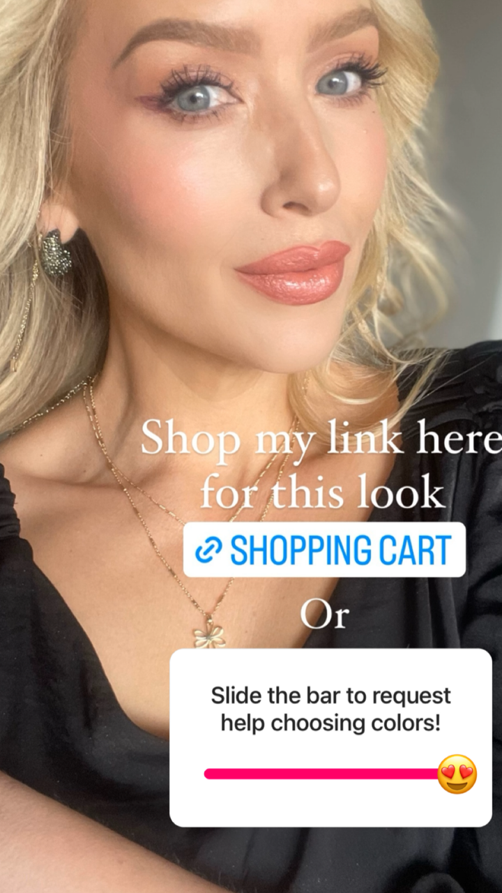
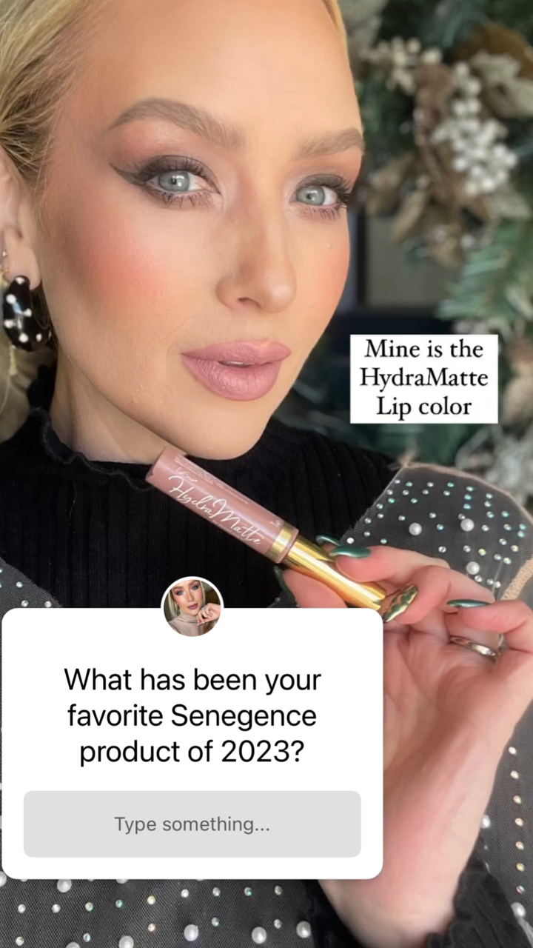
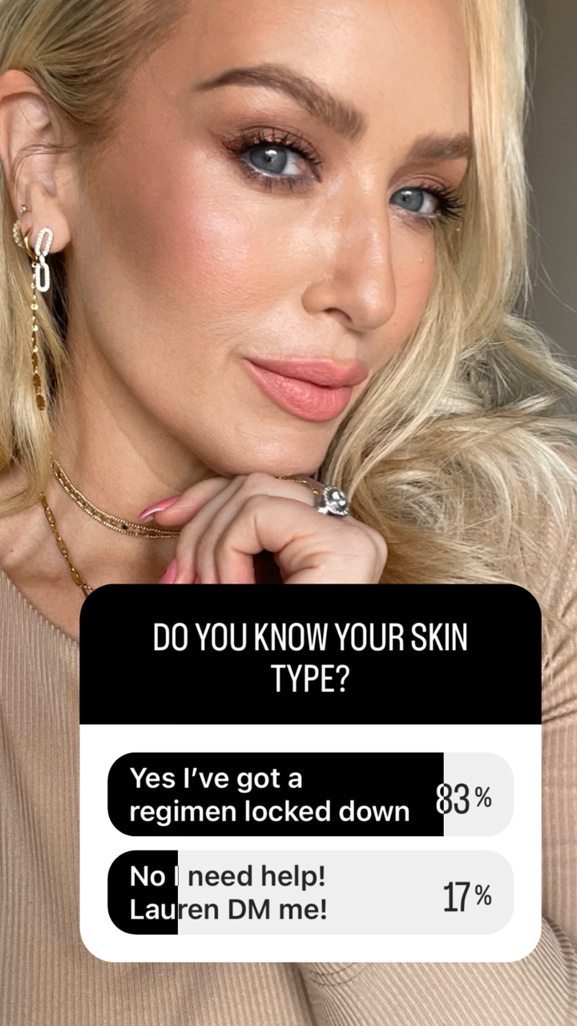


Slide 10
#3 Identify your leads
Know the difference between a
COLD LEAD
WARM LEAD
HOT LEAD

Slide 11
COLD LEAD - those who have shown little or no
interest, they may not know you exist. They don’t other the difference between SheerSense and other brands.
WARM LEAD - they know about you and your products,
But it’s not a priority right now. They may be researching alternatives.
HOT LEADS - they are motivated buyers who are ready to chose
A product that fits their needs. Any new product that comes out,
They are in!!!

Slide 12
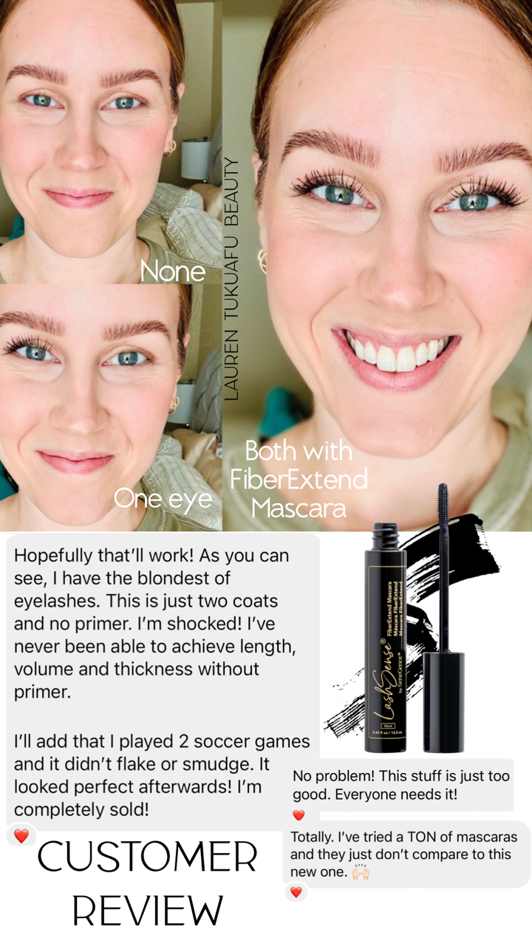

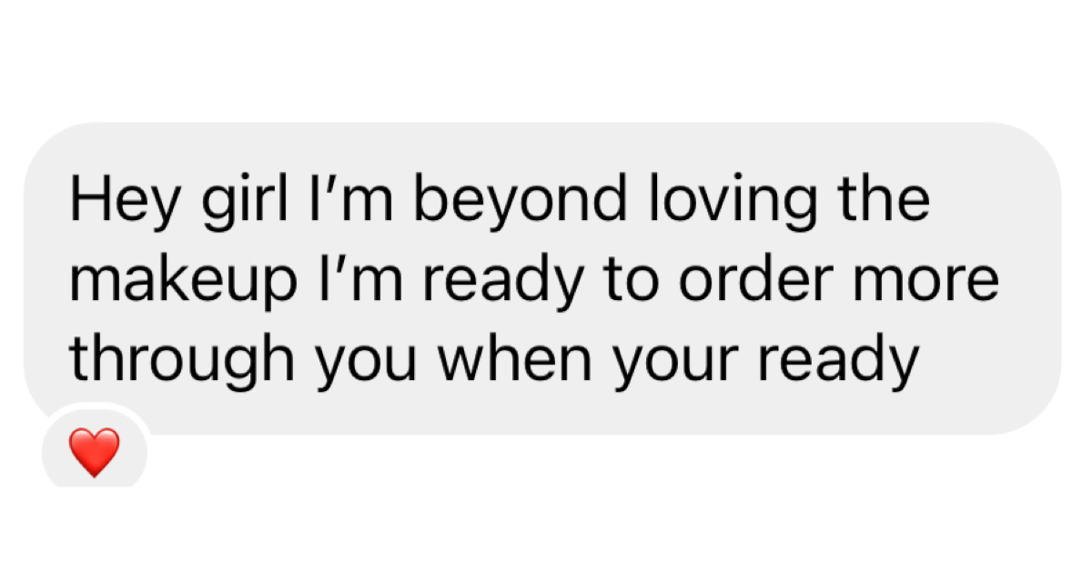
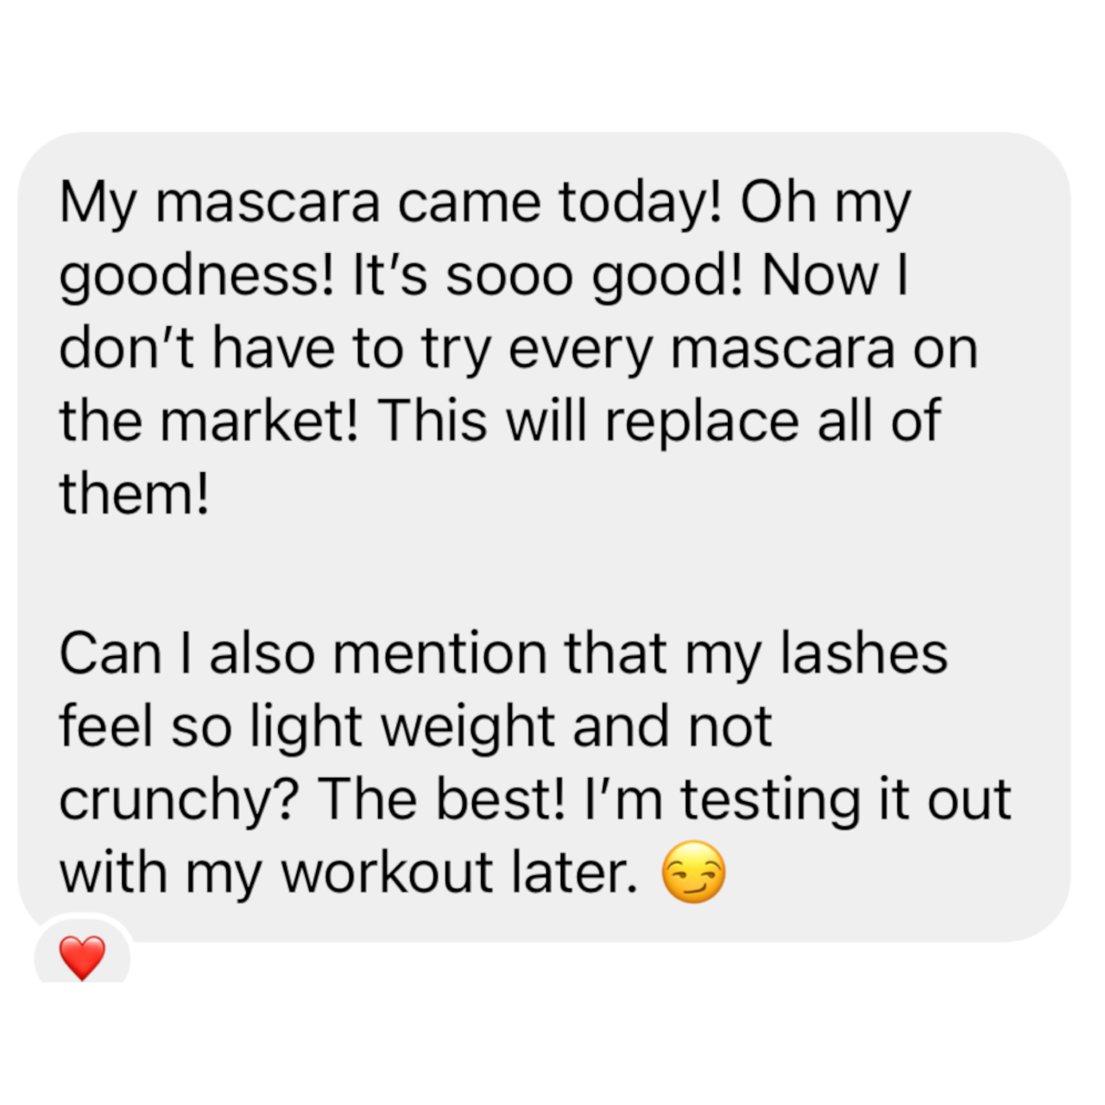
Always ask
Your
HOT LEADS
For testimonials!

Slide 13
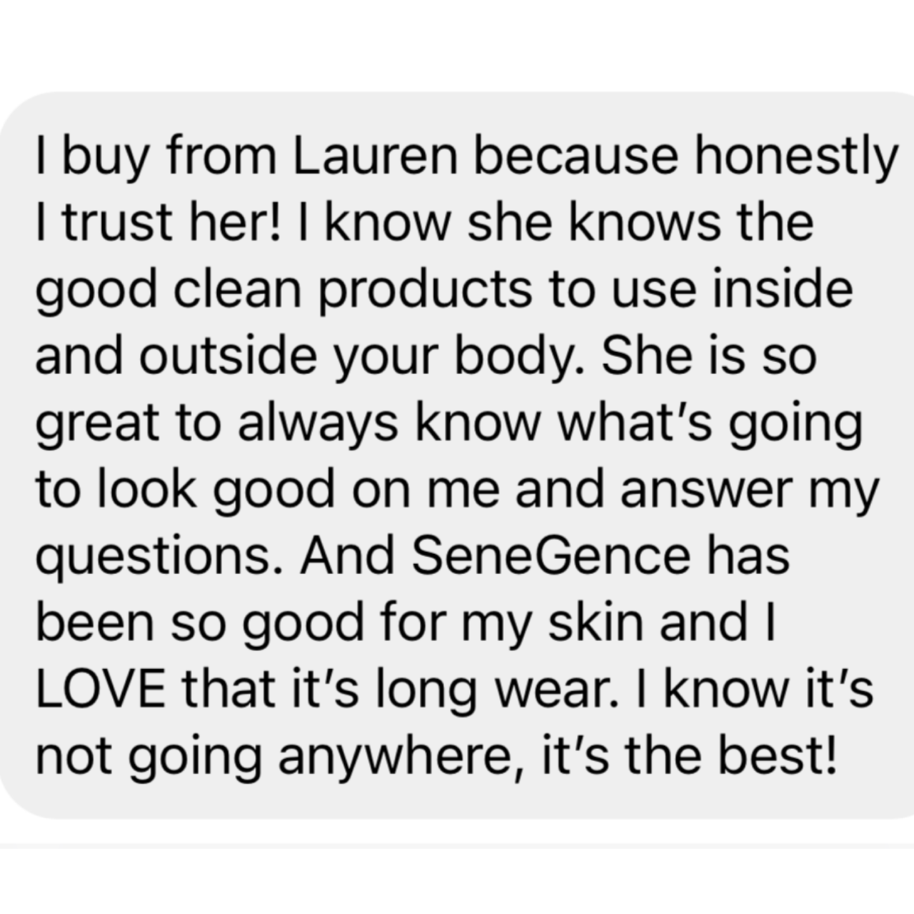
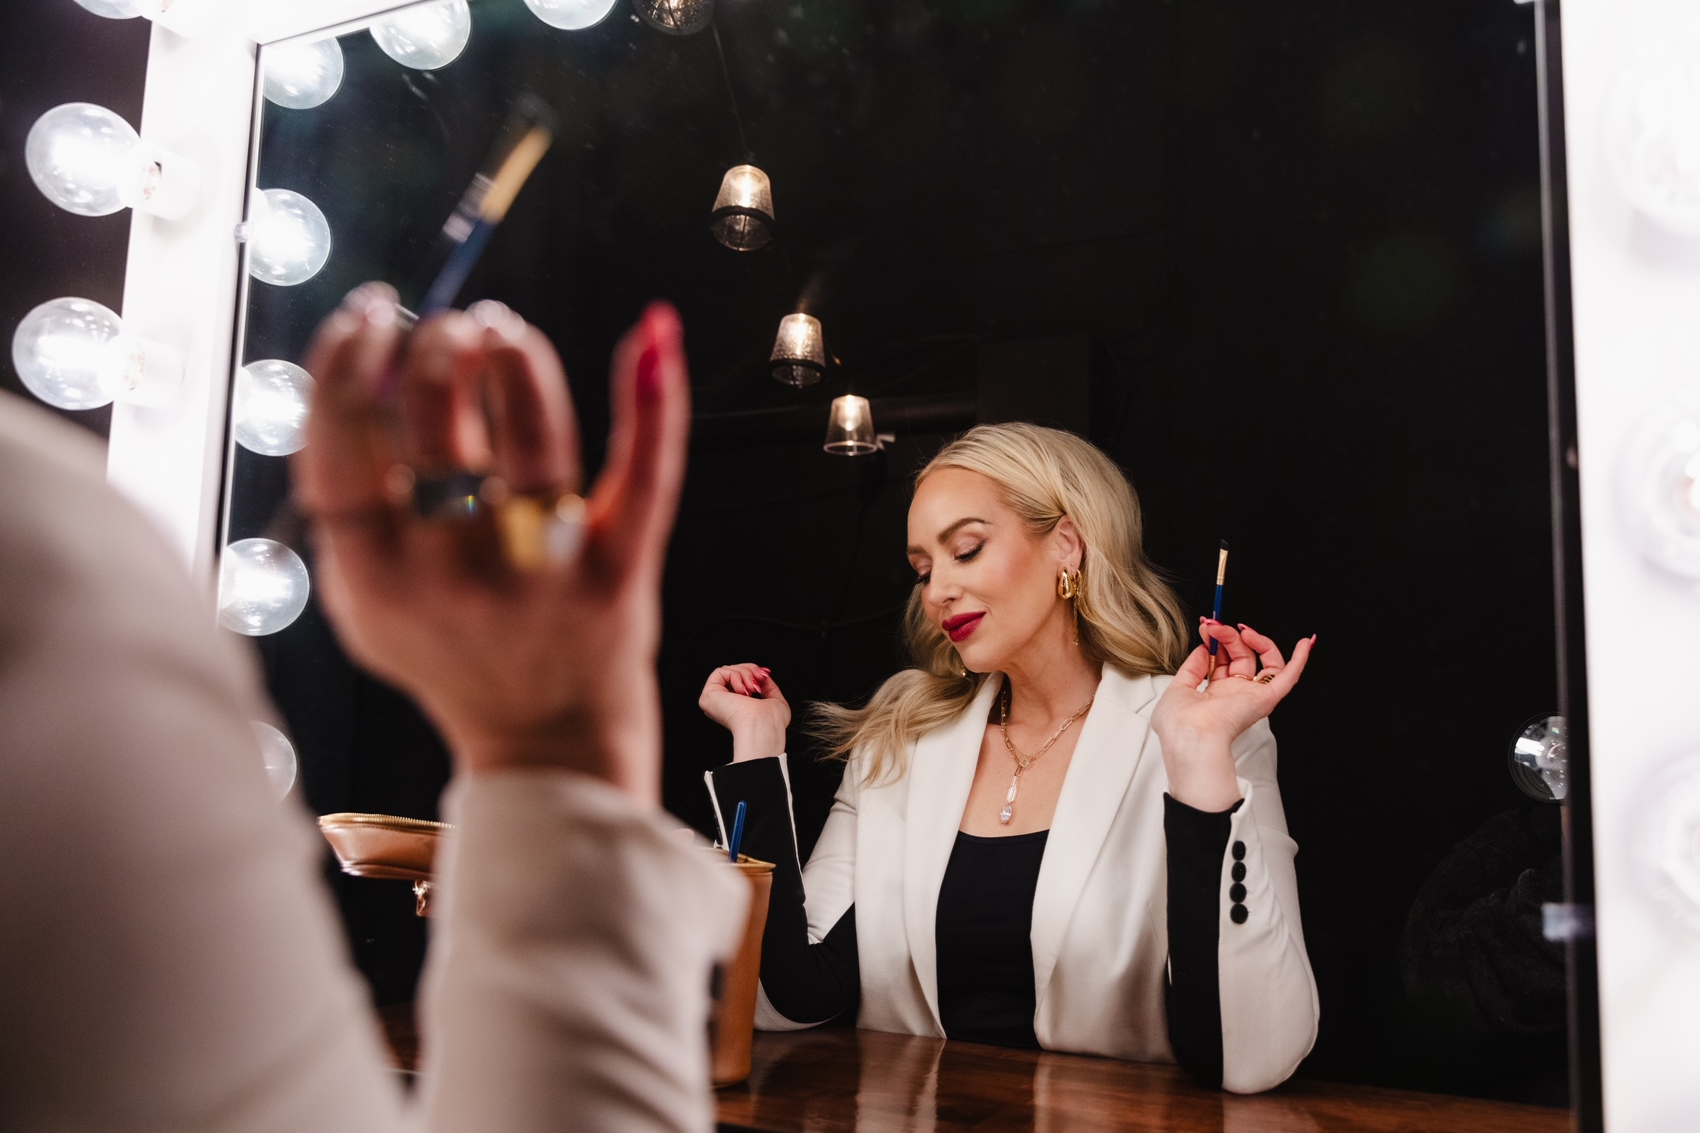
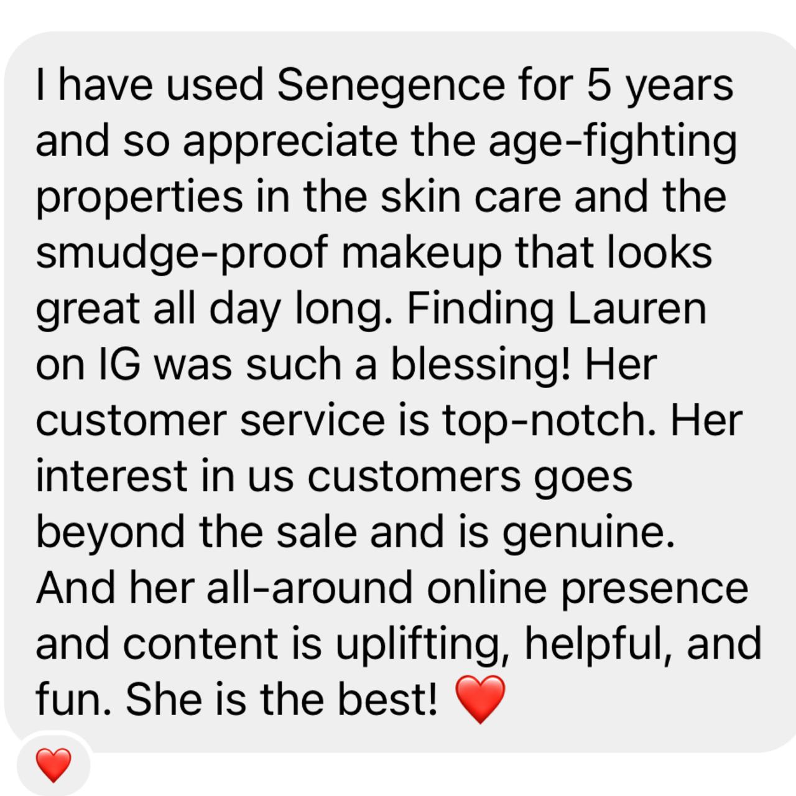

Slide 14
#4 Close the sale
People buy from
you because
you have the
SOLUTIONS!

Slide 15
2 Different Styles of SALES
TRANSACTIONAL:
-only talking about prices and sales
-only talking to people when they show
interest in buying
-bare minimum interaction
-no relationship
-regular customer service
TRANSFORMATIONAL:
-genuinely want to help and serve
-providing tips and solutions
-offer free advice/free value
-provide a customer experience
-go beyond the norm

Slide 16
Once you get this process down,
selling in REELS will become natural.
(Reels are also a great way to increase
visibility and awareness!)

Slide 17
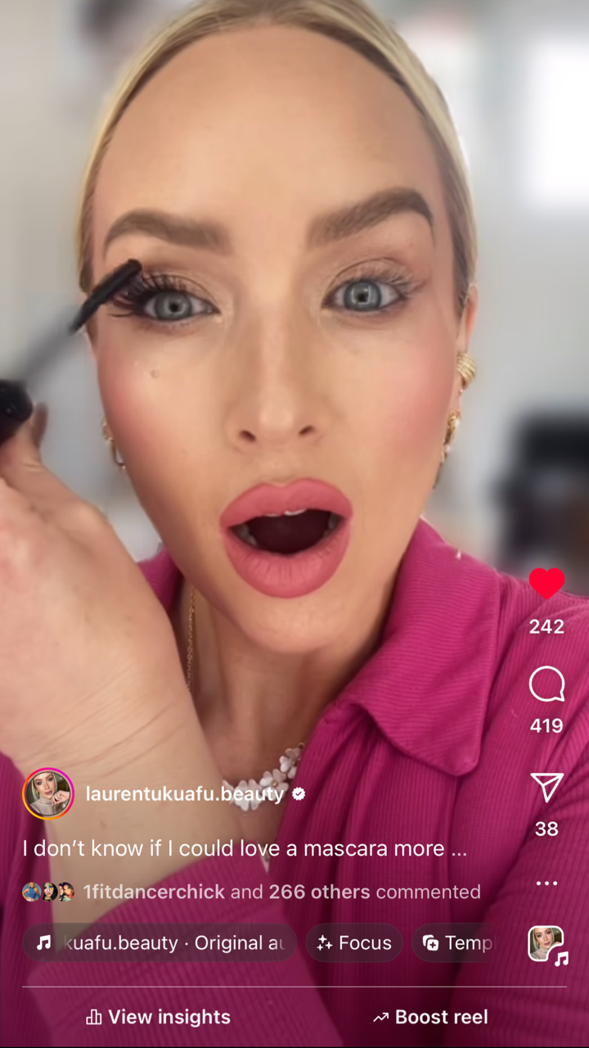
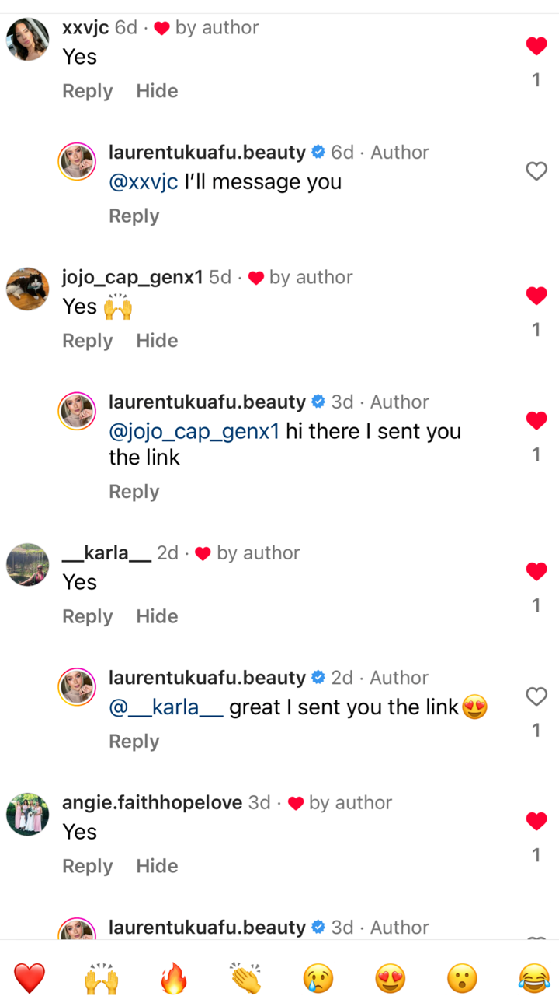
How To Monetize Reels
-create a catchy opener
-showcase the products packaging and features
-what problem does it solve?
-apply it / demo
-show one side without
-always make your offer and a CTA
with a KEY WORD in comments
-send link to all who comment
Comment the word “YES” and I’ll
send you the link for the duo!

Slide 18

My MantraS Each Day:
People want what I have.
What I do makes an impact.
The best is yet to come.
I am exactly where I should be.

