Slide 1
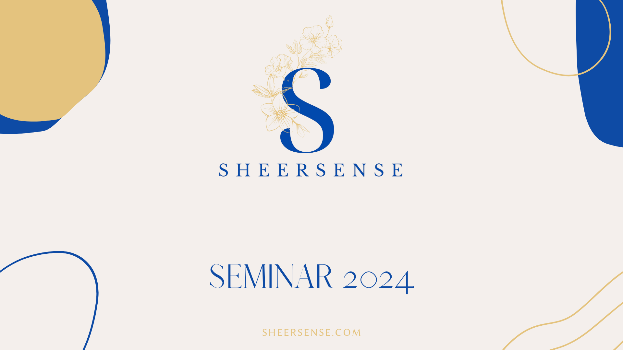

Slide 2

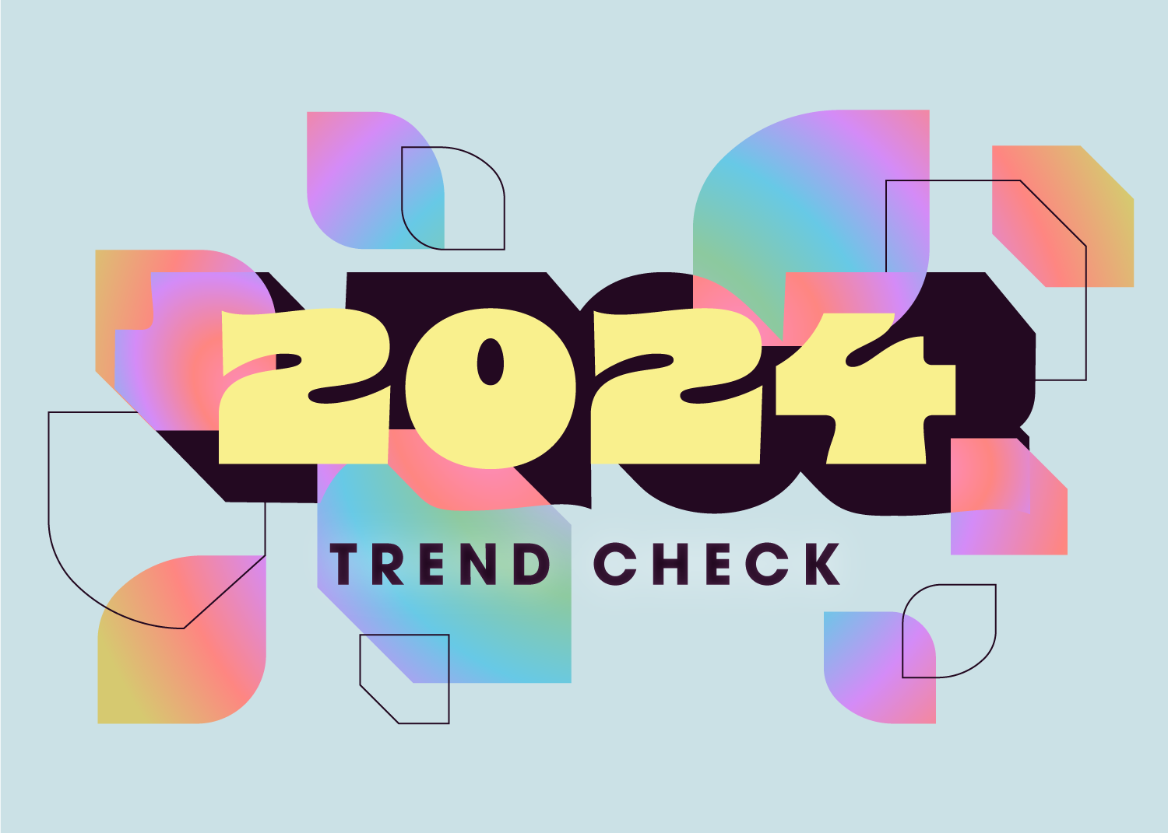
MUST KNOW TRENDS FOR 2024
A note on trends before we start.
Notes:
I will say, I feel trends are subjective. They can be specific to platforms, and can change quickly. However, I do feel confident in the trends I am going to share with you today. One point I do want to make about trends before we start is that I feel like we can get into the trap of using trends as excuses. We “can’t keep up,” or just “can’t get the algorithm to work”, or frankly spend too much looking at what other people are doing to try and figure out the trends. Do I think understanding trends, our industry and the platforms we rely on to make sales, recruit and grow our business is helpful? For sure. But do not give too much credit to trends as the determining factor in our success or failure, when really we have so much control over our businesses.

Slide 3
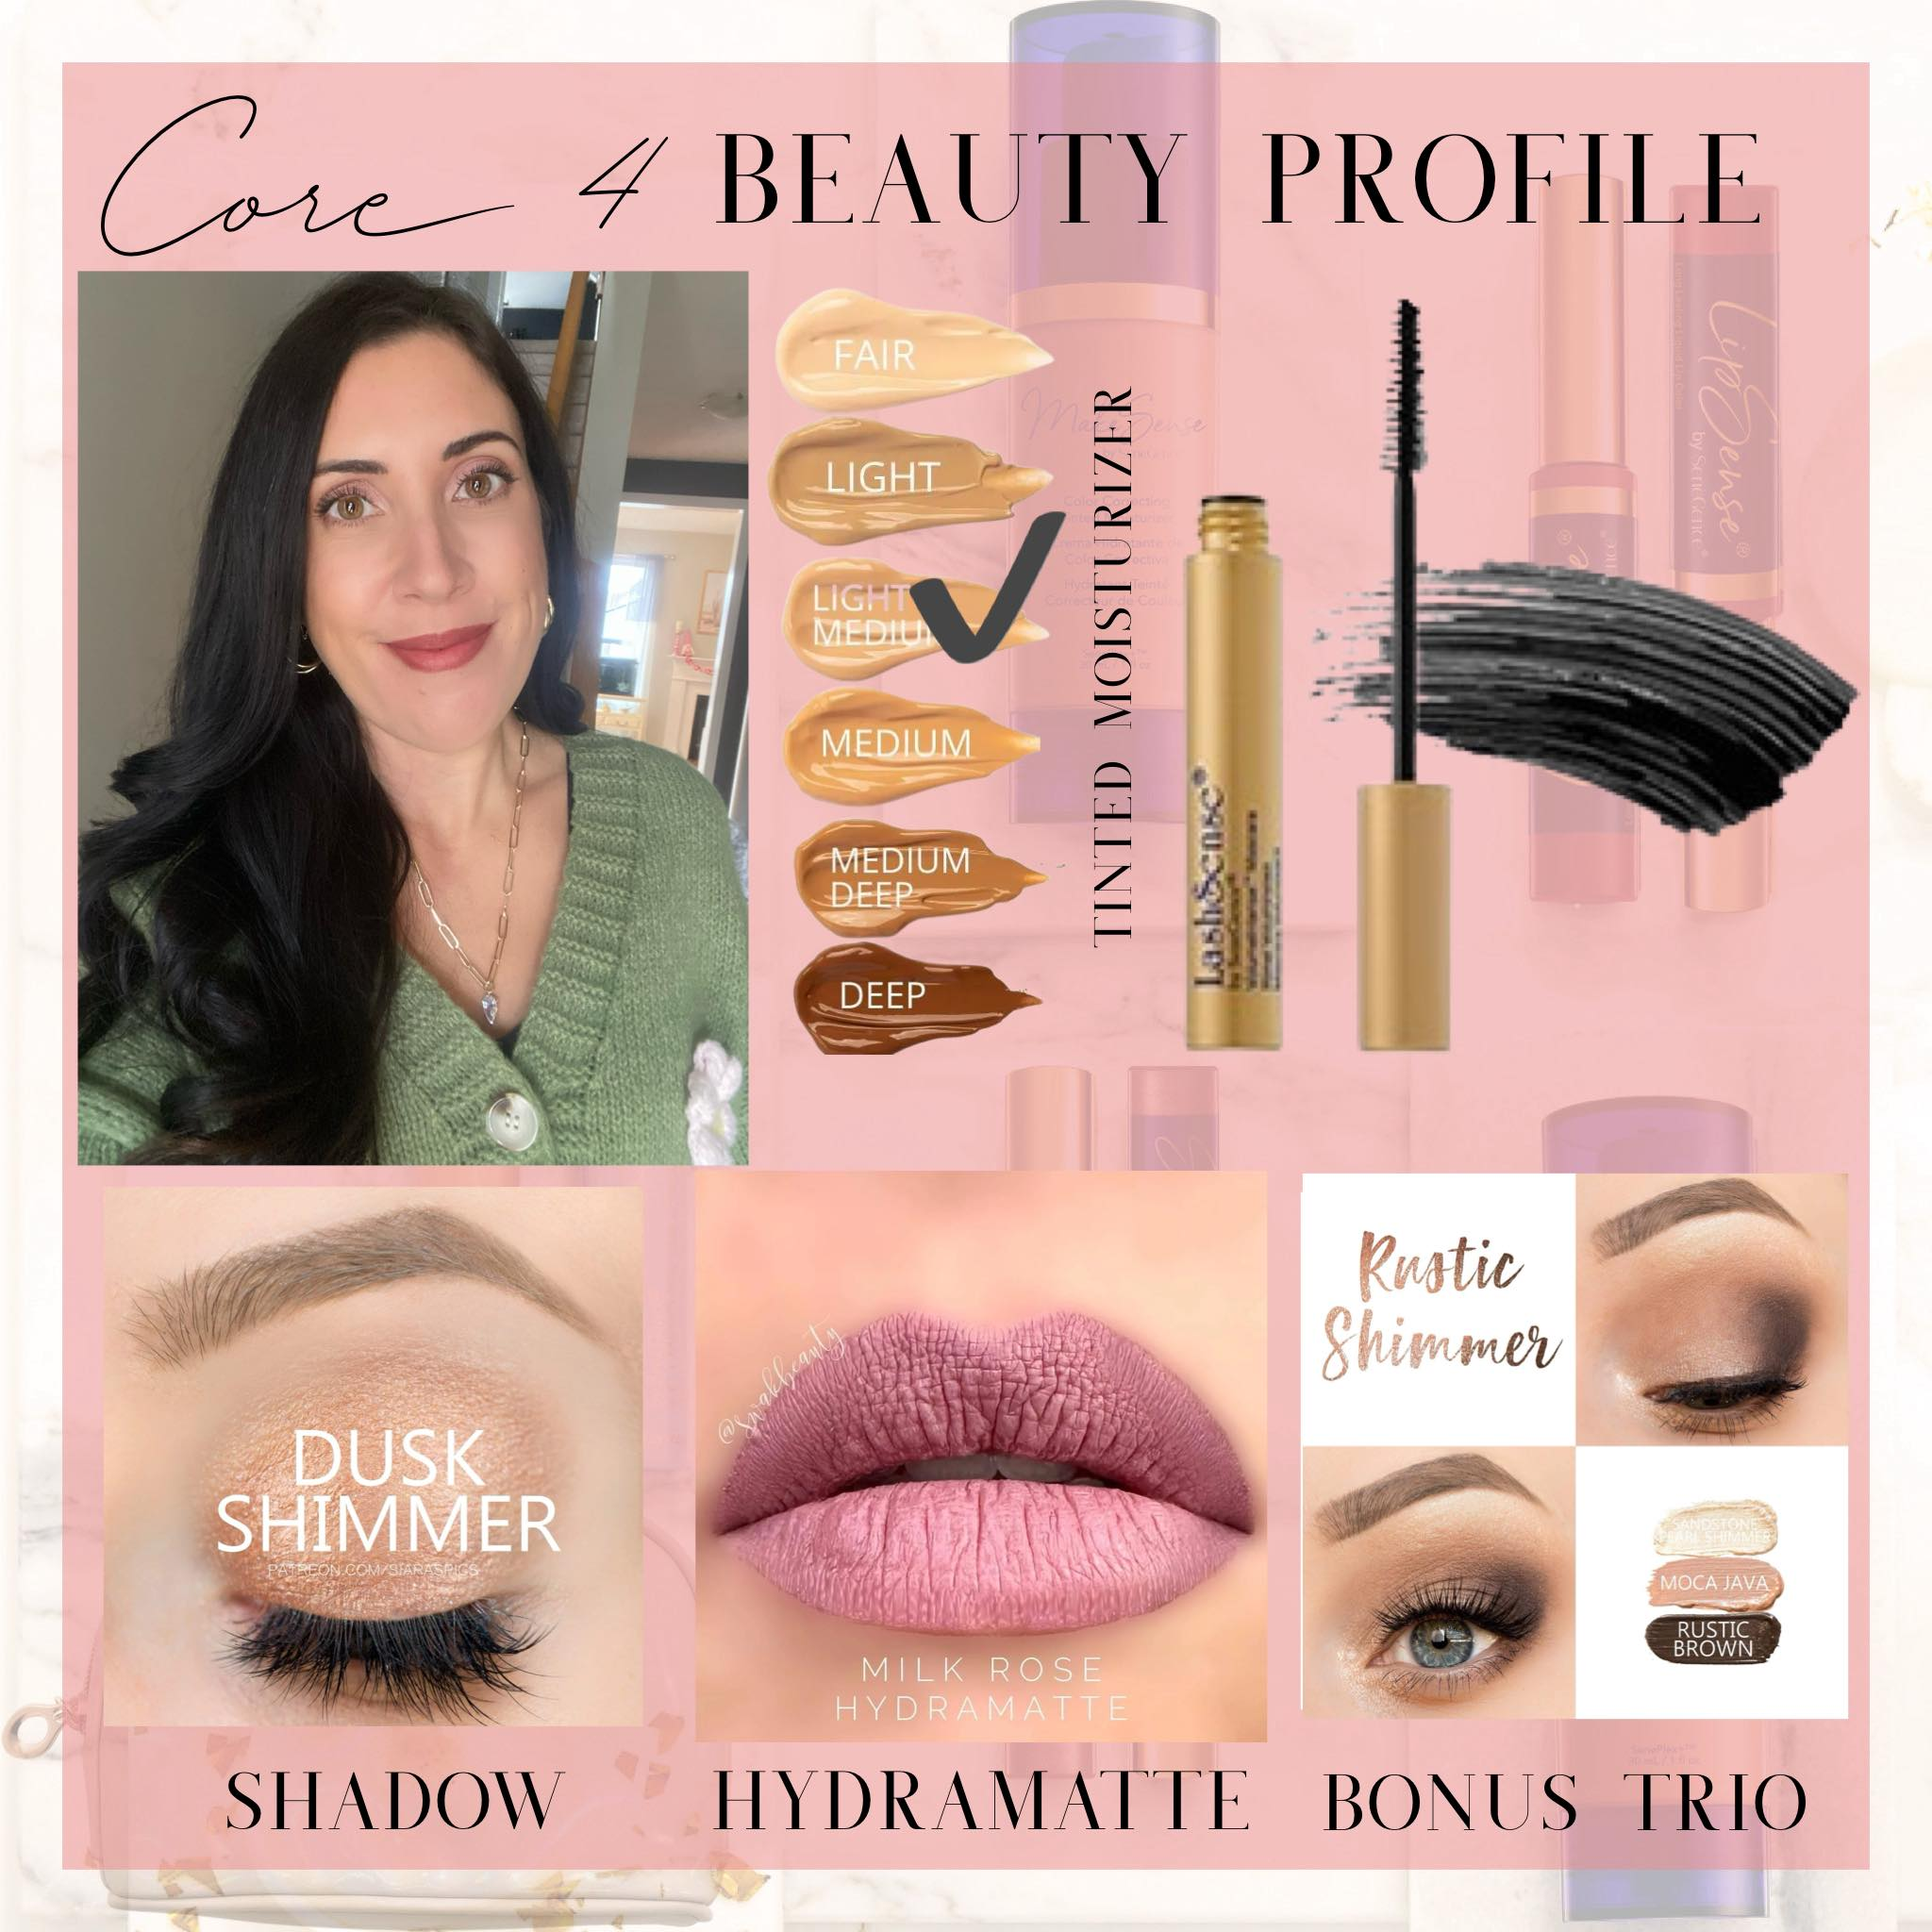

TREND#1: Have a Signature Offering
- Create a signature bundle that you feel confident selling consistently - make it a regular part of your content, parties, in person makeovers
Notes:
What is a signature offering? A signature offering is a bundle that you lead for your new customers. It allows you to speak with confidence and authority and lets you get confident in these specific products and shade recommendations. This is something you can lead and build off and make part of your brand. We are very lucky with SeneGence that our products are good, and there are a lot of them. It can be intimidating when you are introducing someone to SeneGence to know where to start and this is where your signature offering comes in. “SeneGence is a company that specializes in clean beauty and beauty that lasts. Where I like to start people off is with our Core 4. This is going to give you a well-rounded experience with our products and is my most popular offering.” You are doing a couple things with that wording – taking the confusion out of it, speaking with authority, and playing up FOMO. The other nice thing about having a bundle offering is your average spend now goes up and depending on the bundle encourages refill orders. For example, I use a Core 4. The name Core 4 or the concept is not mine, I cannot take credit for it and what I include in this bundle has shifted over the years but this is always where I start. My Core 4 bundle is a tinted moisturizer, one shadow, hydramatte and a mascara. This gives a new customer a 5 minute face and a well rounded sense of our products.

Slide 4
TREND#1: Have a Signature Offering
HOW TO IMPLEMENT THIS TREND - create your signature offering (5 minute face, lips + lashes duo, mom’s makeup bag, skincare sampler, etc.) - create an instructional video that can be saved as a reel, highlight bubble or video in your beauty group. - share your bundle weekly in your group and stories - create content around your offering like a party template, mini workshop or makeover lesson/in home demo
Notes:
How to implement this trend – create your own offering based on your audience and their needs. My customer base is large, but my offering hits both my audience and the bulk of my customer base as well. (Example Home party) Your signature offering can be something you make a part of your regular content. You could create a reel, a highlight bubble, a video tutorial in your beauty group, I have built a party template around it. When I have new people join my group, interested in products they get a custom beauty profile with their core 4 recommendations on it.

Slide 5
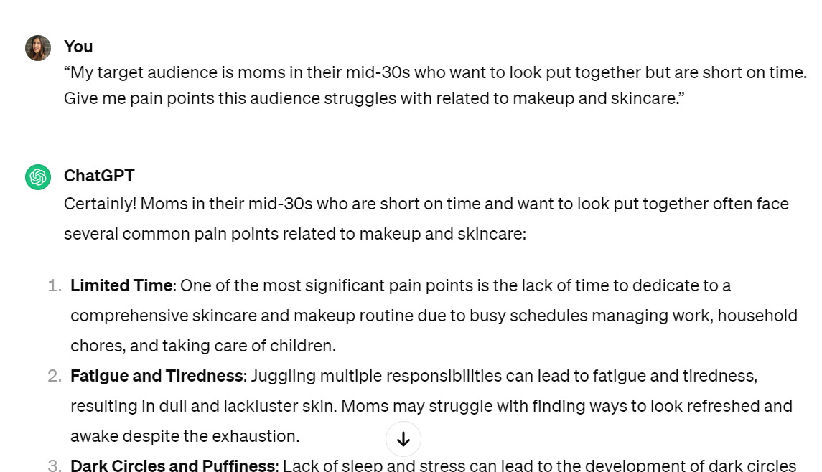
TREND#2: The Power of AI
https://chat.openai.com/
Things to note with AI: - the more specific, the better. - AI might not get it right the first time. - use AI as a starting point, but always proofread/add the human component back in.
Notes:
Joni always says, “if it doesn’t take your personality, outsource it” and we can get AI to help us with some of the aspects of our business that don’t take our personality. AI is honestly a great tool, when used correctly, to do some of the heavy lifting for us and also provide creative inspiration. I have used AI to help me with things like writing Instagram captions and facebook posts, giving me ideas for live video topics and content creation and helping me understand my target audience and their needs.

Slide 6
TREND#2: The Power of AI
HOW TO IMPLEMENT THIS TREND 1️. Topic ideas for posts, reels or live videos WHAT I ASK AI: “My target audience is moms in their mid-30s who want to look put together but are short on time. Give me pain points this audience struggles with related to makeup and skincare.” 2. Live video prompts WHAT I ASK AI: “My target audience is women in their mid 30s with children. What are 20 eye catching live video topics surrounding makeup and skincare that would stop their scroll.”

Slide 7
TREND#2: The Power of AI
3. Thematic Content: WHAT I ASK AI: “I do a motivational Monday Facebook post every week. Give me 52 short motivational posts I can use. Please surround them around self love, beauty, makeup and being a woman” 4. Education: WHAT I ASK AI: “I am writing a post on Facebook about the benefits of using a lash primer. Please write me a 200 word post about this topic. Include 3 examples of why a lash primer is beneficial.”

Slide 8
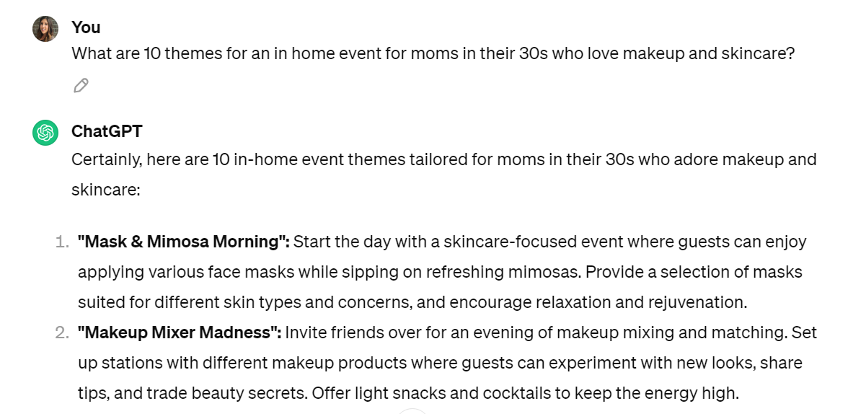
TREND#2: The Power of AI
5. In Home Parties + Workshops: WHAT I ASK AI: “What are 10 themes for an in home event for moms in their 30s who love makeup and skincare?”

Slide 9
TREND#3: User Generated Content
1) When was the last time you bought something because a celebrity bought it? 2) When was the last time you bought something because a friend recommended it to you or you saw someone you follow on social media recommend it? What is user-generated content? It’s original, brand-specific content created by customers and brand loyalists that is published on social media. This can be from people like micro influencers who are paid for this content, but it is also as simple as your friend posting about the last book she bought, or where she got her new travel backpack.
Notes:
Gone are the days of celebrity endorsements. Most purchases come from user generated content. User-generated content is original, brand-specific content created by customers and brand loyalists that is published on social media. This can be from people like micro influencers who are paid for this content, but it is also as simple as your friend posting about the last book she bought, or where she got her new travel backpack.

Slide 10
TREND#3: User Generated Content
“PEOPLE do business with PEOPLE they like, know and trust” - Short form video (reels, Tik Tok, stories, short live or prerecorded content) is king. -For 2024, Forbes states that short form video is the #1 most engaging and consumed form of media.
80% of people surveyed by Forbes said authenticity determines purchasing decisions, not celebrity. -Selling with a story (your story), is what is in and you need to be the face of your business.
Notes:
The old adage “people do business with people they like, know and trust” still rings true even moreso in 2024. What is the most highly consumed and engaging content – short form video, reels, stories, tik toks….of people like you and I (“talking head” videos). The theme here: people showing their faces. For 2024, Forbes states that short form video is the #1 most engaging and consumed form of media and on top of that 80% of people surveyed by Forbes said authenticity is the determining factor in purchasing decisions, not celebrity.
This is the year that, if you haven’t already, you are shifting the focus to putting the spotlight on YOU and your experiences. Selling with a story (your story), is what is in.

Slide 11

TREND#3: User Generated Content
Are you playing the role of the pharmacist or patient?
HOW TO IMPLEMENT THIS TREND: - make a list of ways SeneGence products have benefitted you (do this for the business too!) and see if you can start to share more stories, instead of just information or education.
Notes:
Let me share an analogy: You go to the pharmacy to pick up a prescription. There is the pharmacist on one side of the counter and you on the other side. The pharmacist’s job is to dole out your prescription and make sure you know how to use it. You as the patient are there to get the medication to help you with your ailment. I want to ask you Which one are you when you show up on social media – the pharmacist or the patient? When you show up as the pharmacist you are providing content that is solely educational, you’re providing little pills to make the problem go away, which was a really popular way to show up for a long time. The problem with this is that it’s not relatable. You are positioning yourself solely as the expert with the answers to the problems. When you show up as the patient (aka as yourself) you are acknowledging that you don’t have all the answers, but has experienced the pain – that is more powerful. This is being vulnerable and how we can connect over this shared experienced. Then you can share the “medication” that was prescribed to help you overcome that problem.

Slide 12
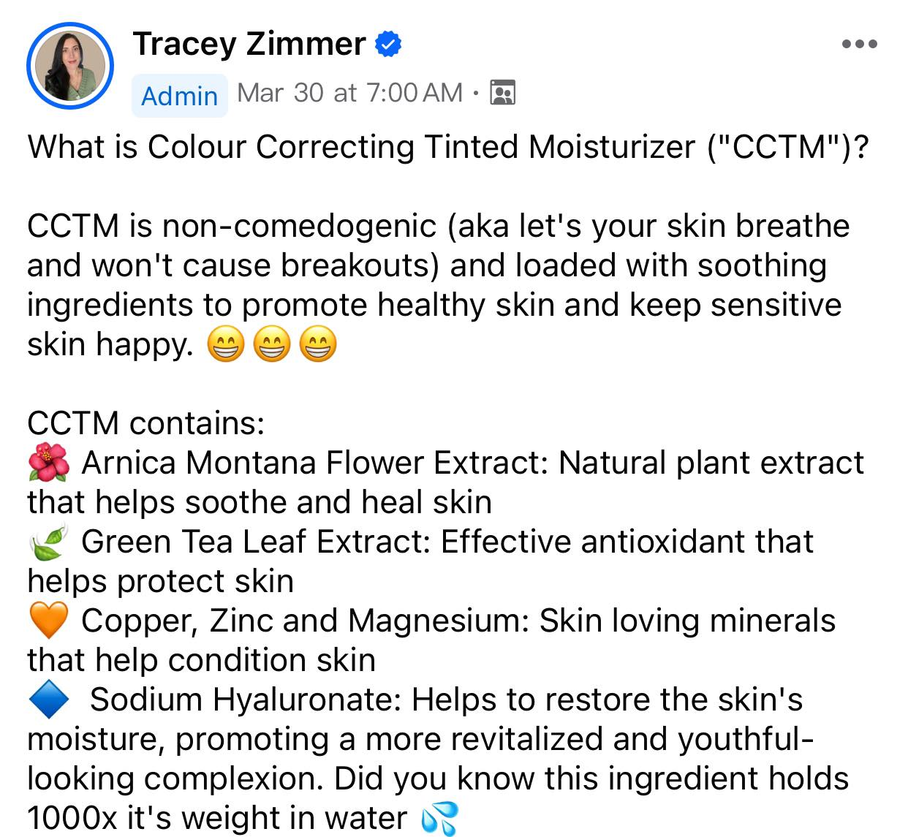
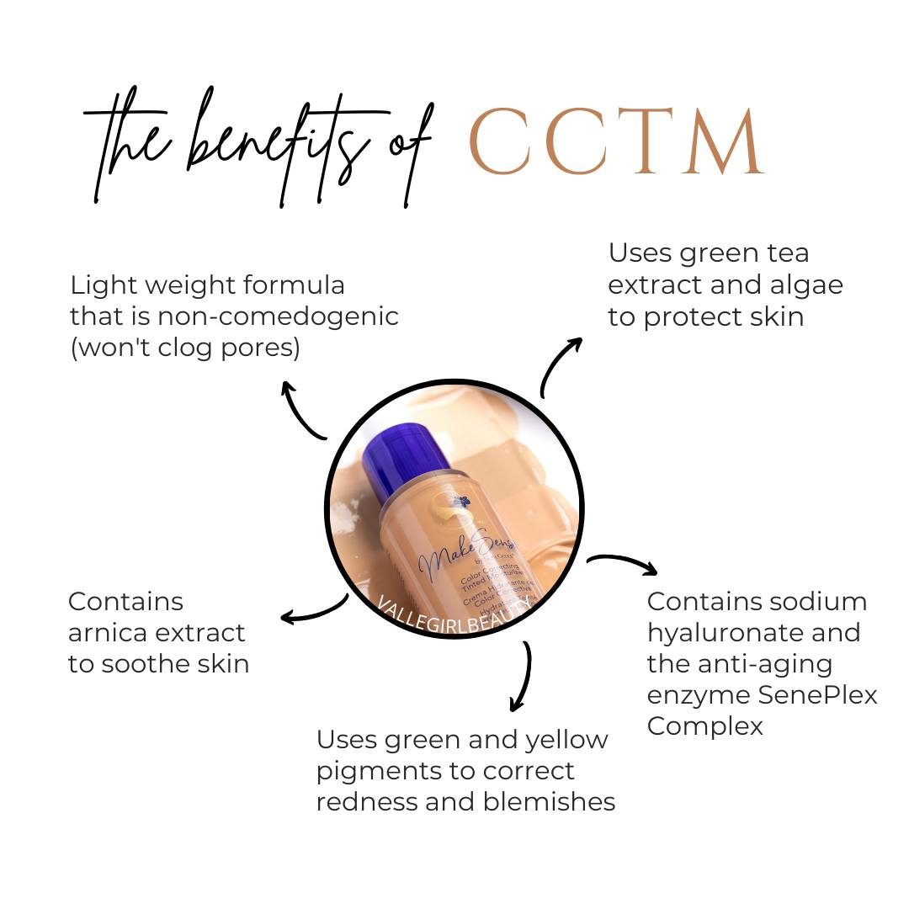
TREND#3: User Generated Content
Pharmacist Post

Slide 13
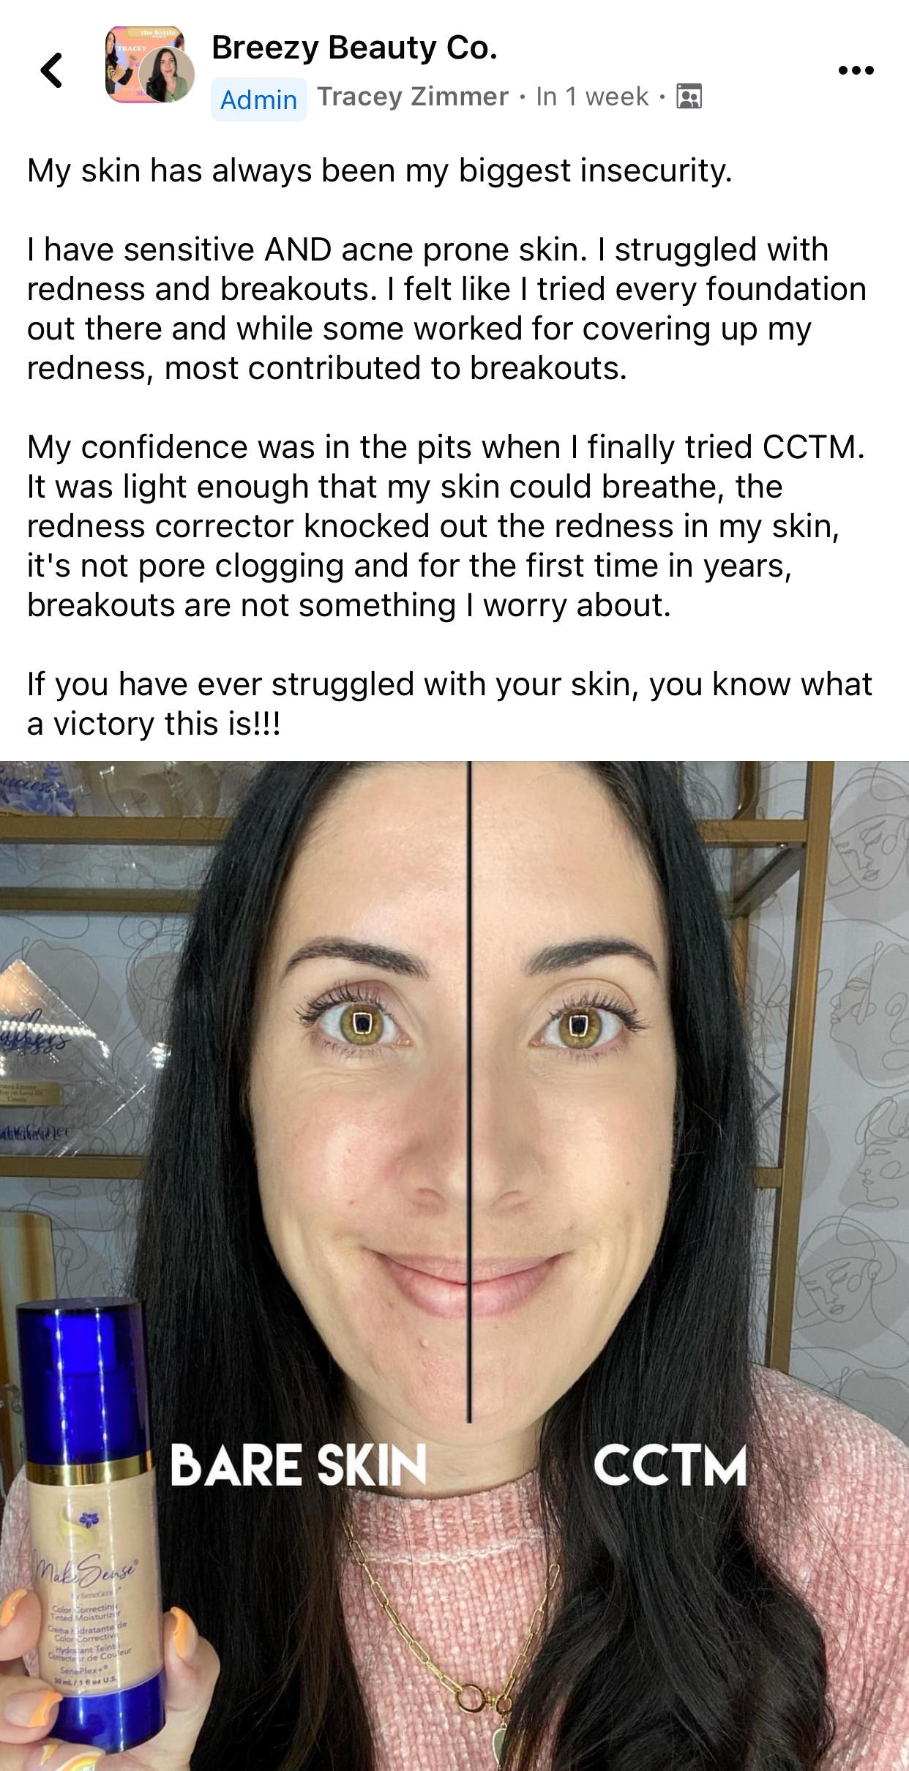
TREND#3: User Generated Content
Patient Post

Slide 14
TREND#3: User Generated Content
HOW TO IMPLEMENT THIS TREND: - make a list of ways SeneGence products have benefitted you (do this for the business too!) and see if you can start to share more stories, instead of just information or education. - in person makeovers, parties or workshops – do you have a collection of stories to share instead of just talking at people with facts? REMEMBER: Stories are a tool to simply and be memorable!

Slide 15
TREND#3: User Generated Content
PEOPLE ARE NOT LOOKING FOR PERMISSION TO FIT IN. THEY ARE LOOKING FOR PERMISSION TO BE THEMSELVES.
Notes:
You showing up as you, with joy and confidence helps give that permission. How you show up and present yourself has a HUGE correlation to sales and sponsoring. Would you join you? Would you buy from you? Do people even know who you are??

Slide 16
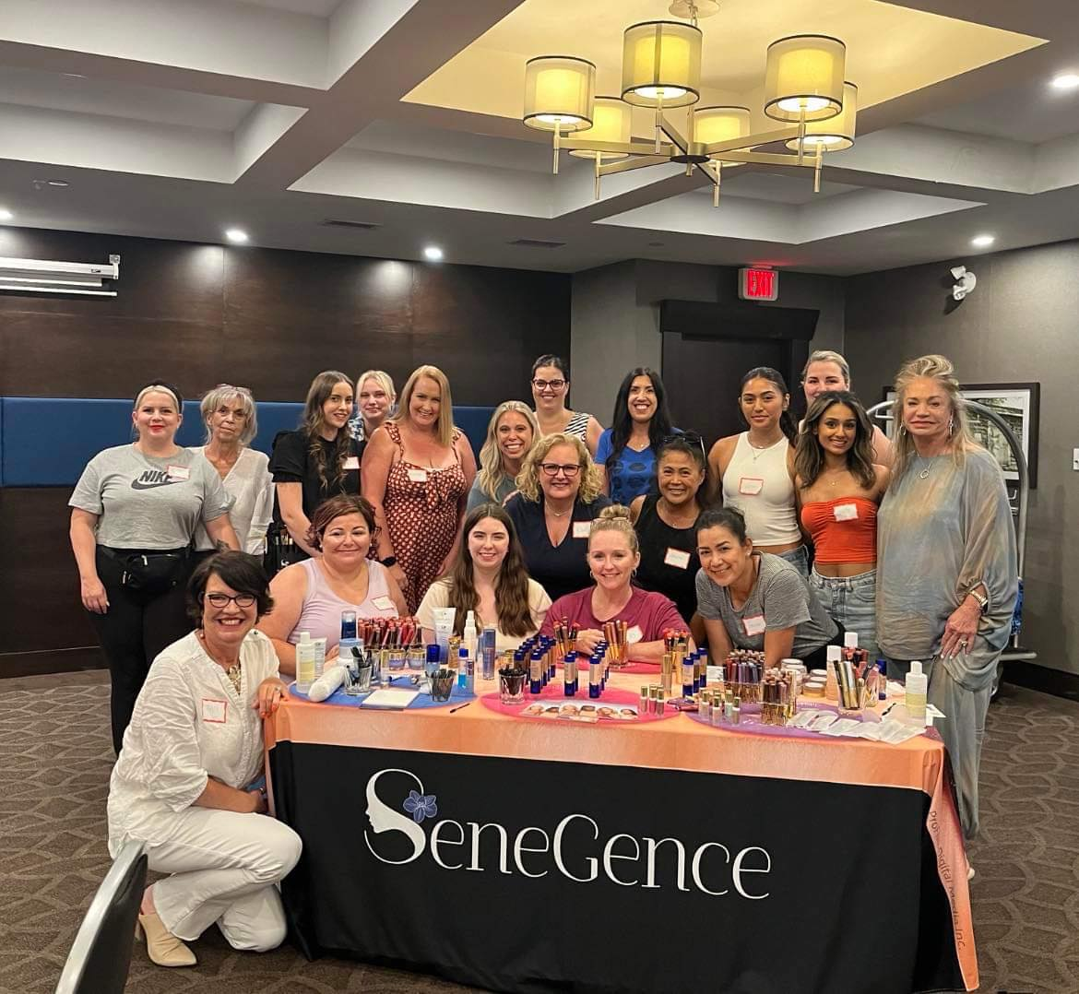
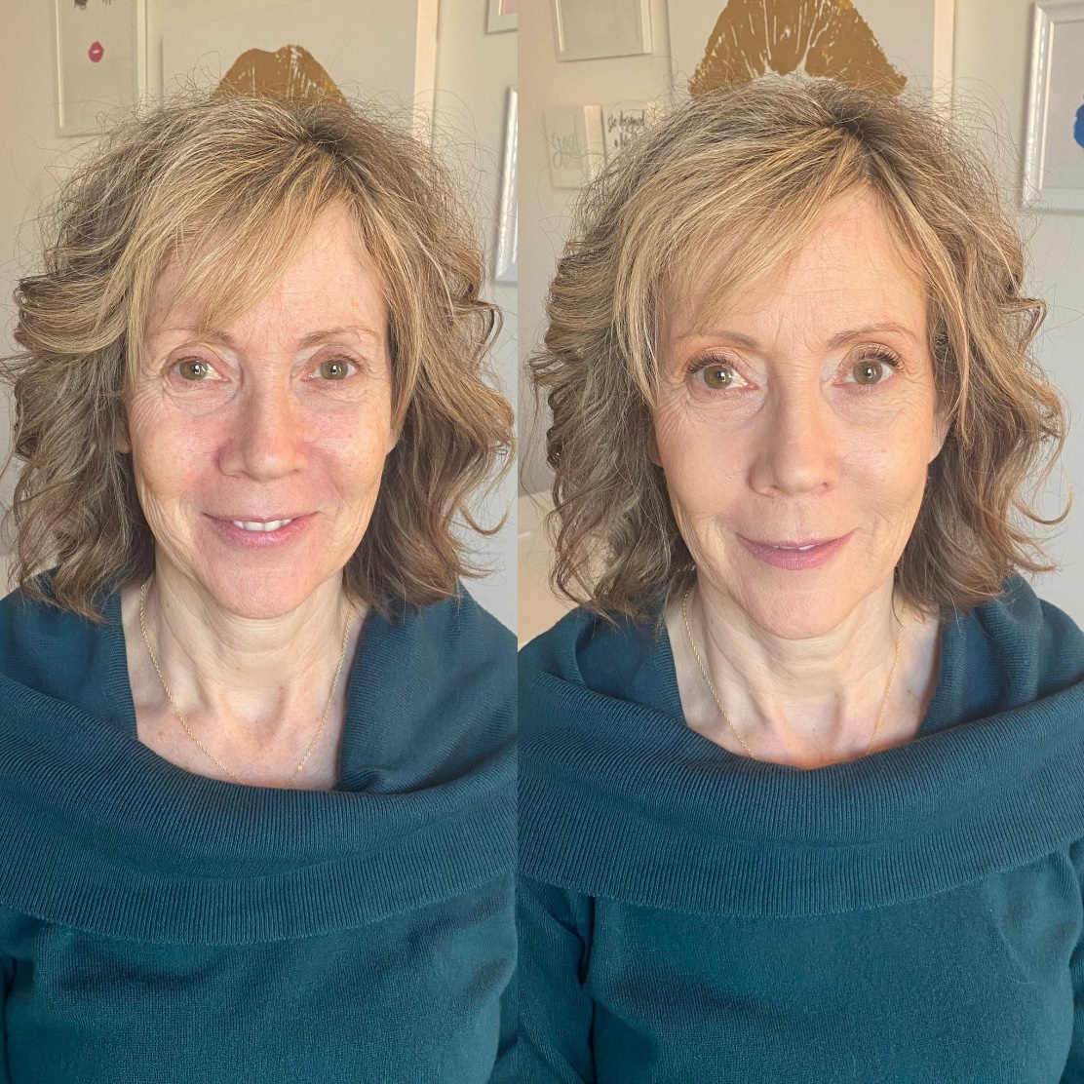
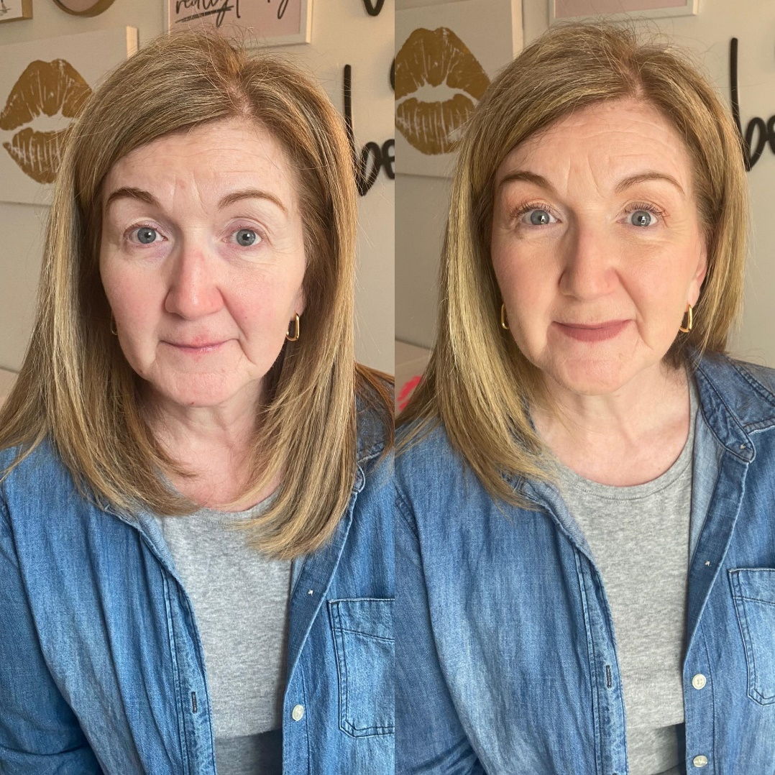
TREND#4: In Person Networking
Team Meet Ups Beautification Programs Mini Workshops Open Houses Networking Events
Sample Drops Where can I go where no one knows me yet?
Notes:
- Team Meet Ups – these do not need to be fancy, can be at someone’s home, a restaurant, coffee shop. Even to meet up and share informal training, work together “power hour,” etc. - Beautification Program – like MUA - Mini Workshops – host mini workshops in your home or collab with another business. - Open Houses – invite customers to shop your stock, have your testers out, have them bring their own products for a mini makeup lesson. - Networking Events – local networking events are great for building connections and getting new business ideas. - sample drops – local businesses, keep in purse to hand out Where can I go where no one knows me yet?

Slide 17
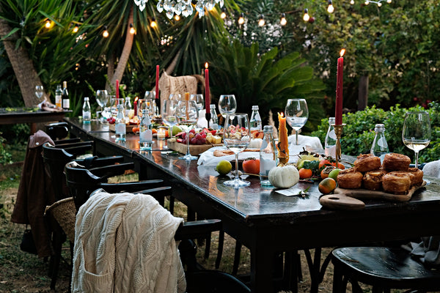
TREND#5: Authentic Relationships
- What kind of host are you being to the guests at your dinner party? ASK YOURSELF: How much time do you spend fostering and growing the relationships with the people who are in your network right now?
Notes:
In 2024, we are going to focus less on who is not there, and more on who is. “Likes,” “follows” and “views,” don’t necessarily equal sales. Yes, these things can help, but while we are chasing a number on a screen, we are forgetting that these metrics do not pay our bills. What are Vanity Metrics? They are data points that good on the surface but do not provide meaningful insights into the performance or success of a business. These metrics often give a false sense of accomplishment or progress because they focus on superficial indicators of success. Example: Total number of social media followers: While having a large following might seem impressive, it doesn't necessarily translate to engaged or loyal customers. Let me share another analogy with you: Imagine hosting this fabulous dinner party and there is a long dining table filled with guests. Where are you? Instead of being present and enjoying conversation with your guests, you’re at the end of the driveway trying to flag down cars to invite in. Your current guests, the ones who showed up, might as well be invisible. Now think of this in terms of your following. You have 100 Instagram followers there consuming your content. They’re like the guests at your table, ready to engage and be part of the experience. Yet, instead of building those connections, you’re fixated on the numbers game looking for your next follow. Focus on who IS at your table and who showed up for the meal. Carve out time in your day to engage and get to know them. ASK YOURSELF: How much time do you spend fostering and growing the relationships with the people who are already there? Don’t get me wrong growing your audience is a relevant and important part of business. We do consistently need to continue to work on filling our funnel and bringing in new business BUT a good chunk of time also needs to be used to nurture your existing leads. When someone says to me, “well I only have 20 people in my beauty group,” or “I only had 7 people in my messenger sale.” WHAT ARE YOU DOING WITH THOSE PEOPLE? How are you nurturing them? Loving on them, getting to know them?? How can we nurture our existing network and build meaningful relationships?

Slide 18
TREND#5: Authentic Relationships
WAYS TO IMPLEMENT THIS TREND: - Audit Your Social Media -Make 2024 the year of connections and relationship building. - Reflect on your audience
- Are you just talking or are you also listening?
Notes:
- audit your socials – take stock of who is there, what percentage of them have you talked to?
Make 2024 the year of connections and relationship building. Make a plan to reach out to one person a day and get to know them. The trick here is not to overthink about how you can turn these connections into business transactions. The goal is simple connection. WORDS THAT WORK: “Hey Jenny, you’ve been in my beauty group for a while now but we have never chatted. My goal for 2024 is to get to know the amazing people in my community. What city do you live in?”
Take time to reflect on who your audience is – Do you know who your audience is? Are you speaking to them and creating content for them?
Are you just talking without listening – meaning are you just putting out content but not contributing to the conversation? How much time do you spend responding to comments, commenting on your followers content or chatting in DMs? This goes for my online people. If you are using the online space as your primary business space, you need to be social and personable. Get to know the people thar are choosing to spend their time online with you – that is privilege not a given.

Slide 19
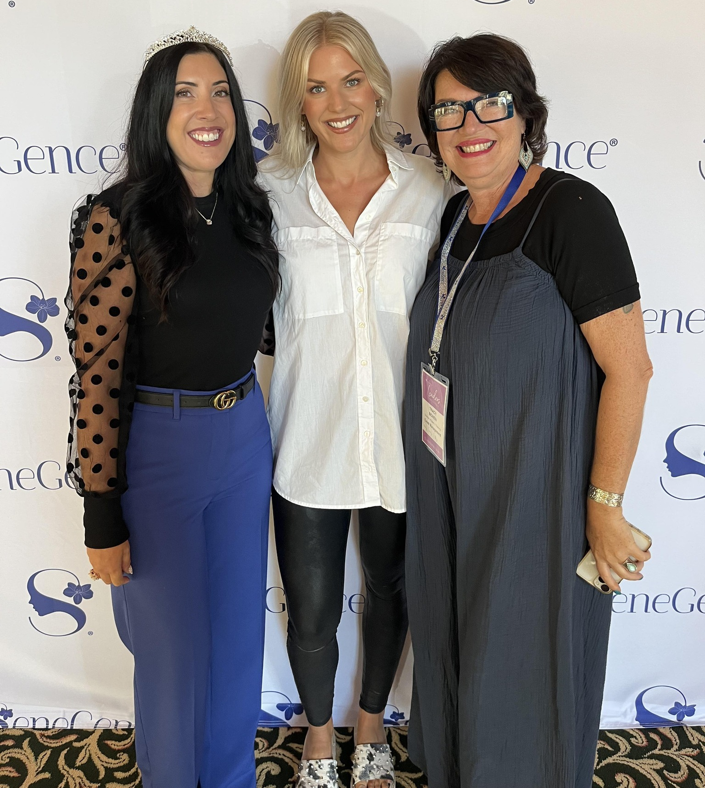
Timeless Trends
-Hard work - Putting time into you - Solution-oriented - Mentors/friendships - Leading with your heart - Finding joy in the little things
Notes:
- audit your socials – take stock of who is there, what percentage of them have you talked to?
Make 2024 the year of connections and relationship building. Make a plan to reach out to one person a day and get to know them. The trick here is not to overthink about how you can turn these connections into business transactions. The goal is simple connection. WORDS THAT WORK: “Hey Jenny, you’ve been in my beauty group for a while now but we have never chatted. My goal for 2024 is to get to know the amazing people in my community. What city do you live in?”
Take time to reflect on who your audience is – Do you know who your audience is? Are you speaking to them and creating content for them?
Are you just talking without listening – meaning are you just putting out content but not contributing to the conversation? How much time do you spend responding to comments, commenting on your followers content or chatting in DMs? This goes for my online people. If you are using the online space as your primary business space, you need to be social and personable. Get to know the people thar are choosing to spend their time online with you – that is privilege not a given.

