Slide 2
You are NOT one decision away from a totally different life.
Notes:
I am so excited to be doing this motivational send off before we end this conference. What can happen with conferences is you leave with a notebook full of ideas, and this fire in your belly and you have all these big plans for your business but then you get home and life takes over. You fall back into your day-to-day routine things get busy you’re not around the infectious energy of your fellow distributors and that notebook ends up on a shelf. Or, you struggle with analysis paralysis where you feel like there’s so many changes that you want to make that you just don’t know where to start so you do nothing. I want to share with you today a little bit about my journey and the impact that habits have played on my success. There is a popular quote that says you are just one decision away from a completely different life and I absolutely hate that. You are not “one decision away from an entirely different life.” When I look back over the last seven years it wasn’t one single decision. I truly believe you are many little decisions and little steps of action away from whatever it is you’re wanting to change. My journey over the last seven years was was the result of little decisions, and daily action. Give yourself permission to try by committing to ONE little change every day. Maybe it’s getting up just ten minutes earlier to journal, maybe it’s forcing yourself to say one nice thing about yourself, or investing $50 into an online course to learn that new skill you know will move you closer to that entirely different life. When you realize that change is the sum of many little actions, and the sum of a thousand decisions, it’s so much more freeing and all of a sudden these goals seem so more attainable.

Slide 3
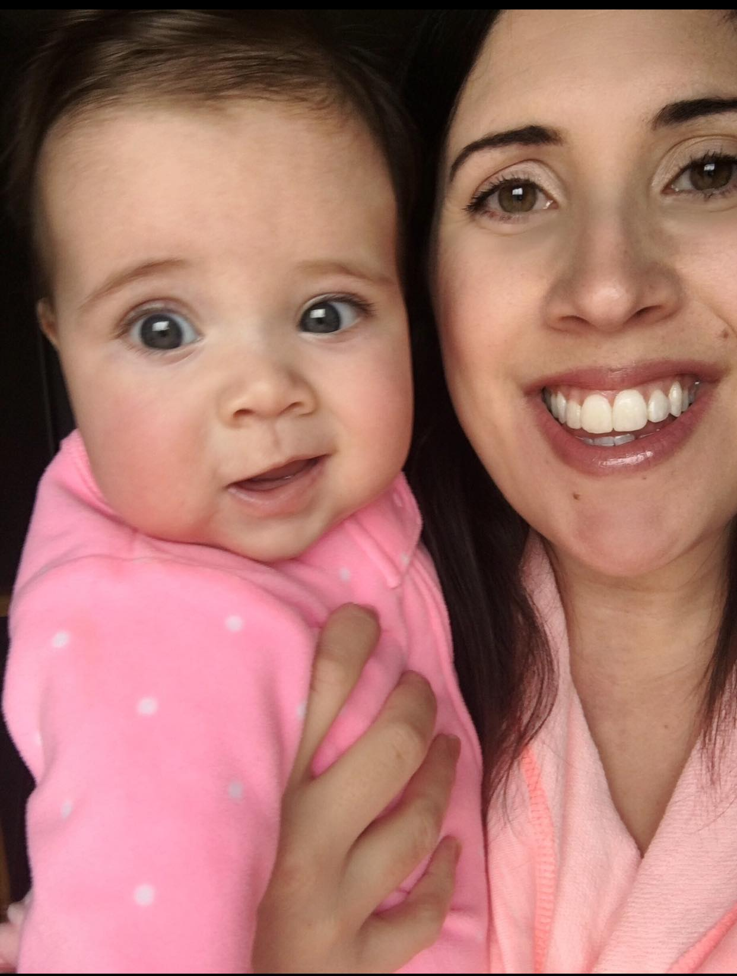
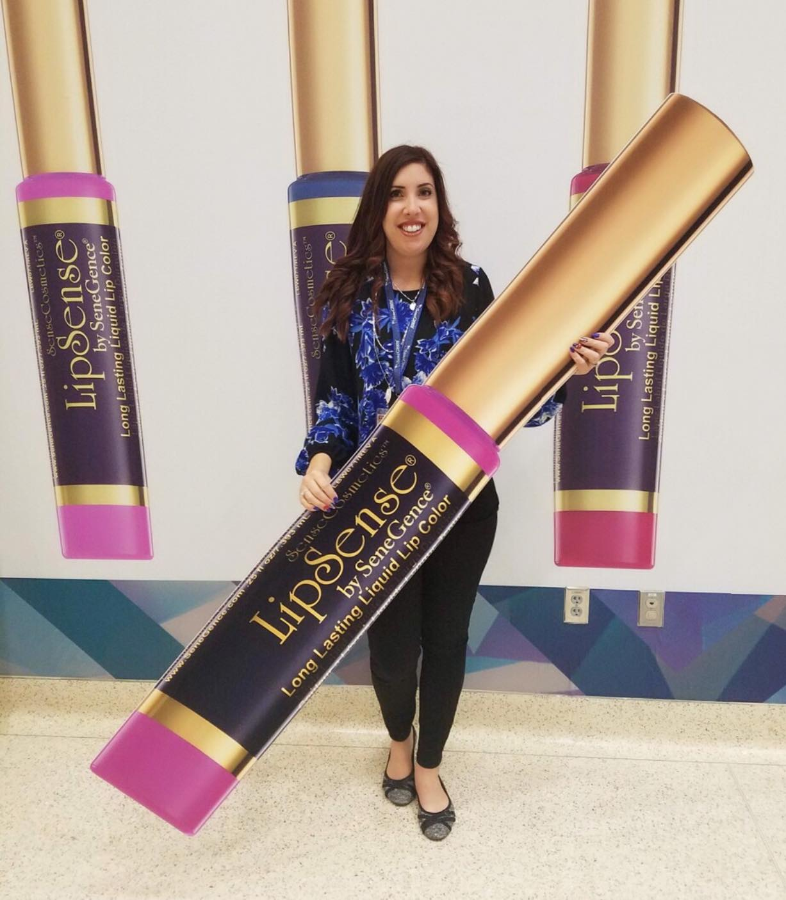
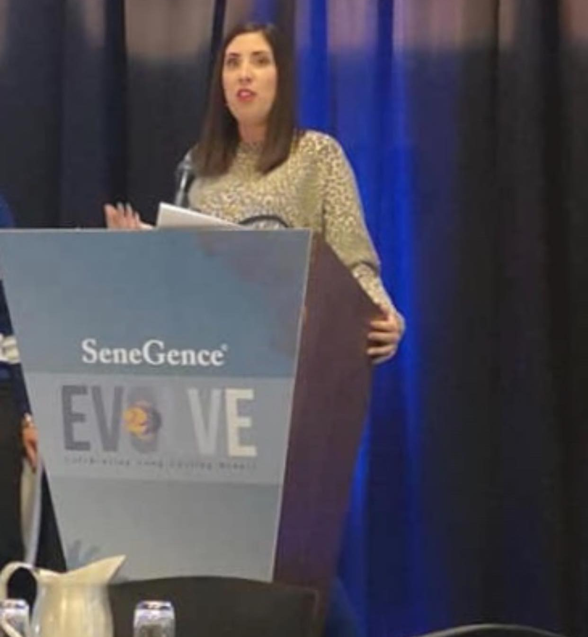
MY JOURNEY
Notes:
I want to walk you through my journey because I think it illustrates what I want to teach you today. Picture #1 is March 2017. In this picture, I am wearing pink champagne, which is the colour that I bought from a local distributor. This picture was taken before I signed up. When I signed up it was solely for the discount and I actually didn’t use my membership for my first month in business. To paint a picture of who I was at this time I had a six month old baby. I was struggling really badly with postpartum depression and anxiety that had at that point remain undiagnosed because of my stubbornness to ask for help. Prior to having a baby I always found my worth in my career so I was validated through my hard work and doing a good job in my workplace. Being out of work I was not getting that external validation because I was at home keeping a baby alive and I think that also contributed to my depression. For my entire life, I struggled with self-confidence. I essentially had no self-confidence whatsoever and I used to the excuse that I was “shy.” Looking back, I don’t think I was shy. I just truly think I had no confidence in myself. I didn’t feel like I was worthy to be in any room. I didn’t feel like I had anything worthy to say. So the interesting thing about picture number one is that even though I didn’t have the confidence or necessarily the belief in myself, I had the determination and I had the resourcefulness to start to learn how this business works and to learn how I could be successful despite what I would call my “handicaps.” The second picture is April 2018. I traveled alone from Canada to Tulsa, Oklahoma and stayed in a room with two people that I had only met on the Internet. This was a really, really huge turning point for me as a person, I felt really uncomfortable there .I felt really unworthy and there was a lot of comparison, but. I had the time of my life and it really opened my eyes to what I could do in this business. Picture three is April 2019. This picture is actually at our one and only Canadian seminar that we ever had and I was convinced to speak. I was still finding my footing in this business. I was a Countess at this point and had earned my Senecar. I was really struggling in personal sales. I trained with another distributor. My training was OK. I was shaking the entire time. I still didn’t feel worthy to be there. I picked apart my appearance. I picked apart what I was going to say. I was really hard on myself, but I did it so that was another huge step of growth.

Slide 4
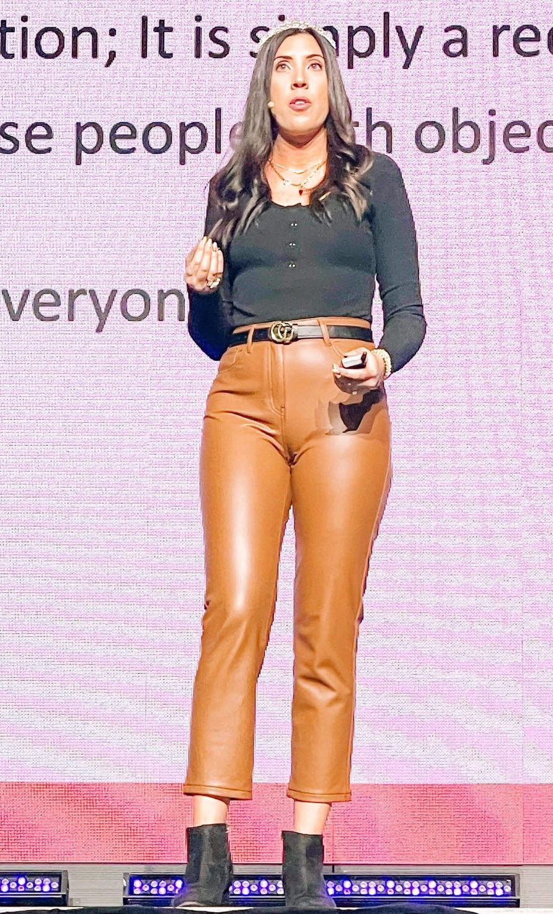
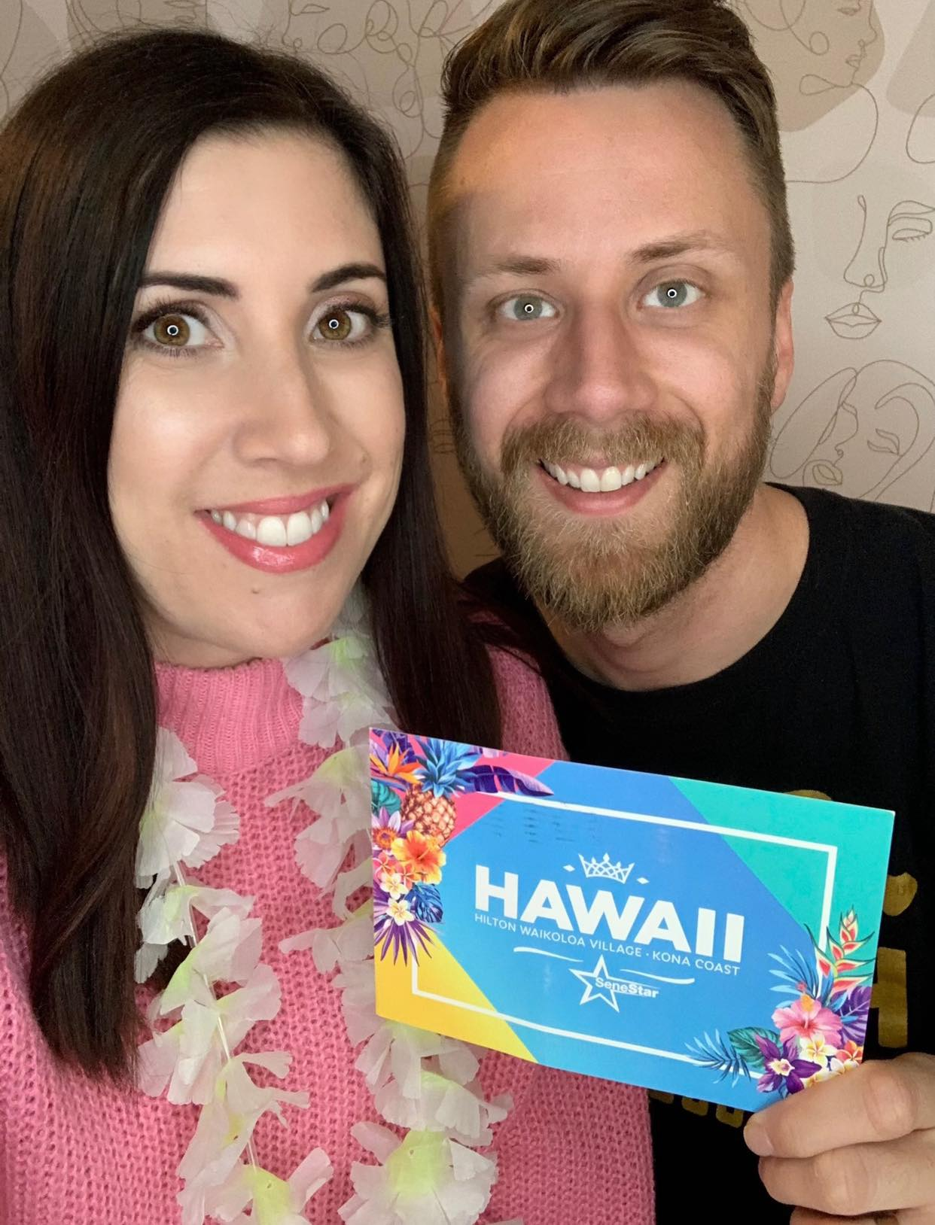
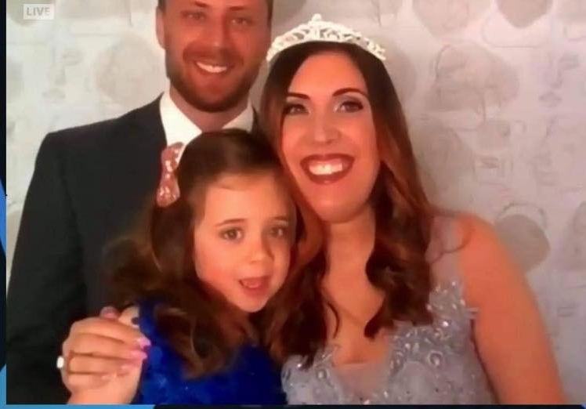
MY JOURNEY
Notes:
Picture number four we are entering the pandemic years. This is April 2020 at this point. I really found my stride. I was seeing a lot of growth. This was the year that my personal sales really took off and I really started to understand and implement a lot of what I taught you in my trainings this weekend. I had earned my first fully paid trip with Senegence, which I could not take because of the pandemic. This year I started to feel confident in what I was doing was, but also this was the year where the “comparison trap,” and people pleasing started to kick into gear – feeling the need to be there for everyone and take on everyone’s successes and failures. Picture number five is April 2021. We were still in lockdown, but this was the year that I had hit crown princess, so from the previous picture to this picture a lot of growth happened. My team actually joked and called me Tracey 2.0 because they saw this level up in me, and I believe that this level up was what helped our team to hit crown princess and helped me to really push through and start to become this version of myself that I see today.
Picture number six. This is the one where I see the biggest difference this is April 2022. I am on stage at seminar training. This was another level up moment for me. As I’m running through all of these pictures. I’m doing this purposefully because you can see how there’s these little shifts and there’s these little decisions all throughout it was never one big thing. At this conference specifically this picture is one of my favourites because of what happened moments before it was taken. This was the weekend that Queen B Lipsense was being released. This was the weekend that I was really excited for this training because I felt like it was one of my best ones and I had worked really hard on it. Also, let’s talk about the outfit- I’ve always loved fashion, but I also kind of held myself back in what I wore because I didn’t want to draw attention to myself. I felt like people would say “who does she think she has wearing these leather pants” BUT (again little decisions) I really pushed myself to wear the outfit that I wanted to wear and show us my authentic self, which is something I had truly never really done. So I was backstage at this conference and I started to get into that loop of where I was telling myself all these negative things.
And then I paused, and I realized that this was the moment when I thought back to that girl in picture one and picture two and even picture three where she was on that stage, and she was so scared and now here I was this leveled up version of myself and people knew who I was and they were excited to hear me speak and I had this whirlwind weekend ahead of myself In that moment I said to myself, this is what you thought was never possible and you’re about to do it and you’re going to spoil it for yourself. I said to myself you can go up there with this negative self talk or you can go up there and enjoy it. THE TIME WILL PASS ANYWAY and so I did that and guess what? That was the best training ever did. I got such great feedback. I felt so good when I got off the stage and I walked through that conference for the rest of the weekend was such confidence. That was another big shift for me when I realized I didn’t have to make myself feel bad and could allow myself the permission to celebrate the positives and enjoy the joy in things.

Slide 5
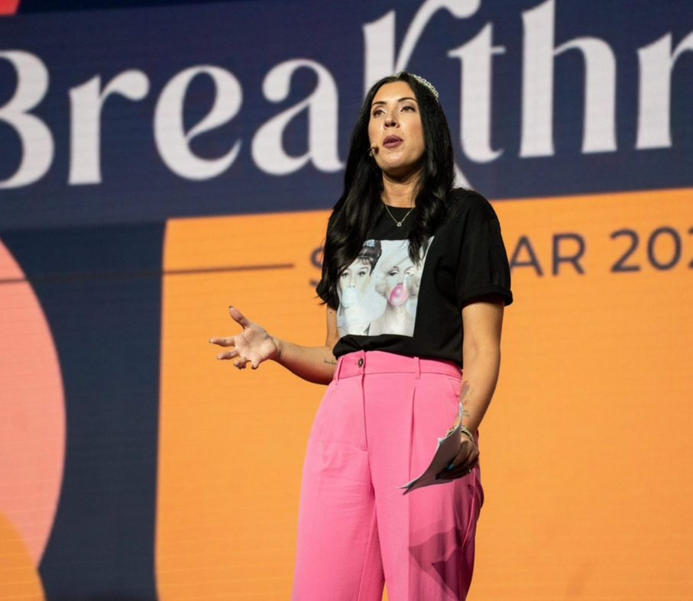
MY JOURNEY
Notes:
And then we get to the final picture which is April 2023 at our Seminar Conference and I think this photo shows it at all. I am there in my Pepto-Bismol pink pants. I am confident and you can see the confidence in my stature. I’m confident about what I’m talking about. I’m confident in the person that I am now. I do still feel like there’s always room to grow and there’s always going to be work to do, but looking from that very first picture back to this one you can see the growth and what I want you to understand is that is seven years. There was no way that happened from one decision. This was making conscious choices every single day. It was years of developing habits, which leads me into the quote that shaped this whole presentation.

Slide 6
“If two people have the same goal, you know nothing about the similarity of their results.
But if two people have the same daily habits, you can infer quite a bit about the similarity of their results.
Your results are largely a byproduct of your habits.” – James Clear
Notes:
This quote is by James Clear who wrote the book Atomic Habits. [read quote] Me starting my business in 2017 - I had nothing special that sent me apart from any other person. There’s no reason why me starting on day one and someone else starting on day one cannot have the exact same results on paper. I should not be as successful as I am because I started with so many handicaps - I was introverted. I had postpartum depression. I did not have confidence. I did not have a social media following. I had never been in sales before. I didn’t know what I was doing, but I was determined and I figured out the daily habits and the things I needed to do and I did it anyway.

Slide 7
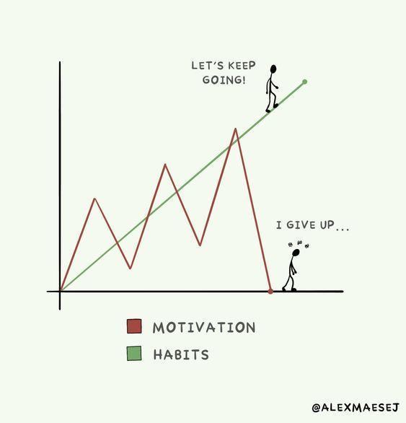
Habits > Motivation
Notes:
Making these little positive decisions, every single day is going to develop and strengthen that muscle that builds strong habits and consistency and that is what leads to not only success but sustainable success.
These little decisions are something as simple as am I going to watch another episode on Netflix or am I going to go spend that 30 minutes doing something in my business. The funny thing is for some of us we want success in our business so badly but it’s somehow so much easier to make the decision to watch one more Netflix episode than it is to do that one more thing in our business.
Quit relying on motivation - start focusing on building sustainable habits. If you are waiting for the motivation to come, you’re going to be waiting forever. Motivation is fickle and fleeting. It can be overpowering one moment, no where to be found the next. Relying on motivation always feels like the smart move. Because when you're motivated, nothing can stand in your way. But, as you probably know, no one stays motivated forever. And, eventually, something will happen in your life that takes your focus elsewhere. It's in those moments - the ones that take your focus elsewhere - habits become crucial. Because habits don't just leave. Habits are part of who you are and what you do. They are ingrained within you. They aren't always easy to create. But once you do, they will never let you down. Motivation often helps you in the short-term, however anyone can do something intense for a short period of time. But it is only someone with strong habits who can succeed for years on end.

Slide 8
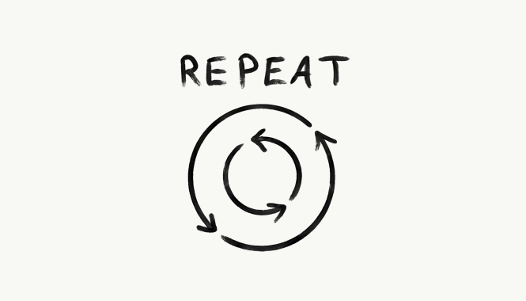
“You get what you repeat.”
Notes:
Changes that seem small and unimportant at first will compound into remarkable results if you’re willing to stick with them for years. We all deal with setbacks but in the long run the quality of our lives depend on the quality of our habits. Improving by 1% isn’t always recognizable but it can be far more meaningful in the long run. The difference a tiny improvement can make over time is astounding. Here’s how the math works out: If you can get 1% better each day for one year you end up 37 times better by the time the year is up. How many of you would like your income to up 37%? That’s a lot! On the other hand, if you get 1% worse each day for a year you’ll decline down to zero. You get what you repeat. Another example: If I exercise, I know its good for me even though I can’t measure in short term. I know I just have to stick to the process and it will work 100% of the time. How long will it take? Nobody knows, its dependent on each person. And this is where you can take this into your business – I am going to do things that I know work, but I won’t be able to measure them right away. I have to be okay with the fact that I know it works Habits often appear to make no difference until you reach a critical threshold and unlock a new level of performance (going back to those level up versions of myself from beginning of presentation). What often happens is people make a few small changes, fail to see a tangible result and decide to stop. Right, how relatable is this? You think, I’ve been going live everyday in my beauty group, why aren’t my sales improving? I’ve been posting reels everyday for a month and I don’t have any new followers? And then once this thinking takes over, we stop,. We quit. So in order to make a meaningful difference, habits need to break through this plateau. This requires patience, determination and consistency.

Slide 9
Winners and losers have the same goals. If the goals do not differentiate winners and losers, what does?
Are you rising to the level of your goals or falling to the level of your habits?
Notes:
Goals are not enough. You need systems/habits. How much time are you spending thinking about your goals versus putting the systems and habits in place to hit them? Winners and losers have the same goals – first and second place. So if the goals do not differentiate winners and losers, what does? Implementation of habits. So what I want ask you is, are you rising to the level of your goals or are you falling to level of your habits? and what I mean by that is I think we often make these big lofty goals and there’s nothing wrong with that but then we rely on our current habits which don’t match our current goals. So when you’re setting a goal, are you elevating yourself? are you elevating your habits to match that goal because you’re never going to get to that goal unless you do that.

Slide 10
HOW TO BUILD HABITS
- “One more thing, one more time” – Josh Sundquist - Spend more time around the winners - Make time for personal growth - Success leaves clues
Notes:
-one more thing, on more time – its doing one more thing than you feel like doing, because successful people are the ones who do one more thing than what everyone else is willing to do.
- spend more time around the winners - make time for personal growth – flex that muscle - success leaves clues - watch what the successful people are doing, Are you rising to the level of your goals or falling to the level of your habits?

