Slide 1
Lauren Tukuafu

Slide 2
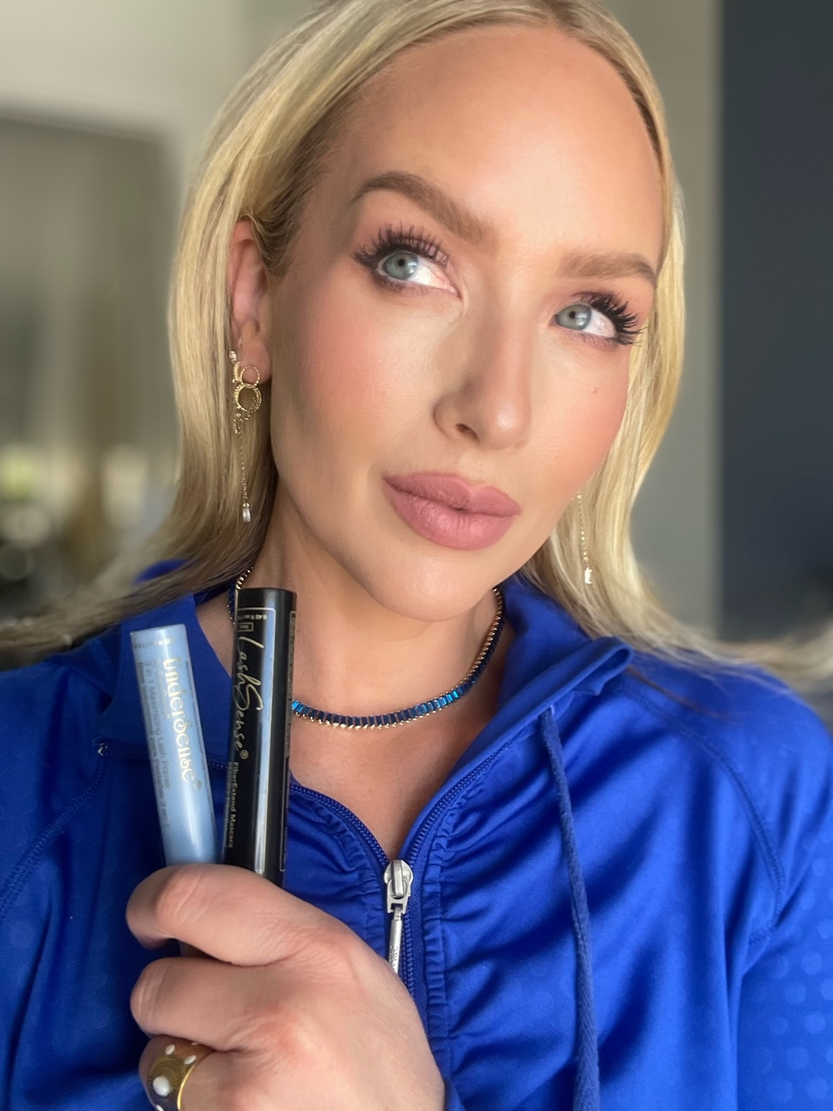
How To Launch A New Product

Slide 3
THE MINDSET
Are you driven by scarcity and FEAR?
NO NERVOUS ENERGY!
Create a plan so you feel confident.

Slide 4
Personal product story
This means that you are going to have to order it!
BE A PRODUCT OF THE PRODUCT!
Then as you sell it, you’ll gather others personal testimonies too!

Slide 5
3 Tactical areas
-CONTENT -CUSTOMERS -TEAM MEMBERS

Slide 6
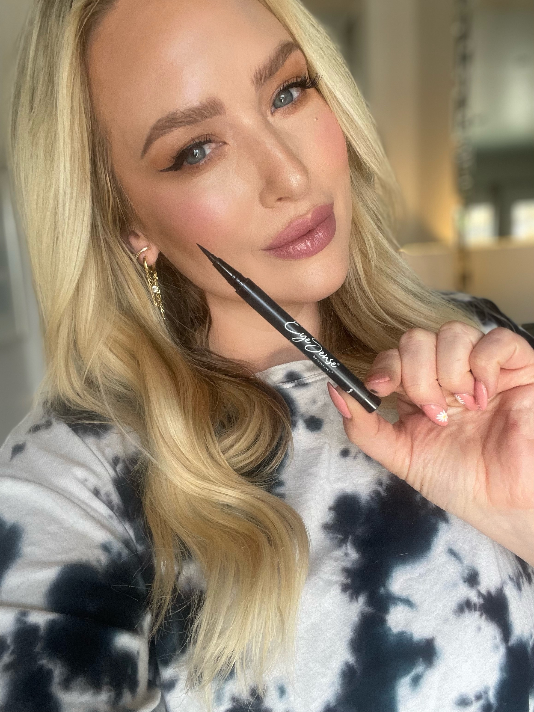
Content
Ask yourself……
IS THERE ANY VALUE BEYOND THIS POST
BEYOND JUST SELLING?
1 - Order product
2-Take a selfie with the product
(could be with kids to make it real life,
doesn’t have to be perfect)
3- Tell story - share solution
4- Make offer

Slide 7
CUSTOMERS
FIRST PRIORITY - Current Existing Customers
(based on lifetime customer value or
average order value)
SECOND PRIORITY - Past Customers
(recent to older orders)
YOU are starting the conversation.
Not leading with product info.
LEAD WITH HELPING AND
PROBLEM SOLVING!

Slide 8
Team
Show CURRENT TEAM: members the right way to reach out
Have them develop their own story
Strategize
-PAST TEAM MEMBERS: reach out authentically
-check in / lead with care
-why did you stop?
-slow down and connect

Slide 9
Think about your
Work flow!
Do you have one?
What is your process?

